Slide 1
Chiba campaign
CIMEL data(2017/07/24 20:44)
Irie lab
B4 Daichi Yonekawa

Slide 2
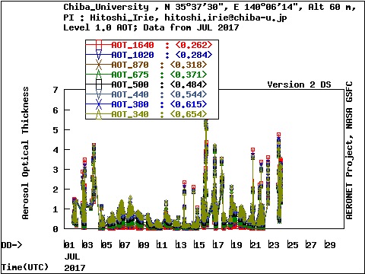
AOD Level 1.0 data from JUL of 2017

Slide 3
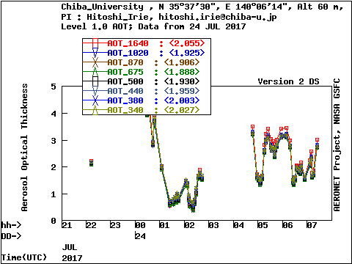
AOD Level 1.0 data from JUL 24 of 2017

Slide 4
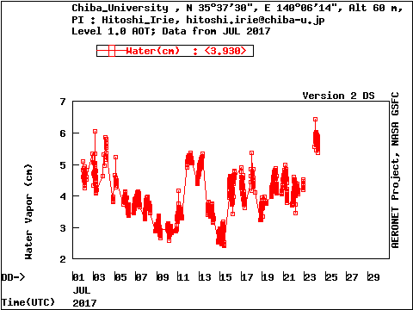
Water Vapor data from JUL of 2017

Slide 5
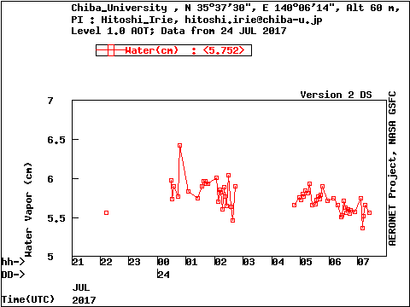
Water Vapor data from JUL 24 of 2017

