Slide 1
Chiba Campaign 2017
MAX-DOAS 3D plots (7/20)

Slide 2
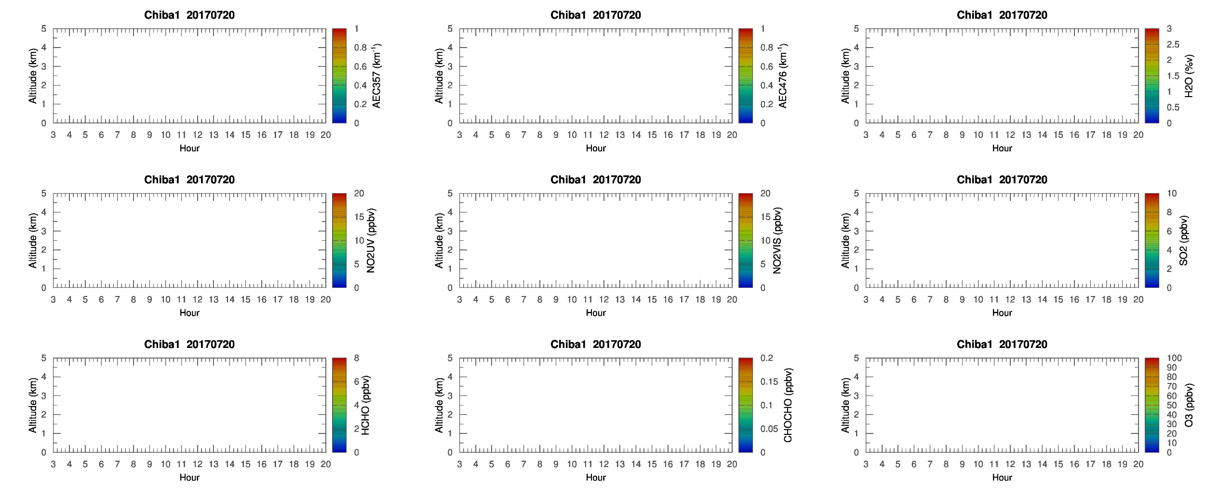
MAX-DOAS 1 (North)

Slide 3

MAX-DOAS 2 (West)

Slide 4

MAX-DOAS 3 (East)

Slide 5
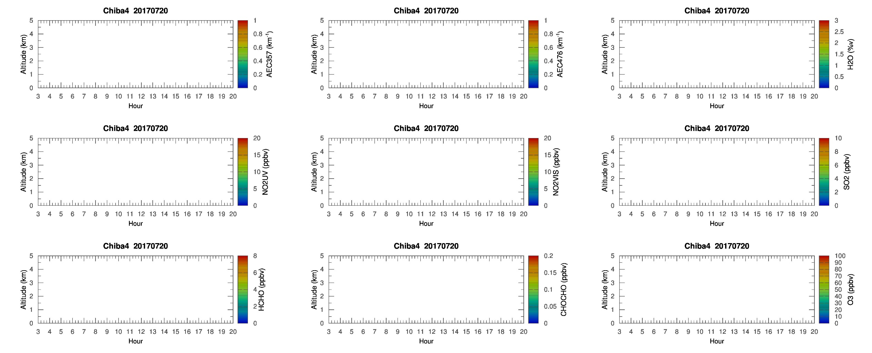
MAX-DOAS 4 (South)

Slide 6
Chiba Campaign 2017
MAX-DOAS 3D plots (7/21)

Slide 7
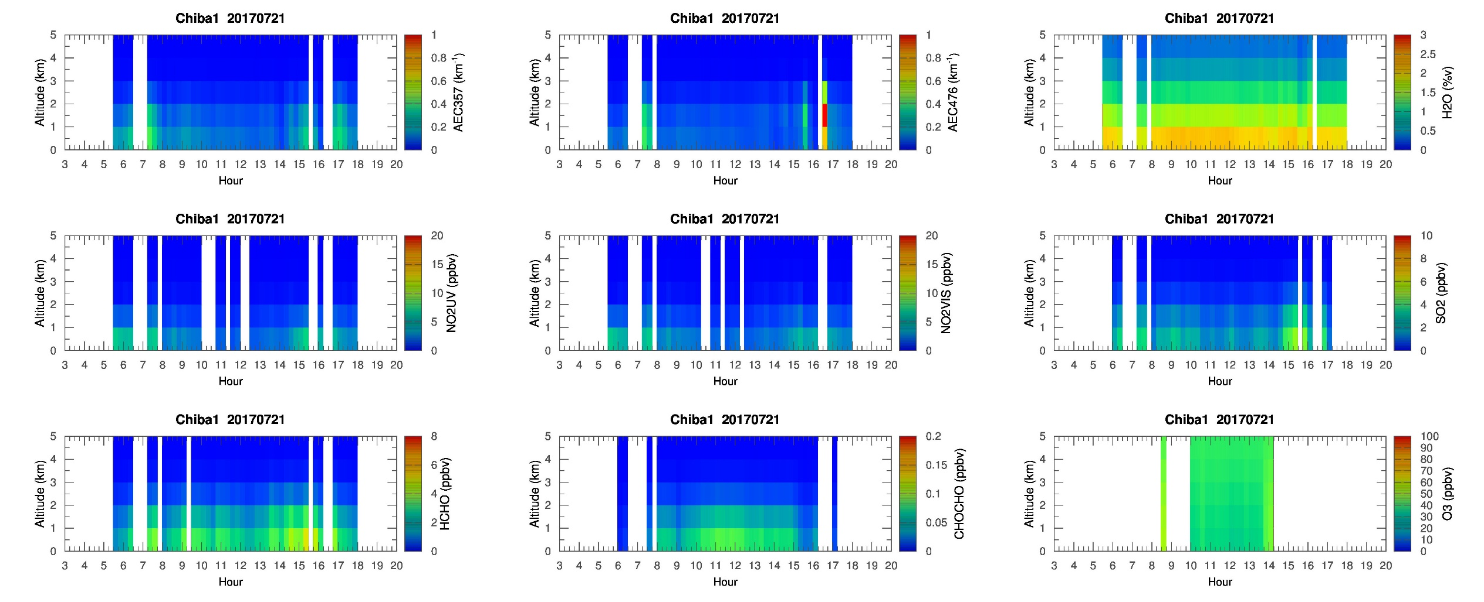
MAX-DOAS 1 (North)

Slide 8
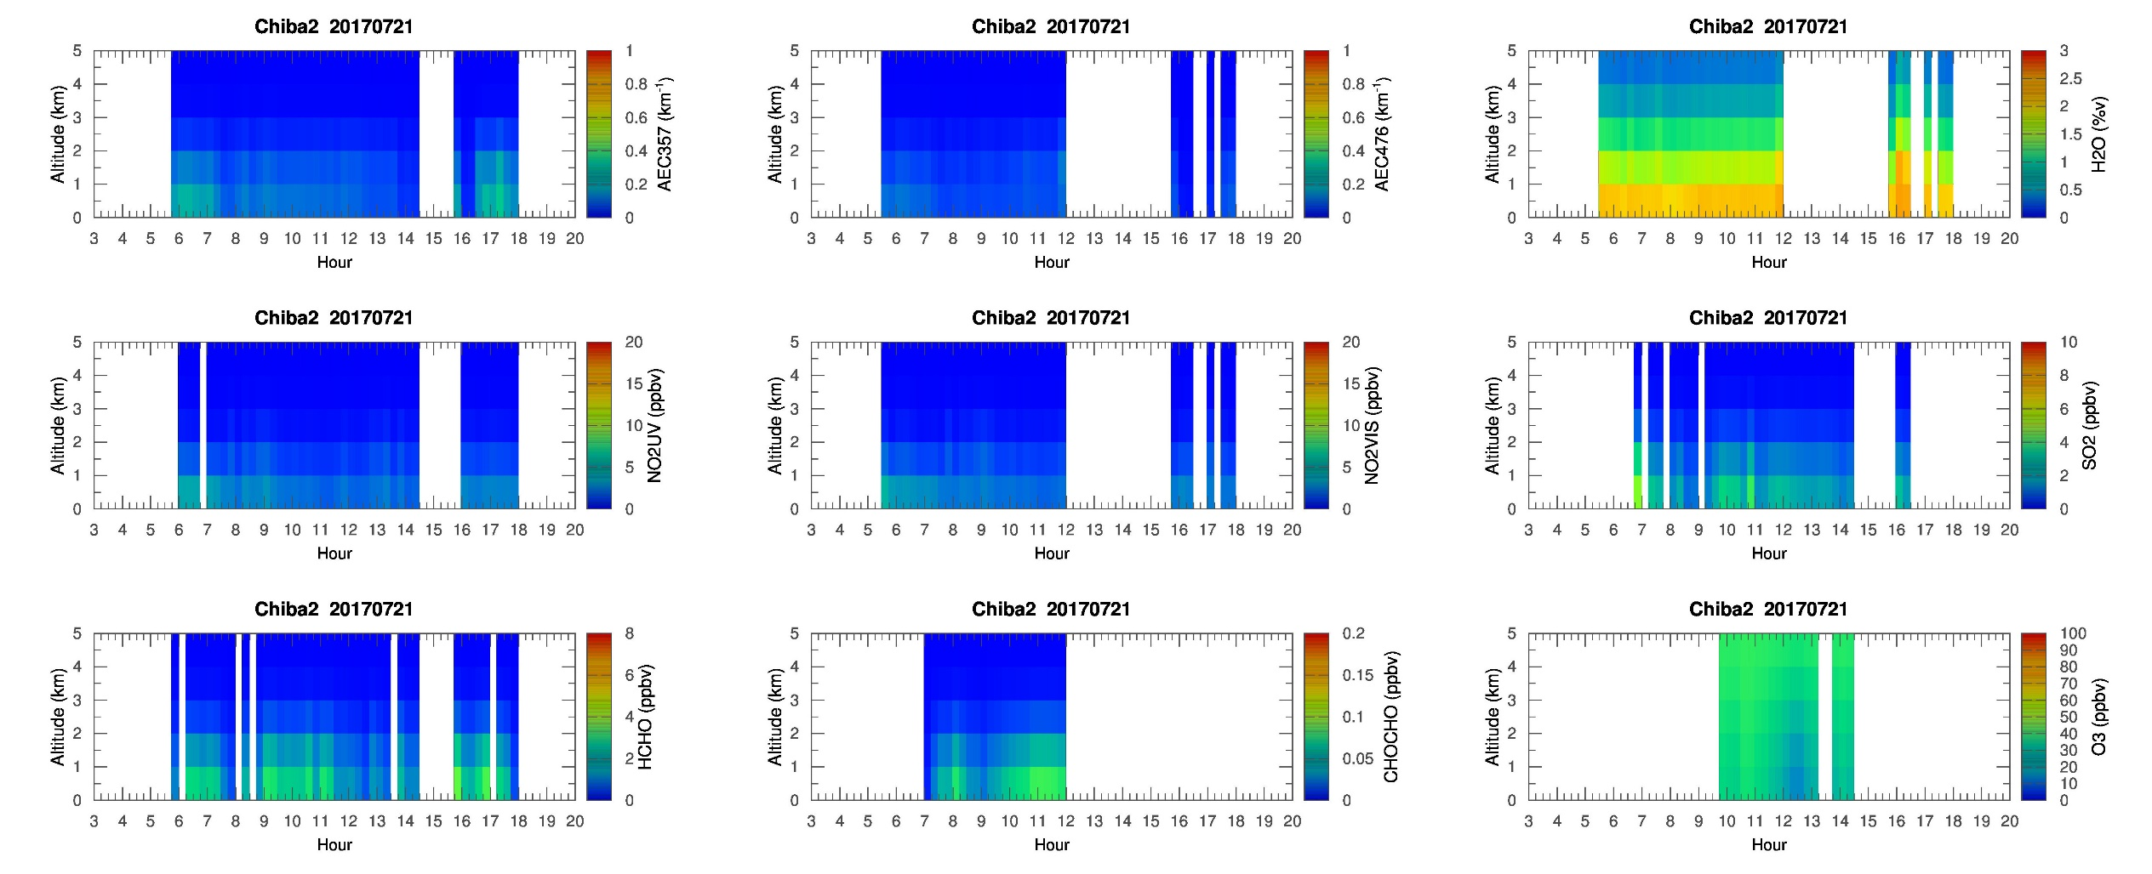
MAX-DOAS 2 (West)

Slide 9
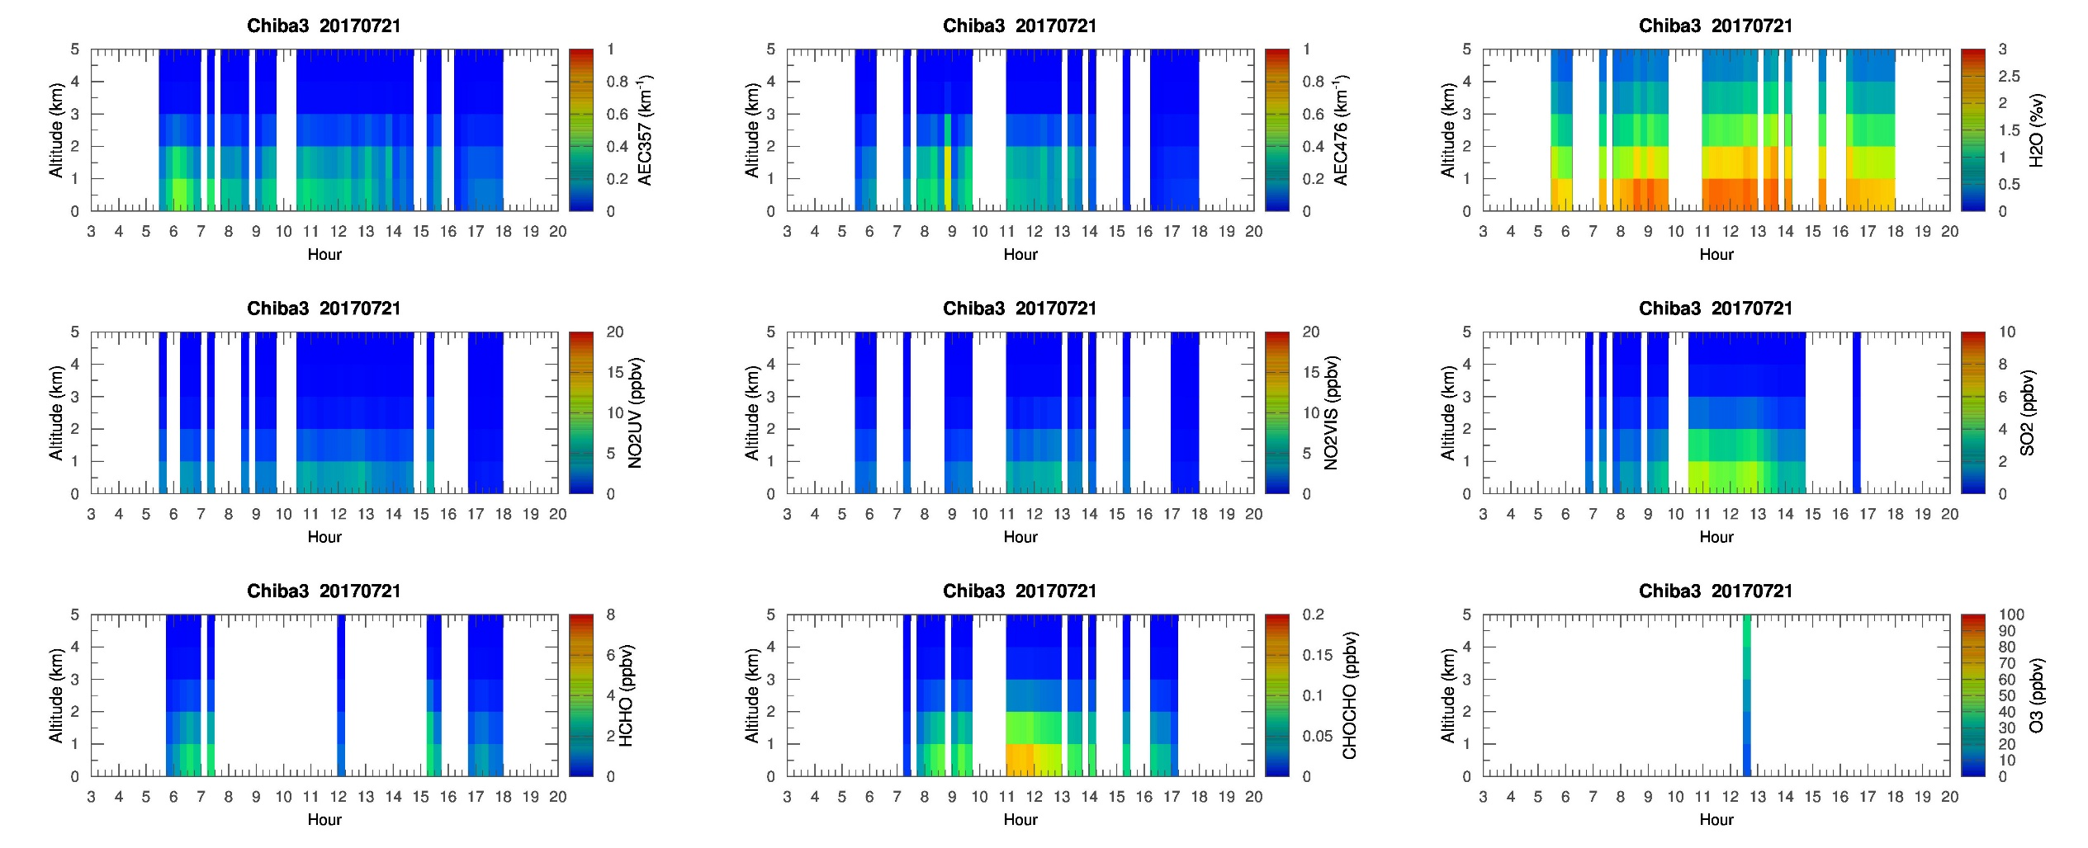
MAX-DOAS 3 (East)

Slide 10
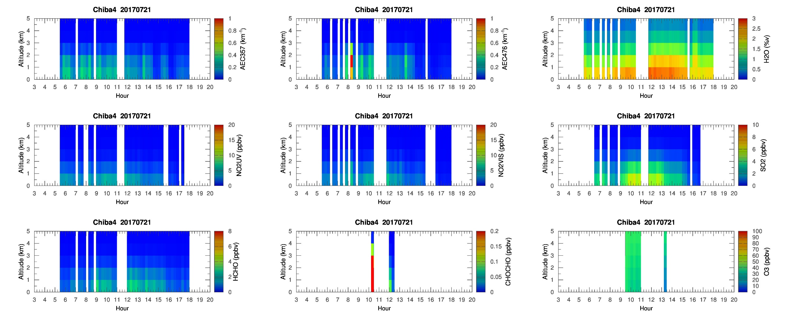
MAX-DOAS 4 (South)

Slide 11
Chiba Campaign 2017
MAX-DOAS 3D plots (7/22)

Slide 12
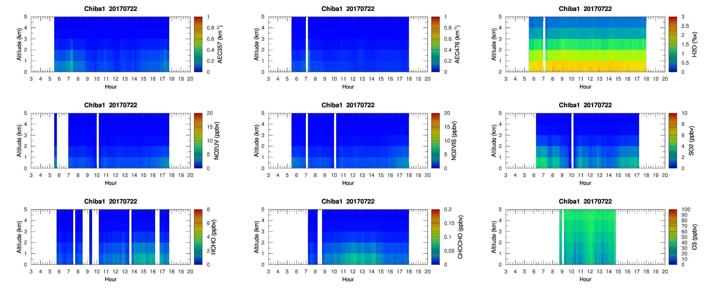
MAX-DOAS 1 (North)

Slide 13
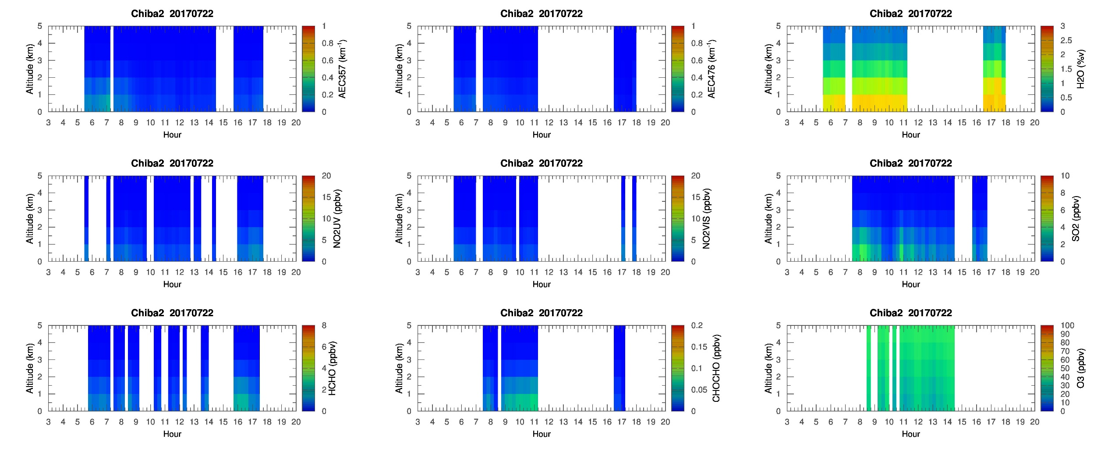
MAX-DOAS 2 (West)

Slide 14
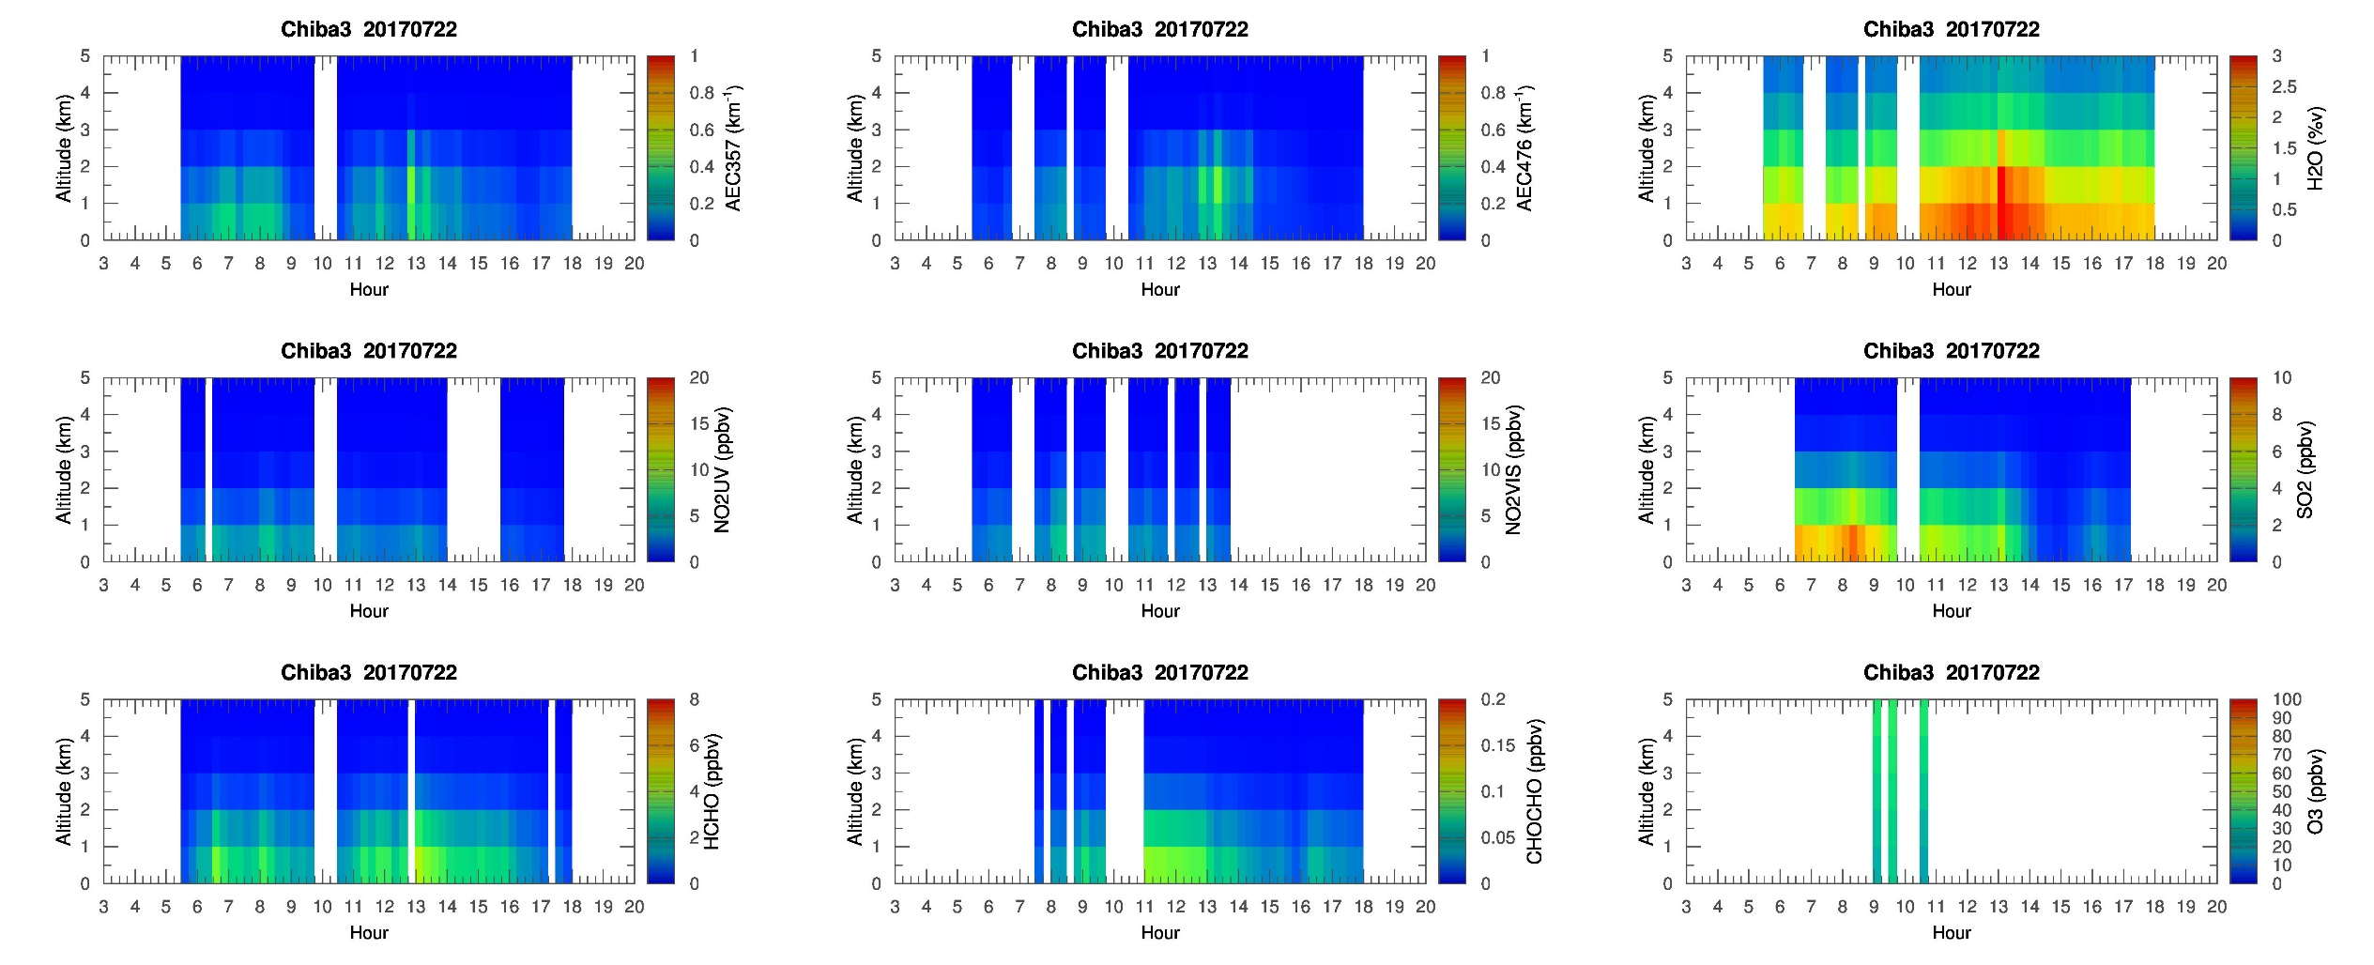
MAX-DOAS 3 (East)

Slide 15
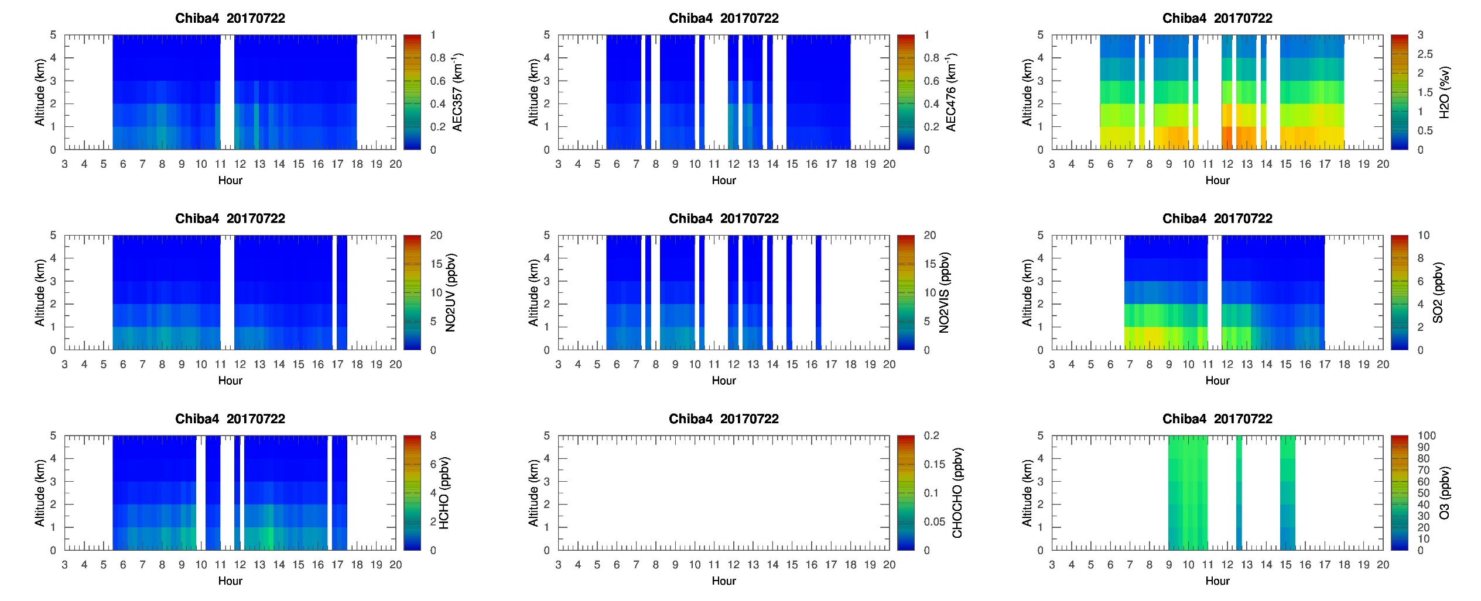
MAX-DOAS 4 (South)

Slide 16
Chiba Campaign 2017
MAX-DOAS 3D plots (7/23)

Slide 17

MAX-DOAS 1 (North)

Slide 18
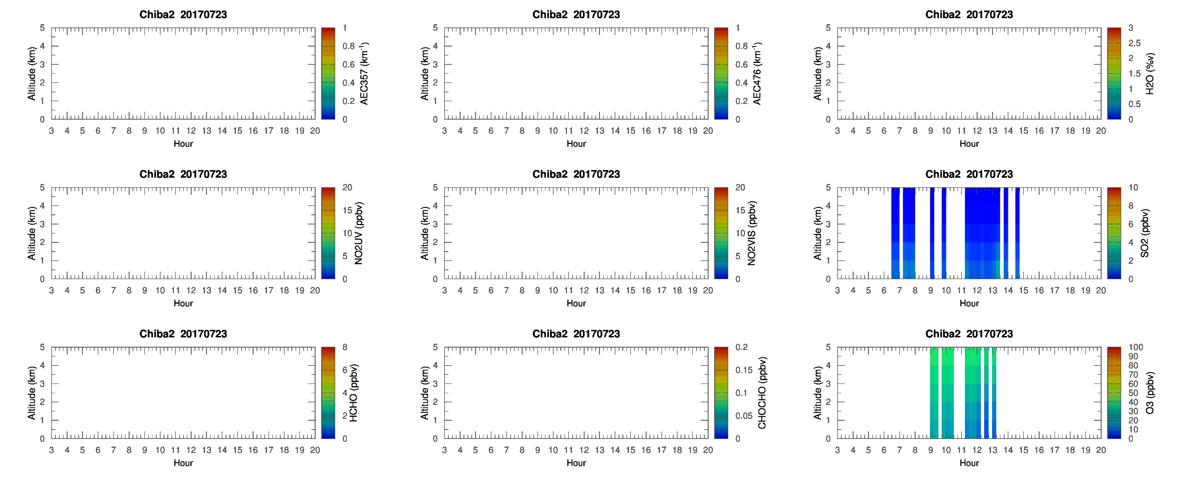
MAX-DOAS 2 (West)

Slide 19

MAX-DOAS 3 (East)

Slide 20

MAX-DOAS 4 (South)

