Slide 1
Chiba Campaign 2017
MAX-DOAS 3D plots (7/13)

Slide 2
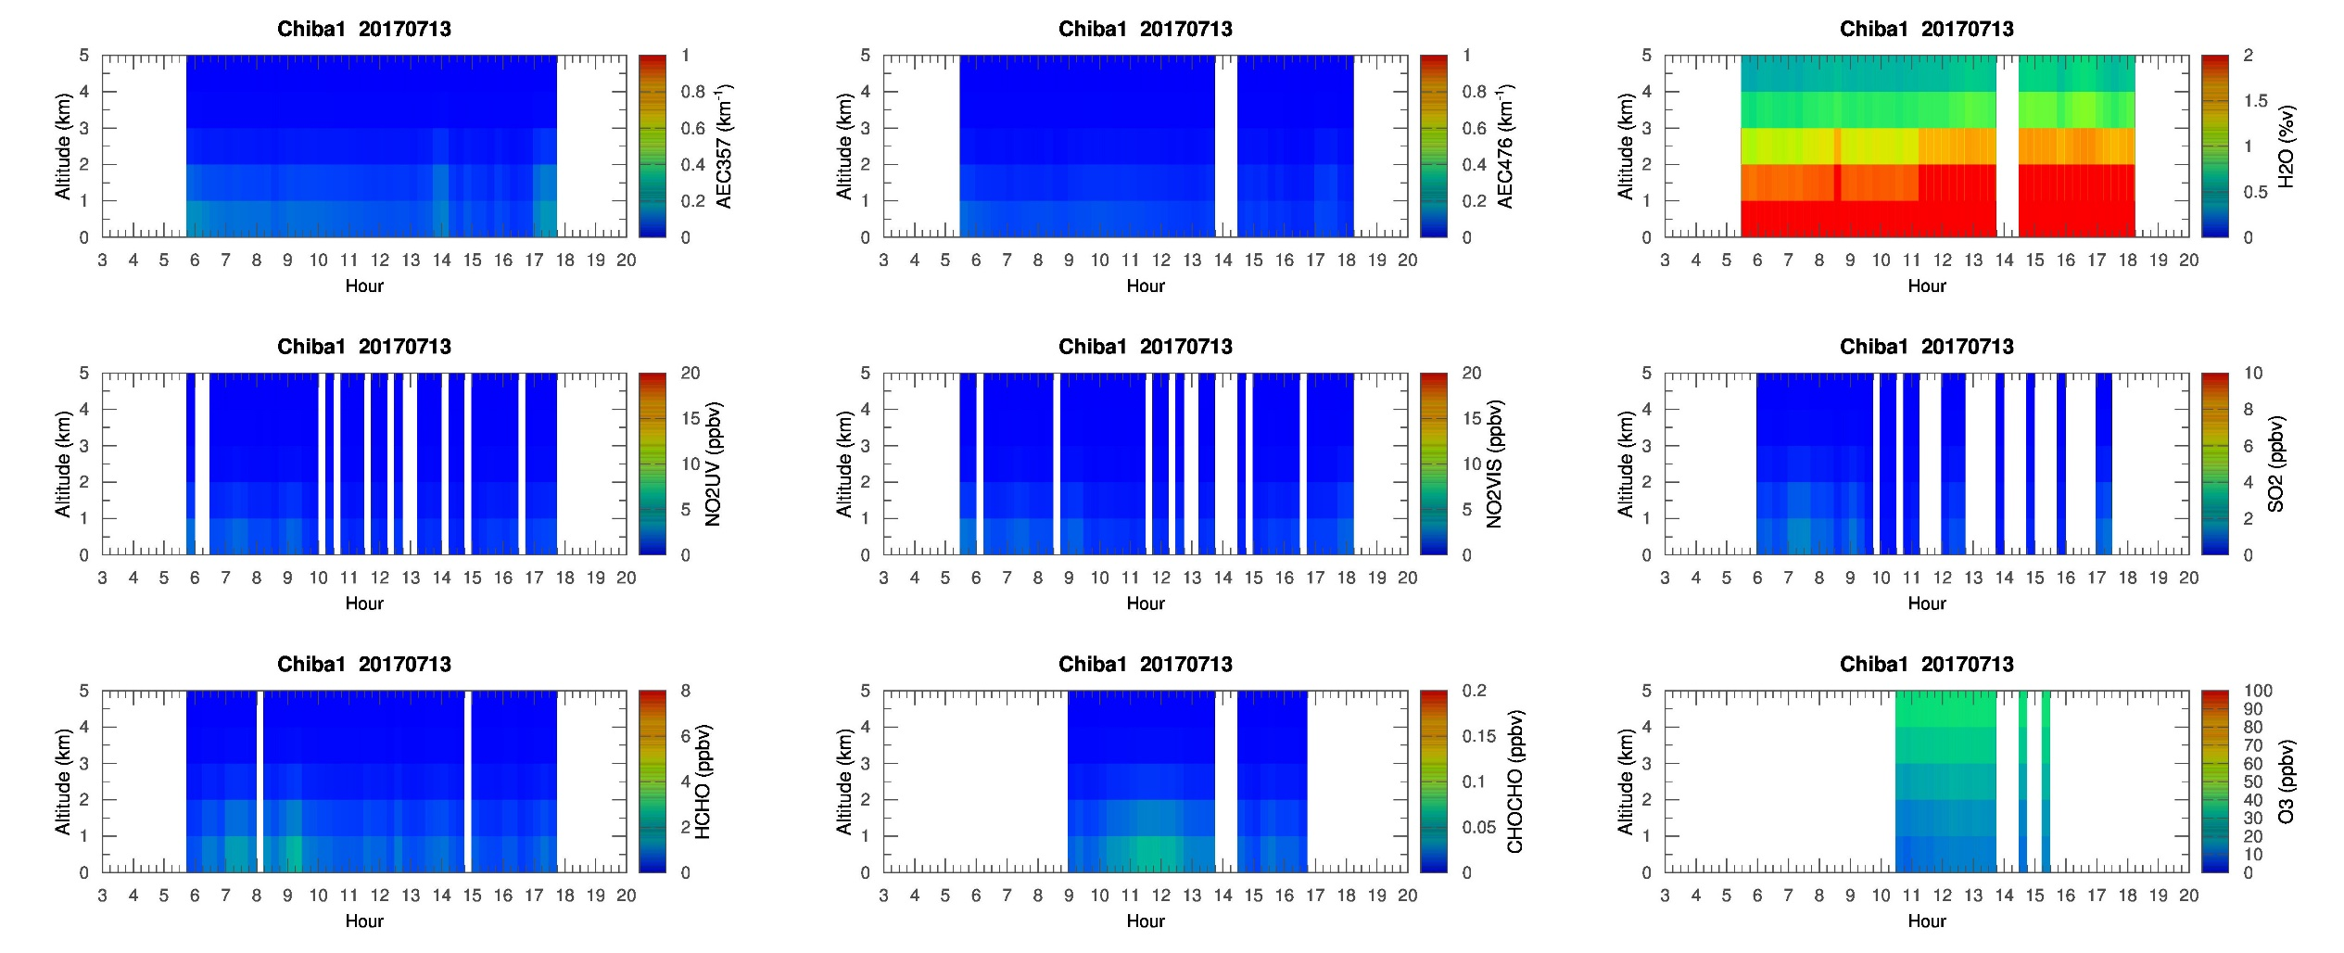
MAX-DOAS 1 (North)

Slide 3
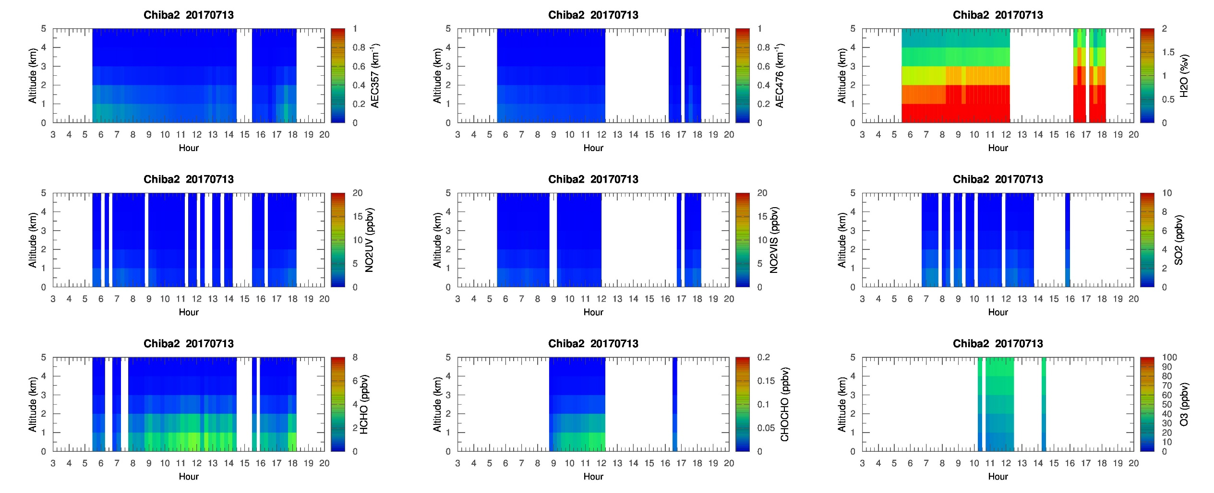
MAX-DOAS 2 (West)

Slide 4
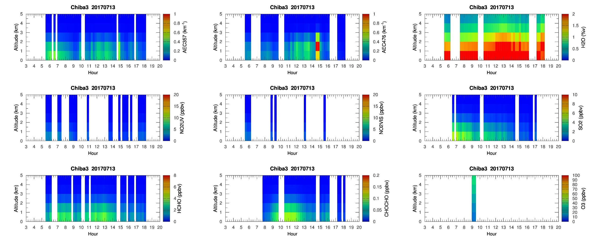
MAX-DOAS 3 (East)

Slide 5
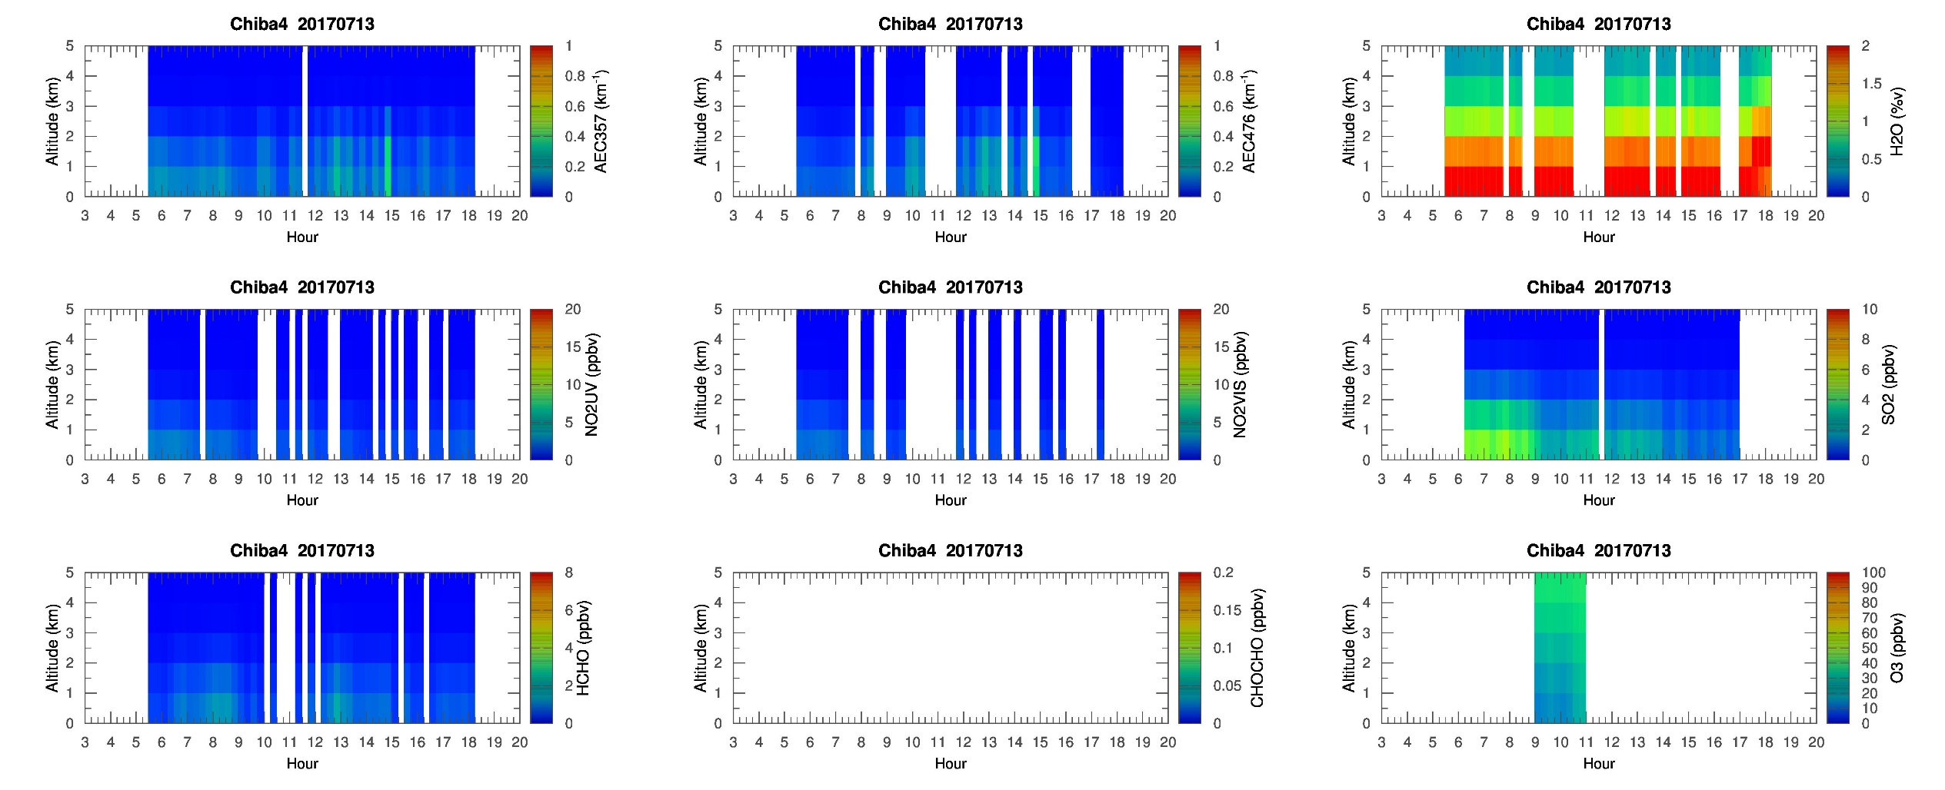
MAX-DOAS 4 (South)

