Slide 1
SVA measurement for CHIBA Campaign 2017
Data was taken at 2017-07-13
Hiroshi OKAMOTO

Slide 2
Condition
Take1 10:28-10:57 Clear sky.
Take2 11:43-12:12 Clear sky.
Take3 13:48-14:17 Around 14:01 clouds covered the sun.
Take4 15:57-16:26 Mottled clouds covered the sun.

Slide 3
Result
WL(nm) | Take1 | Take2 | Take3 | Take4
315 | 2.435E-04 | 2.364E-04 | 2.373E-04 | 2.430E-04
340 | 2.418E-04 | 2.326E-04 | 2.307E-04 | 2.397E-04
380 | 2.422E-04 | 2.342E-04 | 2.324E-04 | 2.386E-04
400 | 2.399E-04 | 2.350E-04 | 2.320E-04 | 2.375E-04
500 | 2.379E-04 | 2.337E-04 | 2.358E-04 | 3.802E-04
675 | 2.338E-04 | 2.280E-04 | 2.347E-04 | 2.371E-04
870 | 2.385E-04 | 2.329E-04 | 2.353E-04 | 2.199E-04
940 | 2.425E-04 | 2.398E-04 | 2.347E-04 | 4.243E-04
1020 | 2.416E-04 | 2.397E-04 | 2.044E-04 | 2.215E-04
1627 | 2.065E-04 | 2.051E-04 | 2.051E-04 | 2.495E-04
2200 | 2.054E-04 | 1.993E-04 | 2.027E-04 | 1.511E-04
Values in Orange BG are not for use. Clouds covered sun.

Slide 4
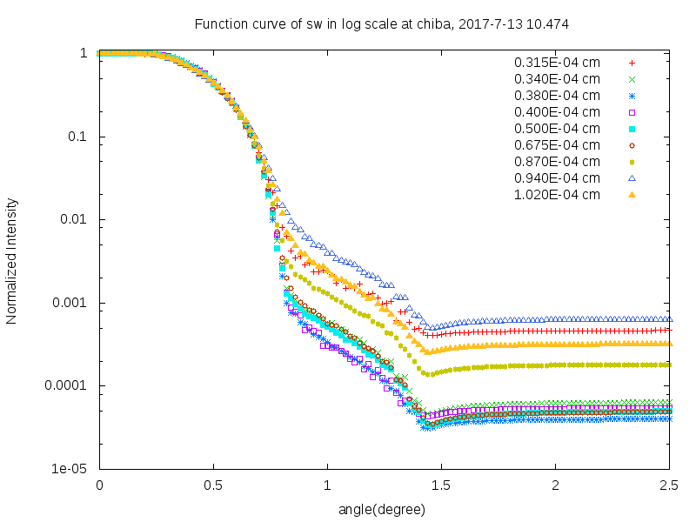
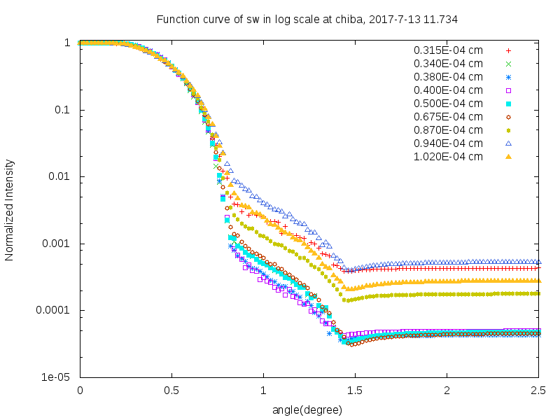
Response Functions of SW
Take1 and Take2. Clear Sky.
Take1
Take2

Slide 5
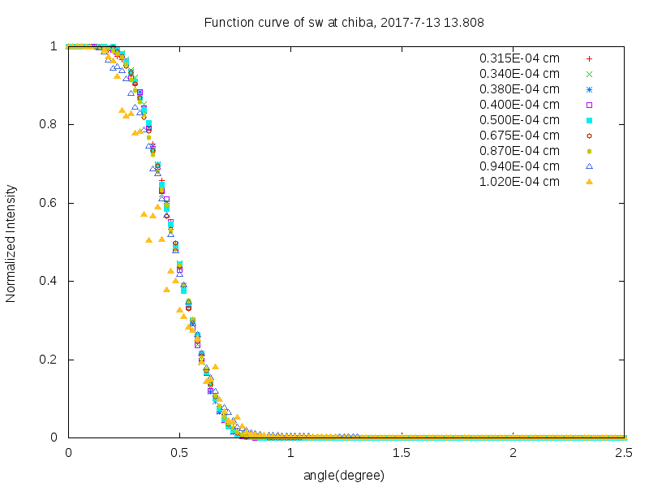
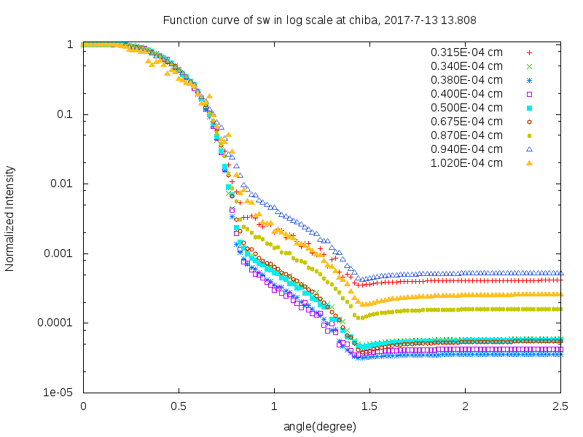
Response Functions of SW
Take3. During measurement, Clouds passed or covered the sun.
Linier scale
Log scale

Slide 6
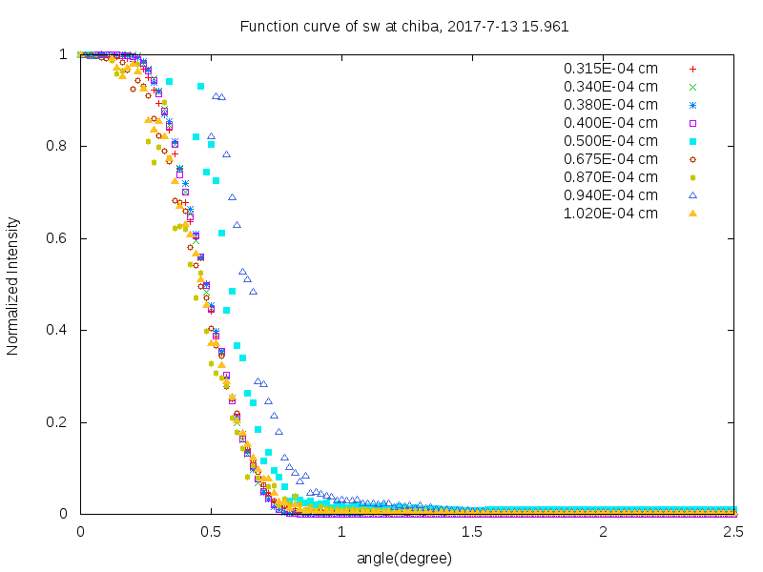
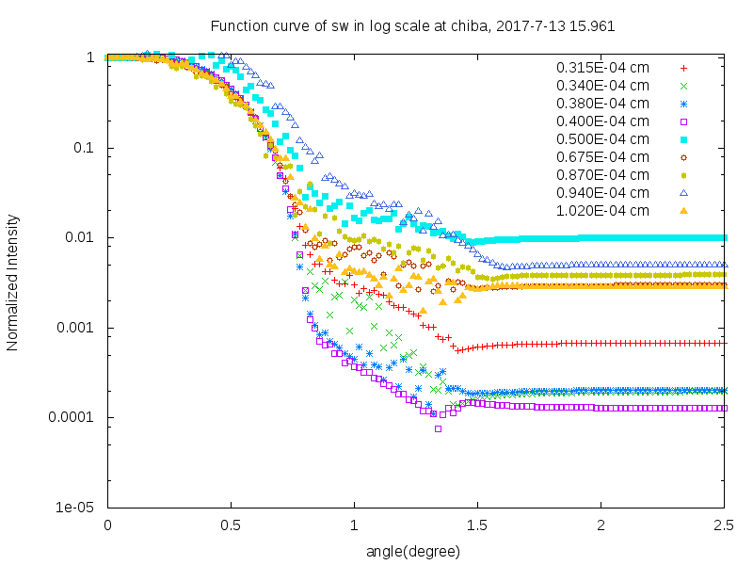
Response Functions of SW
Take4. Mottled clouds covered the sun.
Linier scale
Log scale

Slide 7
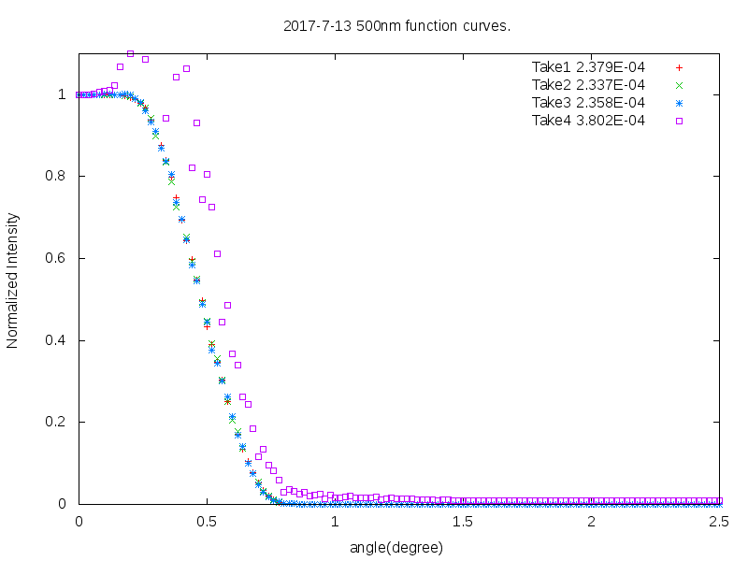
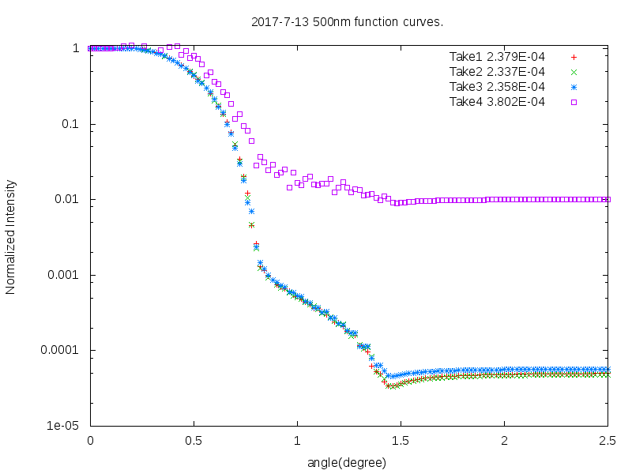
Comparison of Response Function
Response Functions at 500nm.
Linier scale
Log scale
Take4 was interfered by clouds. Take1, Take2 and Take3 are similar. Also SVA values are 2.379E-04, 2.337E-04 and 2.358E-04. There are with in about 2% difference. But Take3 was interfered by clouds.

Slide 8
SVA measurement for CHIBA Campaign 2017
Data was taken at 2017-07-14
Hiroshi OKAMOTO

Slide 9
Condition
Take1 11:08-11:37 Clear sky.
Only 1 measurement.

Slide 10
Result
WL(nm) | Take1
315 | 2.435E-04
340 | 2.418E-04
380 | 2.422E-04
400 | 2.399E-04
500 | 2.379E-04
675 | 2.338E-04
870 | 2.385E-04
940 | 2.425E-04
1020 | 2.416E-04
1627 | 2.065E-04
2200 | 2.054E-04

Slide 11
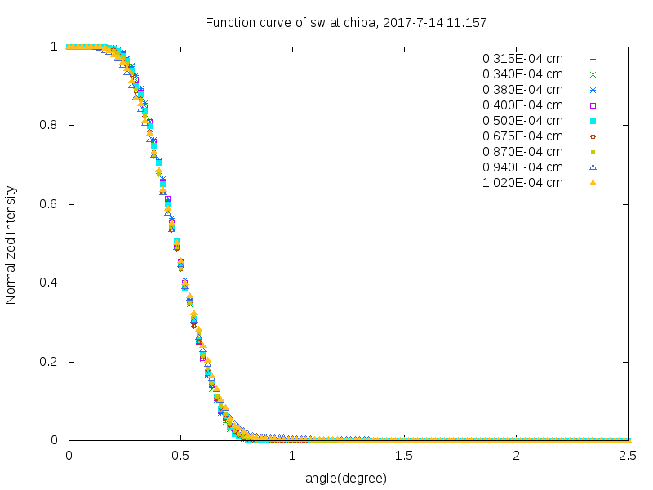
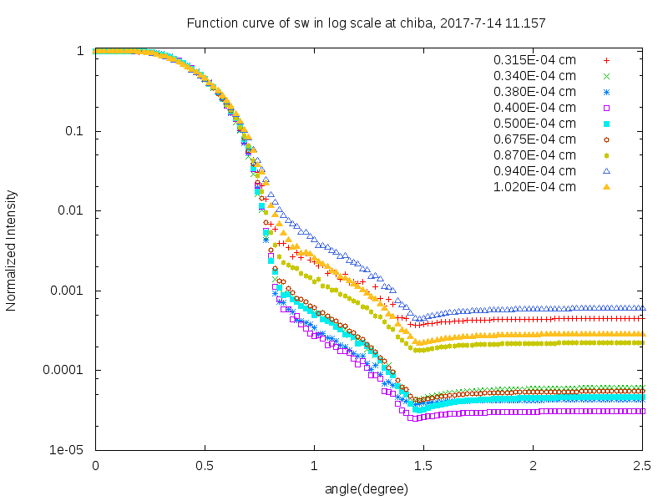
Response Functions of SW
Linier scale
Log scale

Slide 12
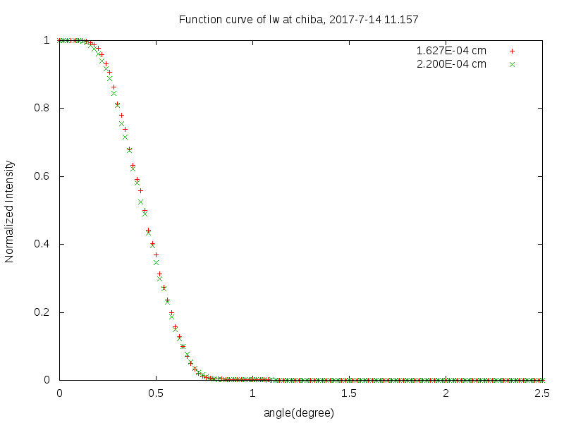
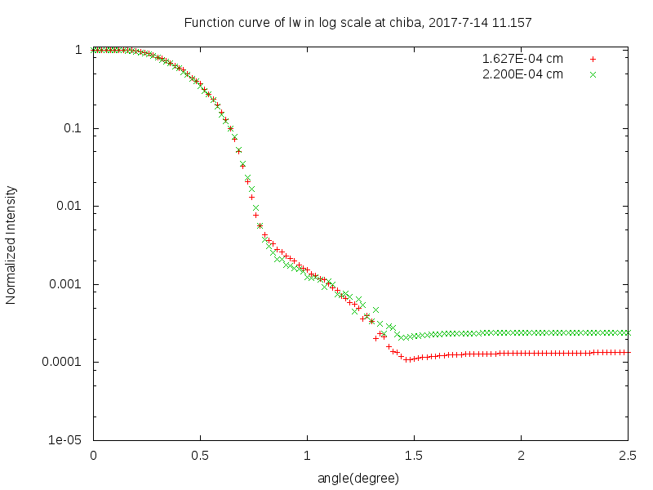
Response Functions of LW
Linier scale
Log scale

Slide 13
SVA measurement for CHIBA Campaign 2017
Data was taken at 2017-07-16
Hiroshi OKAMOTO

Slide 14
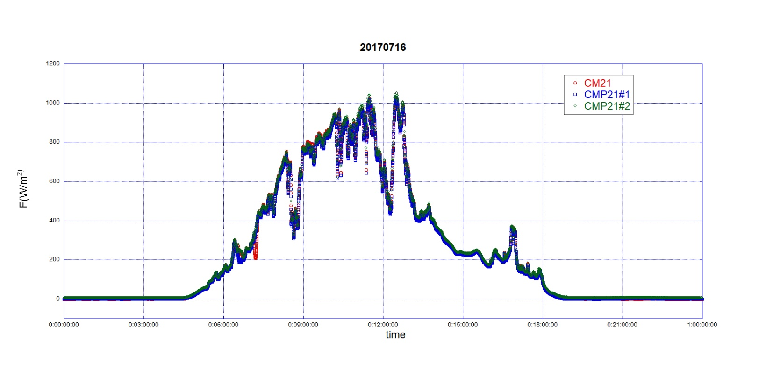
Condition
Take1 10:05-10:34
Automatic scheduled measurement.
According to Global Solar
Irradiance, there might
be some clouds.

Slide 15
Result
WL(nm) | Take1
315 | 2.451E-04
340 | 2.393E-04
380 | 2.413E-04
400 | 2.466E-04
500 | 2.392E-04
675 | 2.383E-04
870 | 2.437E-04
940 | 2.442E-04
1020 | 2.491E-04
1627 | 2.224E-04
2200 | 2.174E-04

Slide 16
Response Functions of SW
Linier scale
Log scale

Slide 17
Response Functions of LW
Linier scale
Log scale

Slide 18
SVA measurement for CHIBA Campaign 2017
Data was taken at 2017-07-18 and 2017-07-19
Hiroshi OKAMOTO

Slide 19
Condition
Mottled
Cloudy days.
2017-07-18 11:15-11:44
Mottled clouds passed the sun.
2017-07-18 11:48-12:17
Clouds covered the sun.

Slide 20
Result
WL(nm) | 2017-07-18 | 2017-07-19
315 | 2.362E-04 | 2.177E-03
340 | 2.820E-04 | 6.584E-04
380 | 2.220E-04 | 1.383E-04
400 | 2.593E-04 | 1.322E-02
500 | 3.472E-04 | 2.237E-03
675 | 2.732E-04 | 1.511E-03
870 | 1.846E-04 | 1.264E-03
940 | 2.887E-04 | 4.240E-04
1020 | 2.448E-04 | 2.308E-04
1627 | 5.146E-04 | 5.816E-03
2200 | 1.939E-04 | 4.689E-03
Almost measurements are interfered by Clouds.

Slide 21
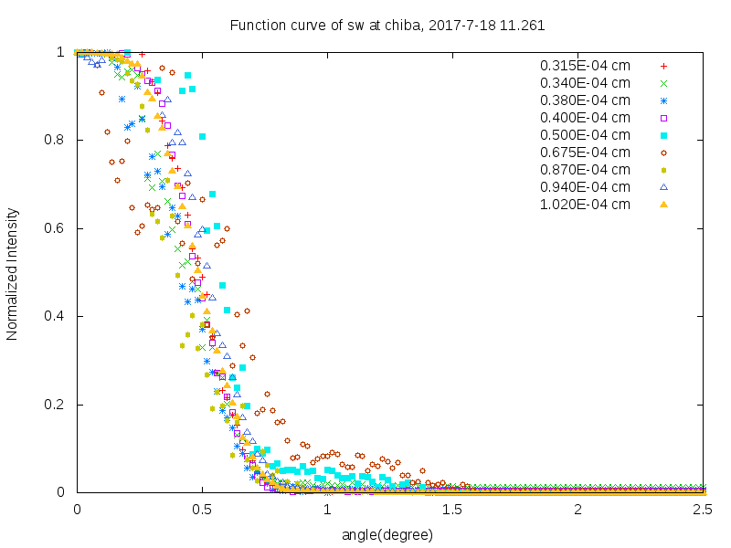
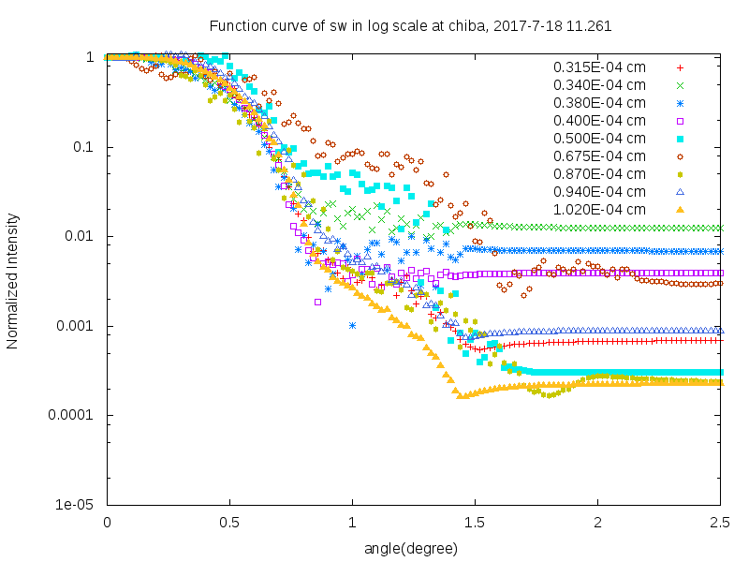
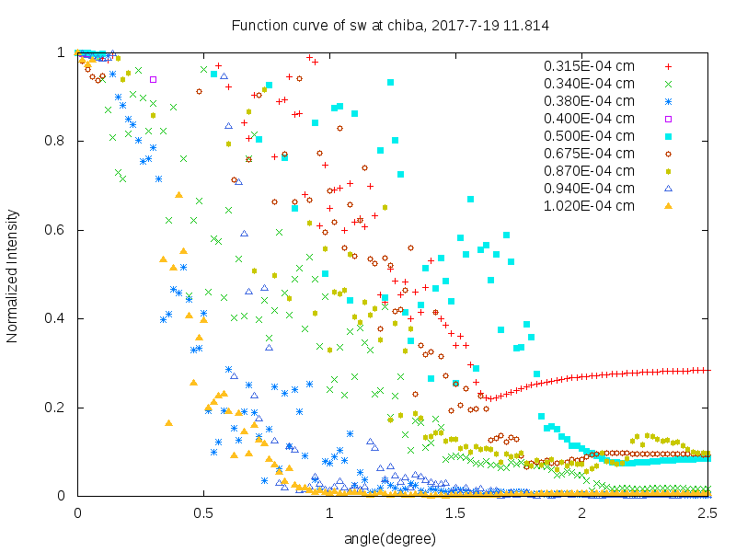
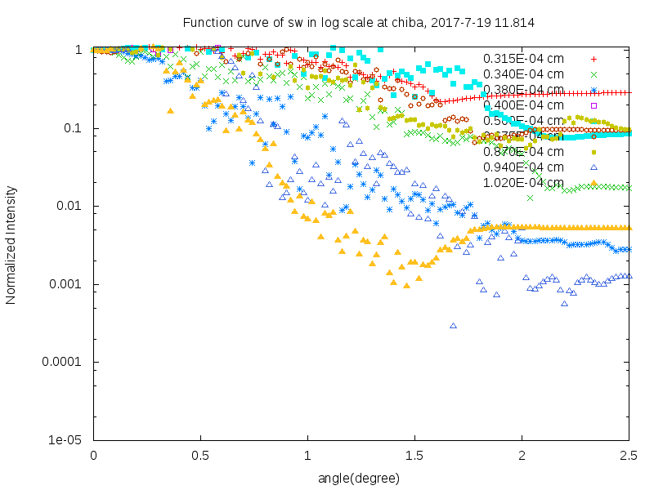
Response Functions of SW
Log scale
Linier scale

Slide 22
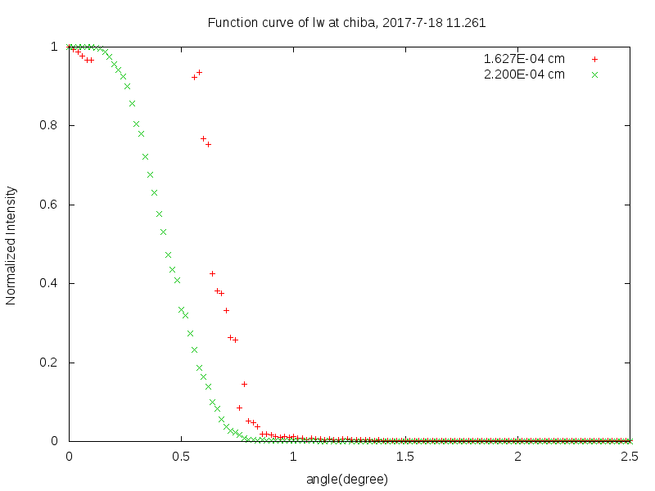
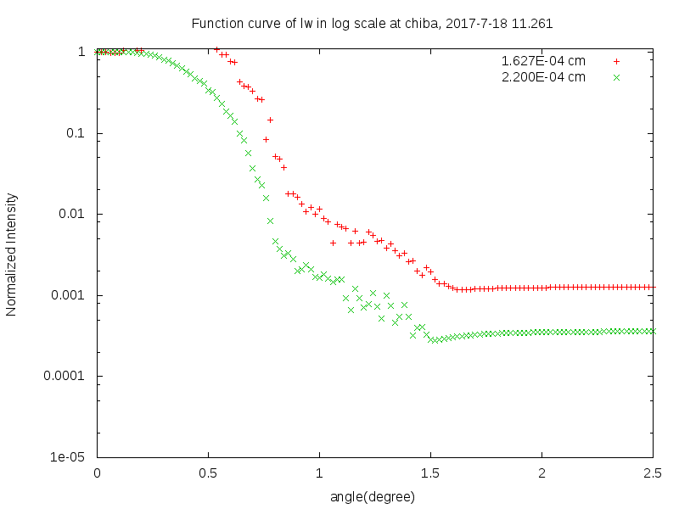
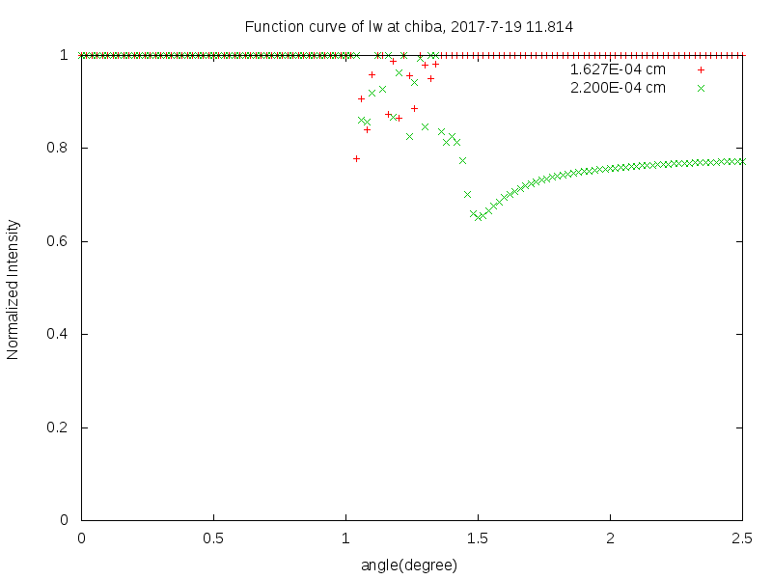
Response Functions of LW
Log scale
Linier scale

Slide 23
SVA measurement for CHIBA Campaign 2017
Data was taken at 2017-07-20
Hiroshi OKAMOTO

Slide 24
Condition
Take1 10:30-10:59 Slightly cloudy weather.
Take2 14:26-14:51 Mottled clouds around the sun.
Take3 17:20-17:49 Clear sky.

Slide 25
Result
WL(nm) | Take1 | Take2 | Take3
315 | 2.416E-04 | 4.370E-04 | 2.454E-04
340 | 2.392E-04 | 1.641E-04 | 2.426E-04
380 | 2.429E-04 | 2.219E-04 | 2.410E-04
400 | 2.412E-04 | 4.819E-04 | 2.396E-04
500 | 2.395E-04 | 1.487E-04 | 2.369E-04
675 | 2.390E-04 | 6.497E-05 | 2.351E-04
870 | 2.400E-04 | 1.180E-04 | 2.366E-04
940 | 2.412E-04 | 1.867E-04 | 2.428E-04
1020 | 2.416E-04 | 1.713E-04 | 2.423E-04
1627 | 1.869E-04 | 1.552E-04 | 2.063E-04
2200 | 1.965E-04 | 4.741E-03 | 2.031E-04
Take1 and Take2, there ware some clouds covered the sun.
Only Take3 was measured under clear sky.

Slide 26
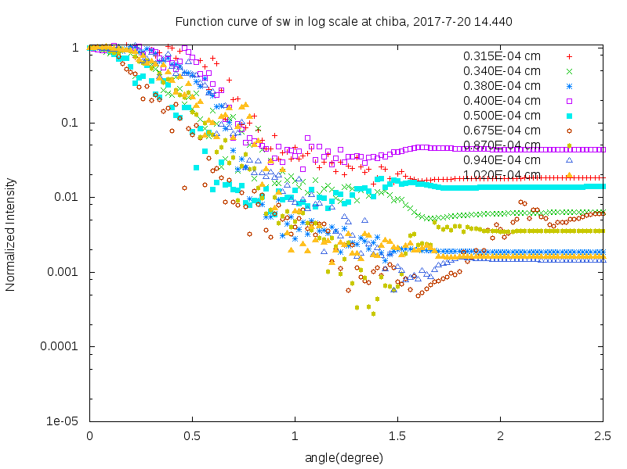
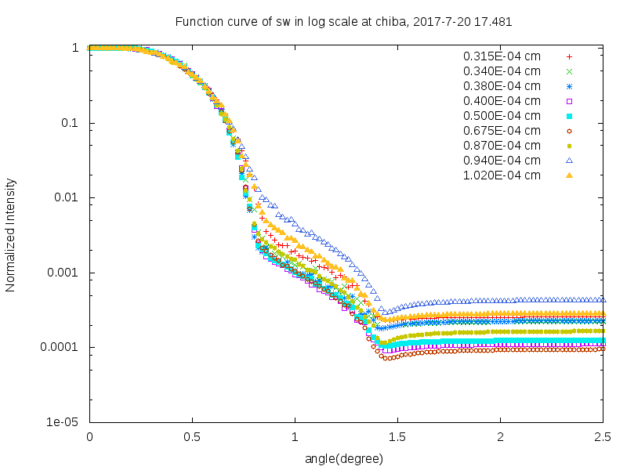
Response Functions of SW (Log scale)
Take1 10:30-10:59 Slightly cloudy weather.
Take2 14:26-14:51 Mottled clouds around the sun.
Take3 17:20-17:49 Clear sky

Slide 27
SVA measurement for CHIBA Campaign 2017
Data was taken at 2017-07-21
Hiroshi OKAMOTO

Slide 28
Condition
Take1 10:54-11:23 Clouds passed and covered the sun.
Take2 14:43-15:12 Clouds covered the sun.

Slide 29
Result
WL(nm) | Take1 | Take2 | Take3
315 | 2.416E-04 | 4.370E-04 | 2.454E-04
340 | 2.392E-04 | 1.641E-04 | 2.426E-04
380 | 2.429E-04 | 2.219E-04 | 2.410E-04
400 | 2.412E-04 | 4.819E-04 | 2.396E-04
500 | 2.395E-04 | 1.487E-04 | 2.369E-04
675 | 2.390E-04 | 6.497E-05 | 2.351E-04
870 | 2.400E-04 | 1.180E-04 | 2.366E-04
940 | 2.412E-04 | 1.867E-04 | 2.428E-04
1020 | 2.416E-04 | 1.713E-04 | 2.423E-04
1627 | 1.869E-04 | 1.552E-04 | 2.063E-04
2200 | 1.965E-04 | 4.741E-03 | 2.031E-04
Take1 and Take2, there ware some clouds covered the sun.
Only Take3 was measured under clear sky.

Slide 30
Response Functions of SW (Log scale)
Take1 10:30-10:59 Slightly cloudy weather.
Take2 14:26-14:51 Mottled clouds around the sun.
Take3 17:20-17:49 Clear sky

Slide 31
SVA measurement for CHIBA Campaign 2017
Data was taken at 2017-07-24
Hiroshi OKAMOTO

Slide 32
Condition
Take1 10:03-10:32 Cloud covered the sun .
Take2 13:38-14:07 Mottled cloud covered the sun.

Slide 33
Result
WL(nm) | Take1 | Take2
315 | 3.234E-04 | 2.770E-04
340 | 3.889E-04 | 2.416E-04
380 | 2.745E-04 | 3.152E-04
400 | 6.525E-04 | 3.027E-04
500 | 5.934E-04 | 2.962E-04
675 | 6.111E-04 | 3.335E-04
870 | 9.983E-04 | 3.266E-04
940 | 5.950E-03 | 3.166E-04
1020 | 2.749E-04 | 3.072E-04
1627 | 2.381E-04 | 2.725E-04
2200 | 2.355E-04 | 2.904E-04

Slide 34
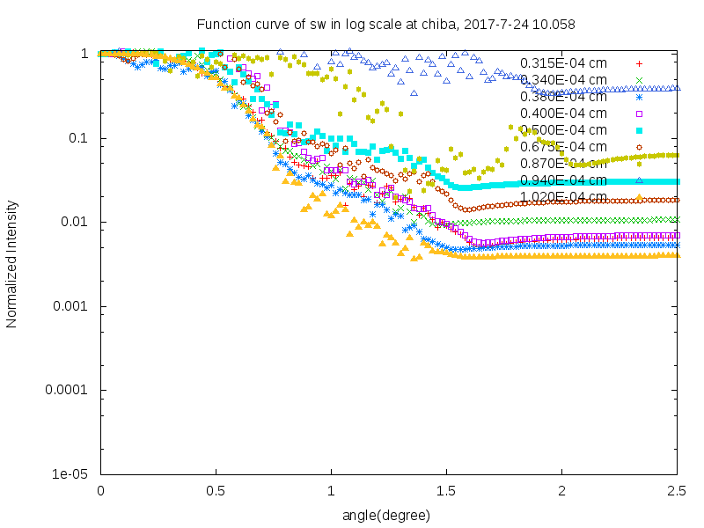
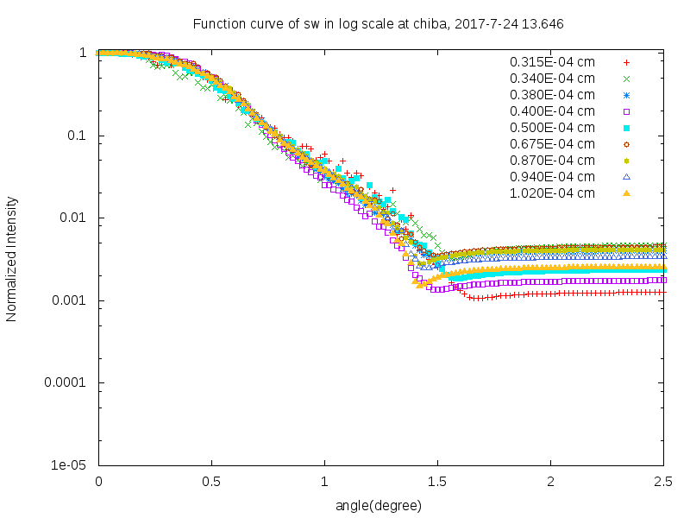
Response Functions of SW(log scale)
Take1
Take2

Slide 35
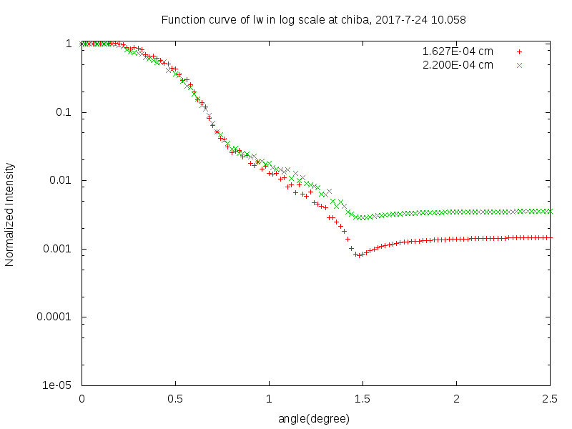
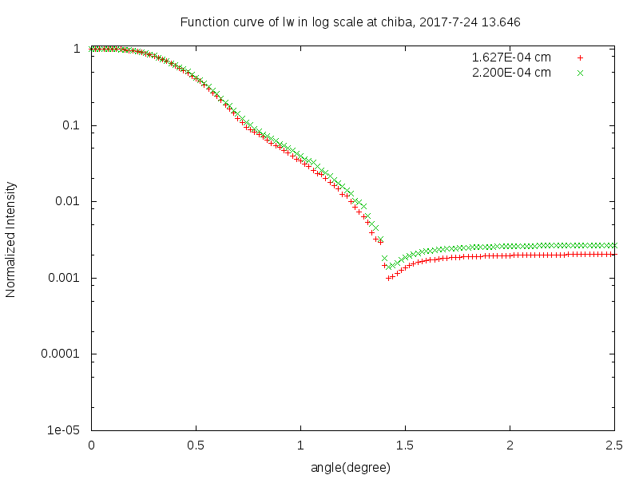
Response Functions of LW(log scale)
Linier scale
Log scale

