Slide 1
SVA measurement for
CHIBA Campaign 2017
Data was taken at 2017-07-12
Hiroshi OKAMOTO

Slide 2
Condition
Take1 10:23-10:52 Clear sky.
Take2 11:48-12:17 Clear sky.
Take3 13:58-14:25 around 14:10 clouds covered sun.

Slide 3
Result
WL(nm) | Take1 | Take2 | Take3
315 | 2.461E-04 | 2.395E-04 | 2.395E-04
340 | 2.393E-04 | 2.342E-04 | 2.373E-04
380 | 2.421E-04 | 2.337E-04 | 2.384E-04
400 | 2.423E-04 | 2.314E-04 | 2.167E-04
500 | 2.432E-04 | 2.327E-04 | 4.259E-04
675 | 2.388E-04 | 2.319E-04 | 1.484E-04
870 | 2.411E-04 | 2.361E-04 | 1.624E-04
940 | 2.458E-04 | 2.397E-04 | 9.188E-05
1020 | 2.439E-04 | 2.384E-04 | 1.890E-04
1627 | 2.077E-04 | 2.043E-04 | 1.430E-03
2200 | 2.038E-04 | 2.032E-04 | 2.262E-04
Values in Orange BG are not for use.
Cloud covered sun.

Slide 4
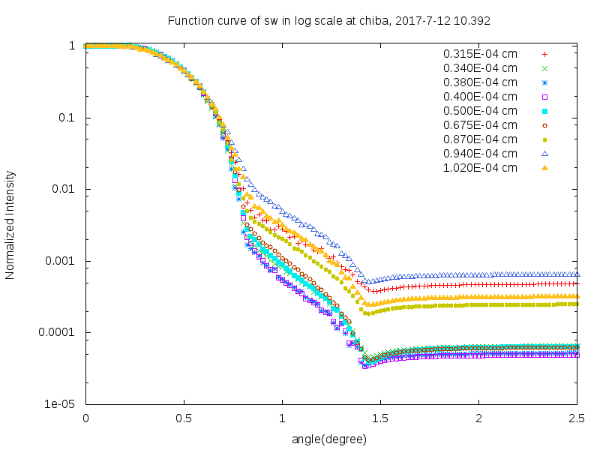
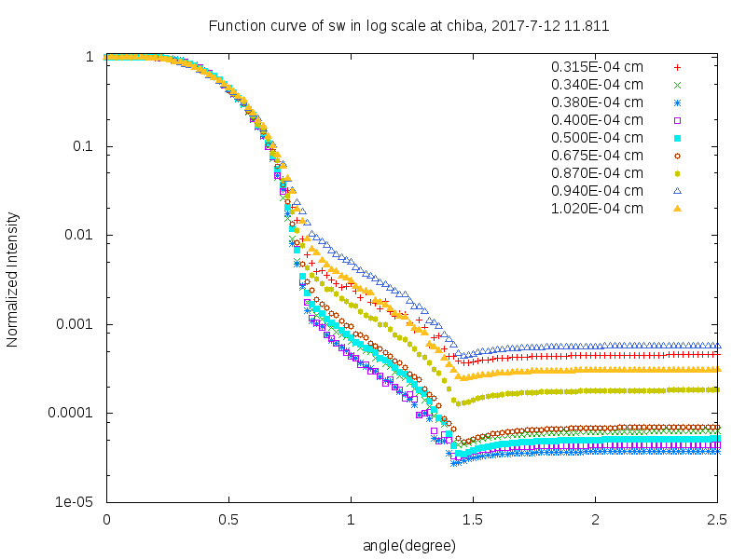
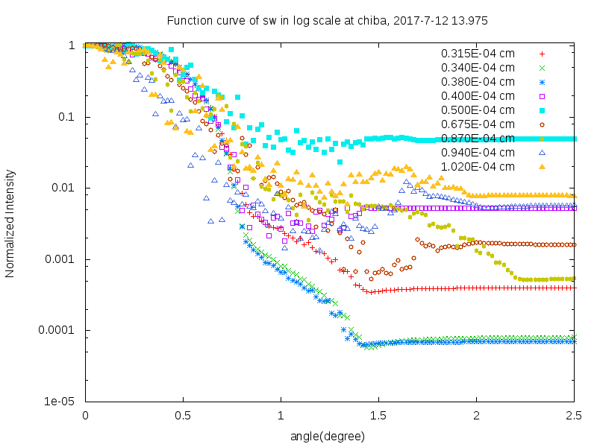
Response Functions of SW (Log scale)
Take1 10:23-10:52 Clear sky.
Take2 11:48-12:17 Clear sky.
Take3 13:58-14:25
around 14:10 clouds covered sun.

Slide 5
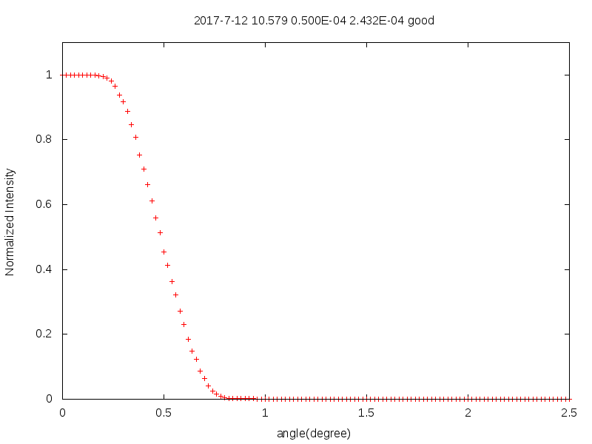

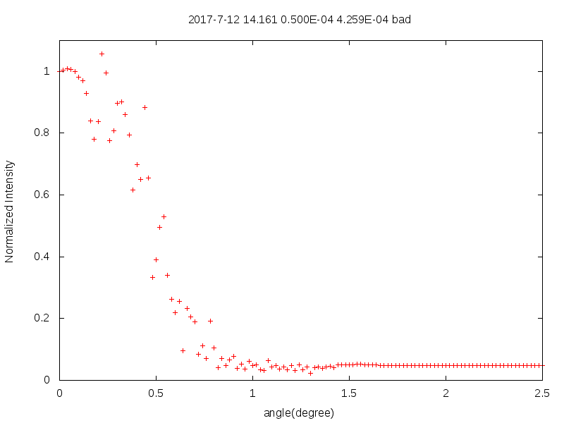
Comparison of Response Function
Response Functions at 500nm.
Take1
Take2
Take3
Take3 was interfered by cloud. Take1 and Take2 are similar but SVA values are 2.432E-04 and 2.327E-04.There are about 4% difference.

