Slide 1
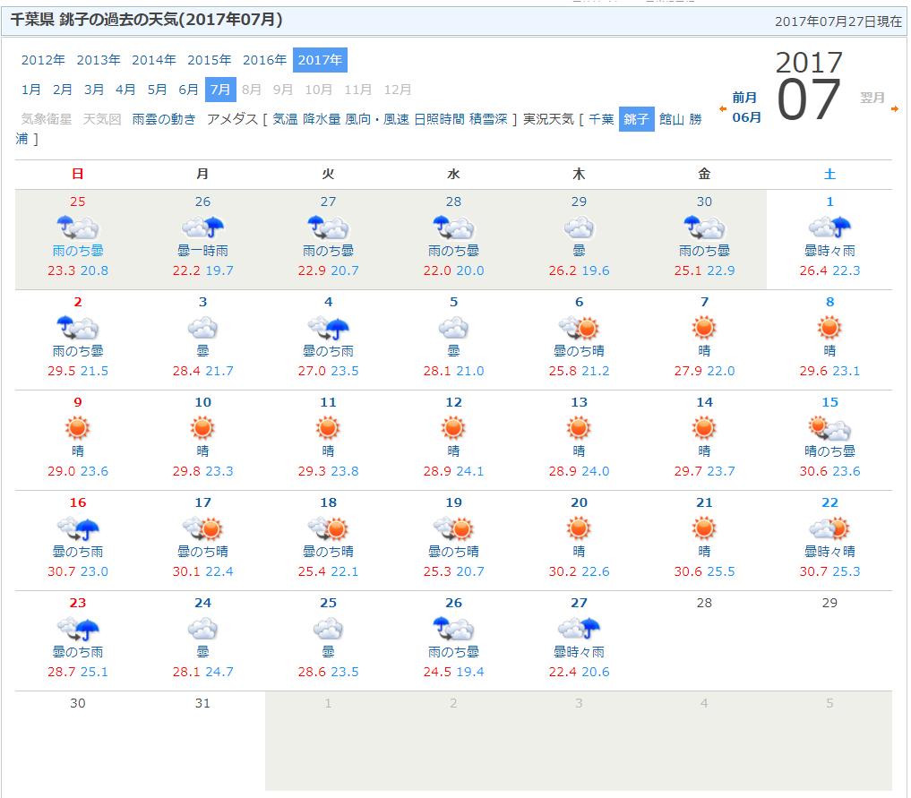
Weather
Rainy season ended.

Slide 2
What to Do (raised in the last MTG)
Continue daily analysis. → Done.
Pyranometer comparisons under several conditions (e.g., without the RasPi CMP21, ...) → Occasional large differences were most likely due to the problem that A/D conversion for RasPi pyranometer didn’t work properly. We are asking Prede for improvement.
Check cloud interferences using whole-sky camera and lidar. → data are available on the web sites.
Characterization of Chiba’s atmospheric composition in July by using past MAX-DOAS data. → investigation started by Yonekawa-kun.
Seasonal variation in AOD and SSA.
Change in AOD and SSA before/after the end of rainy season.
→ investigation started by Yasuda-kun and Fatmi-kun.
Toward publications.

Slide 3
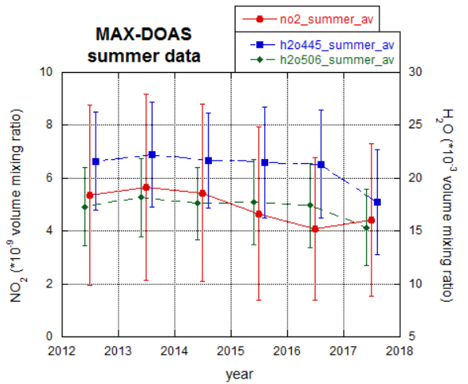
Characterization of Chiba’s atmospheric composition in summer

Slide 4
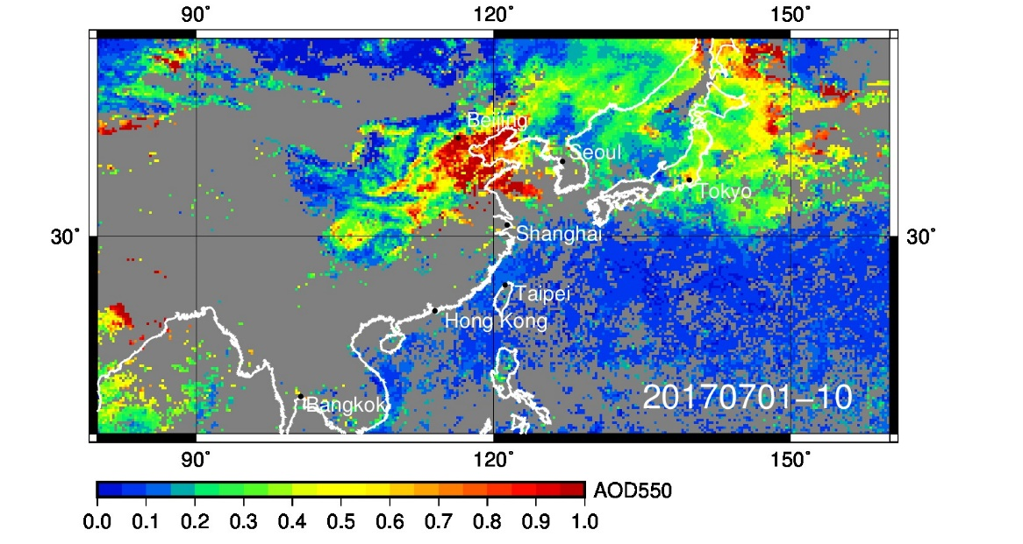
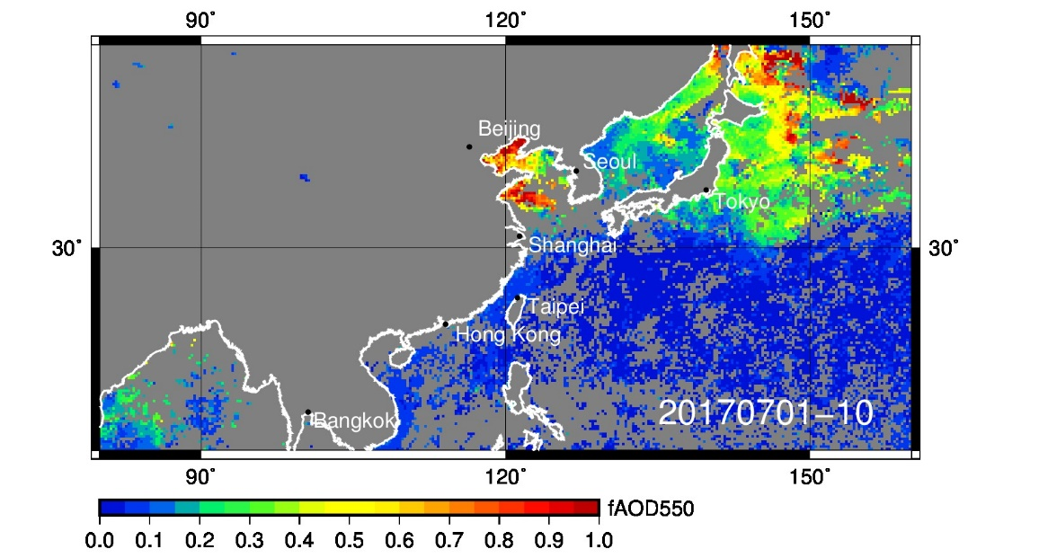
MODIS AOD and fAOD (early July)
AOD
fine AOD

Slide 5
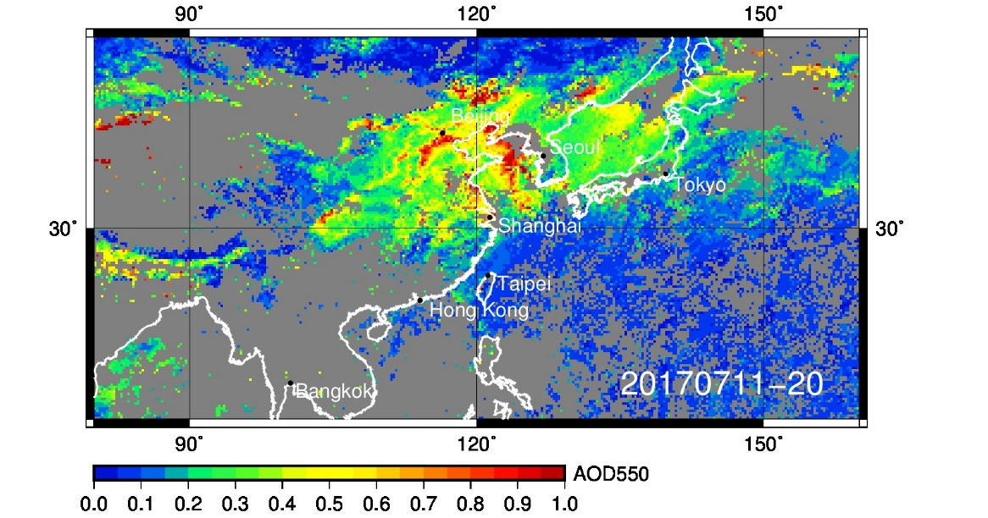
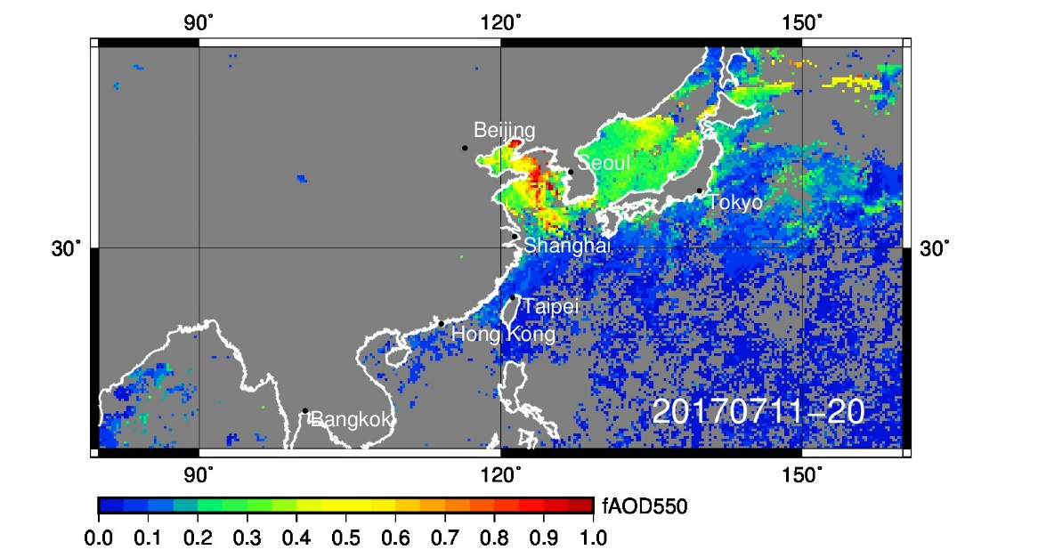
MODIS AOD and fAOD (mid July)
AOD
fine AOD

Slide 6
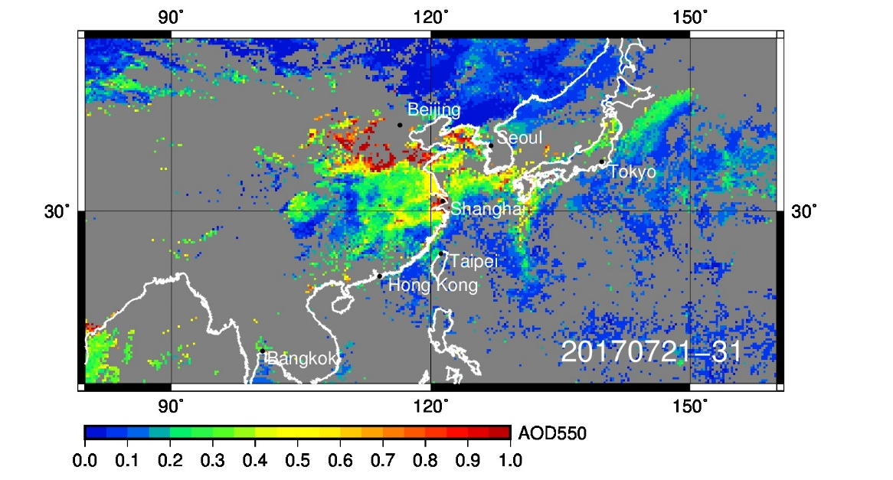
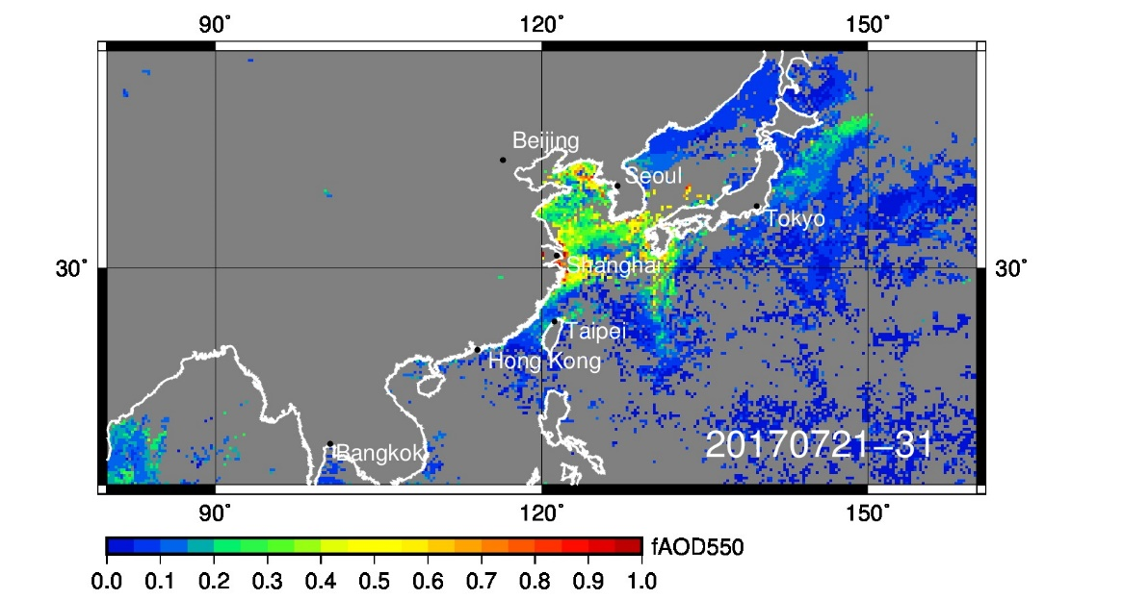
MODIS AOD and fAOD (late July)
AOD
fine AOD

Slide 7
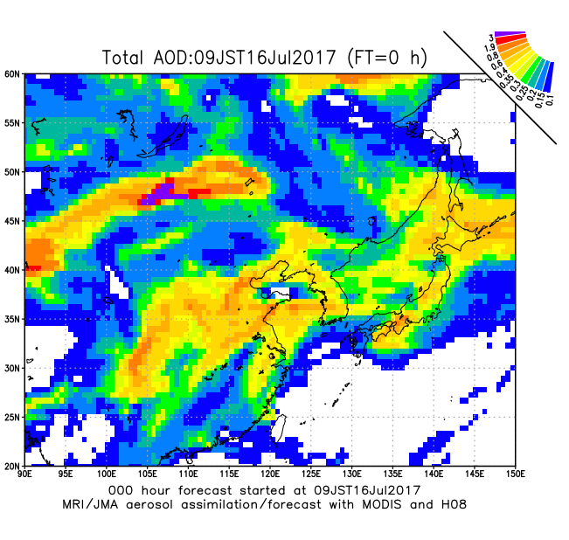
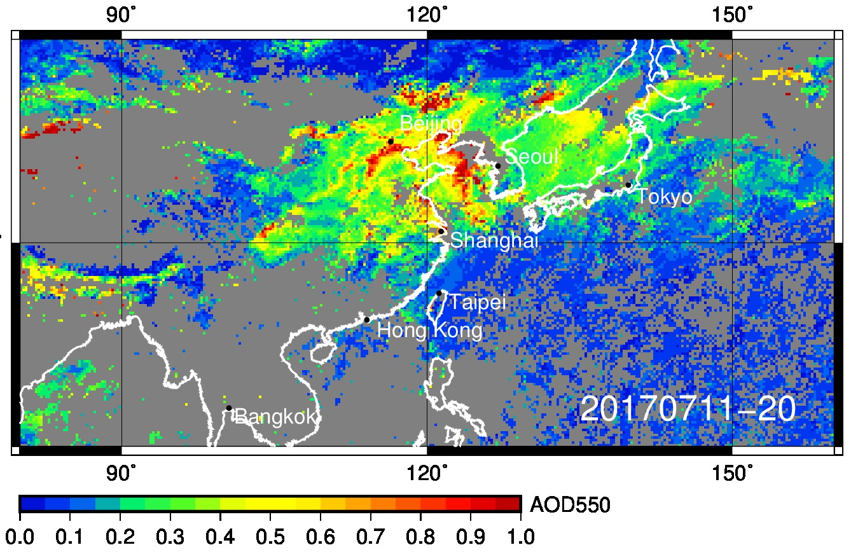
Satellite/model comparison

