Slide 1
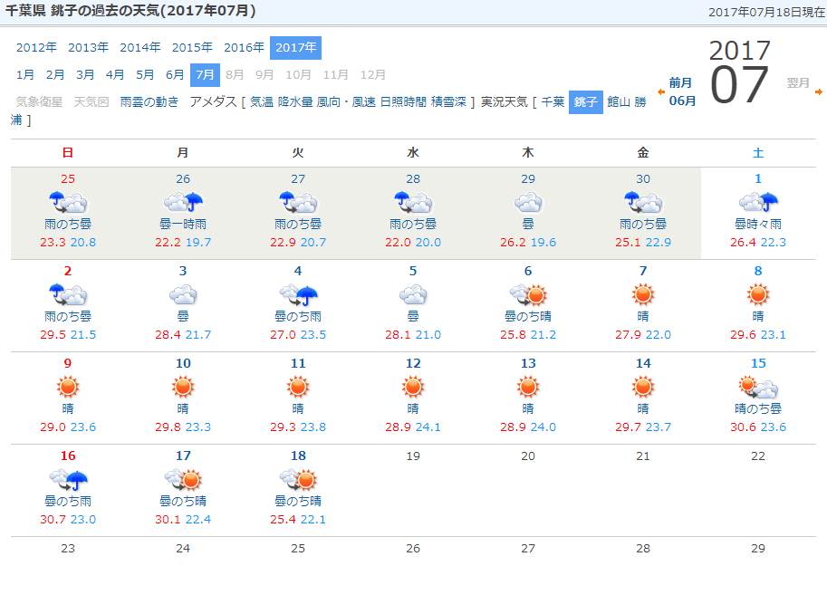
Weather
Rainy season ended.

Slide 2
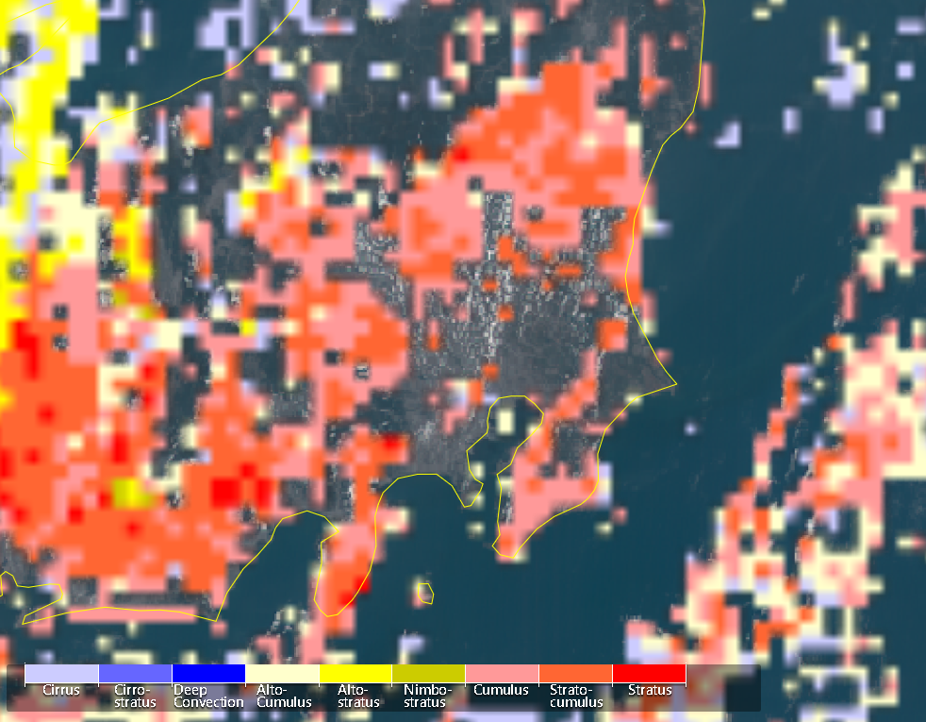
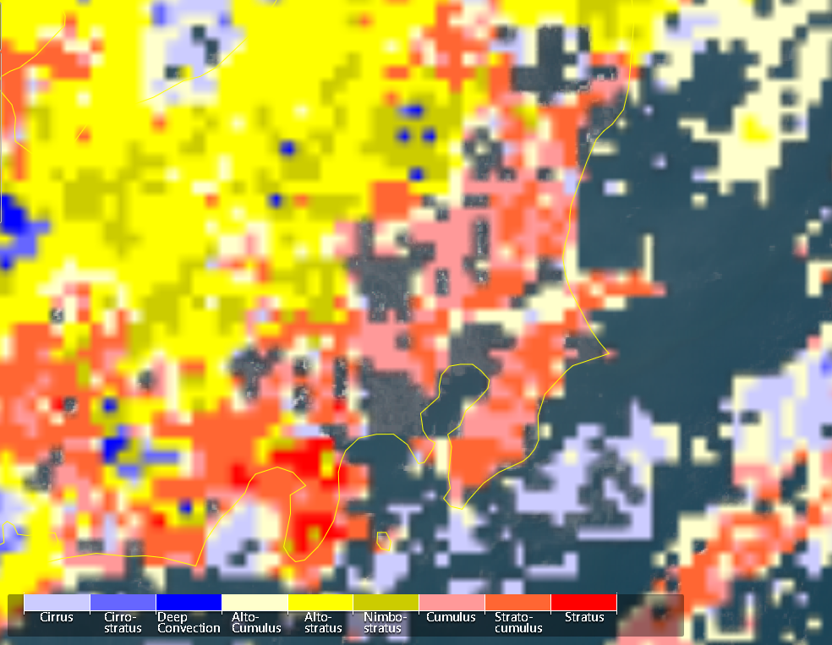
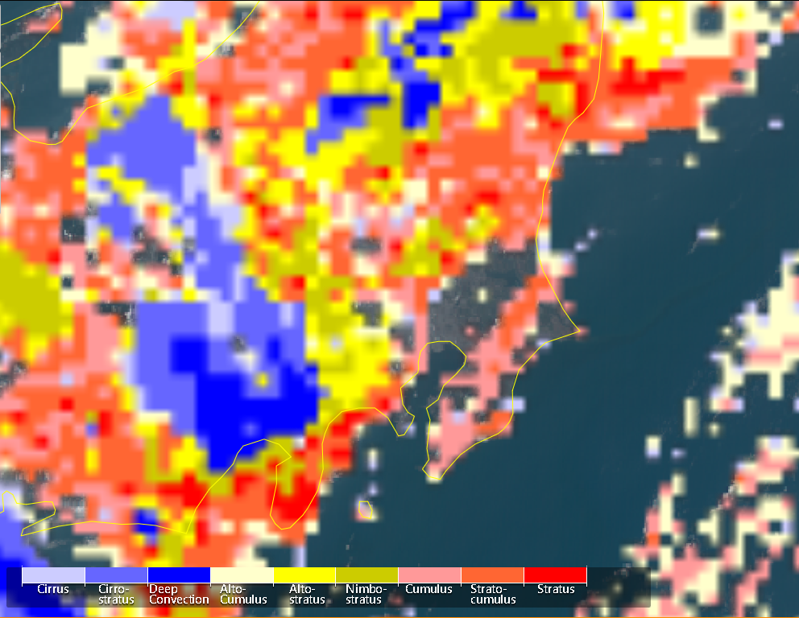
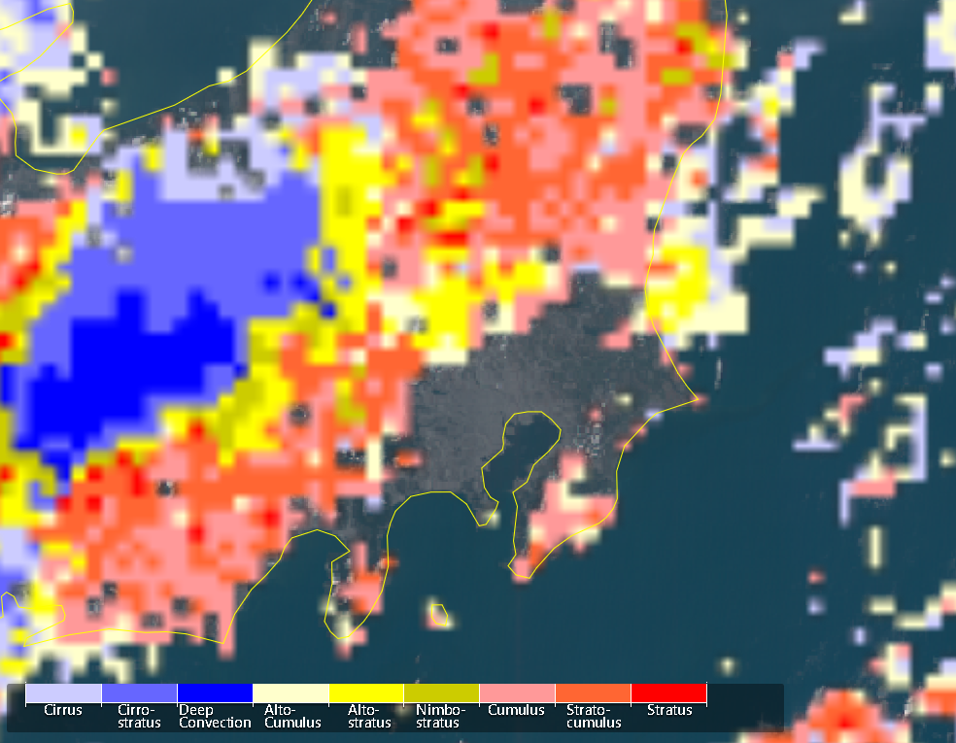
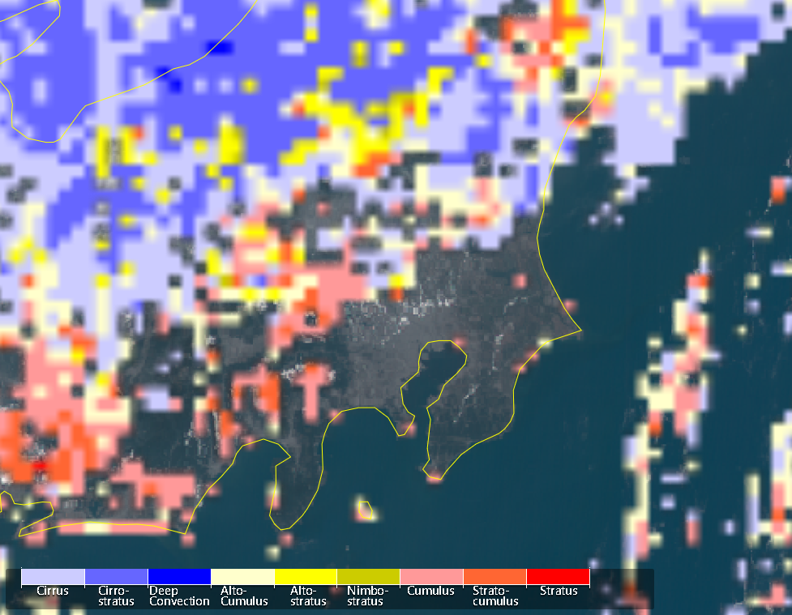
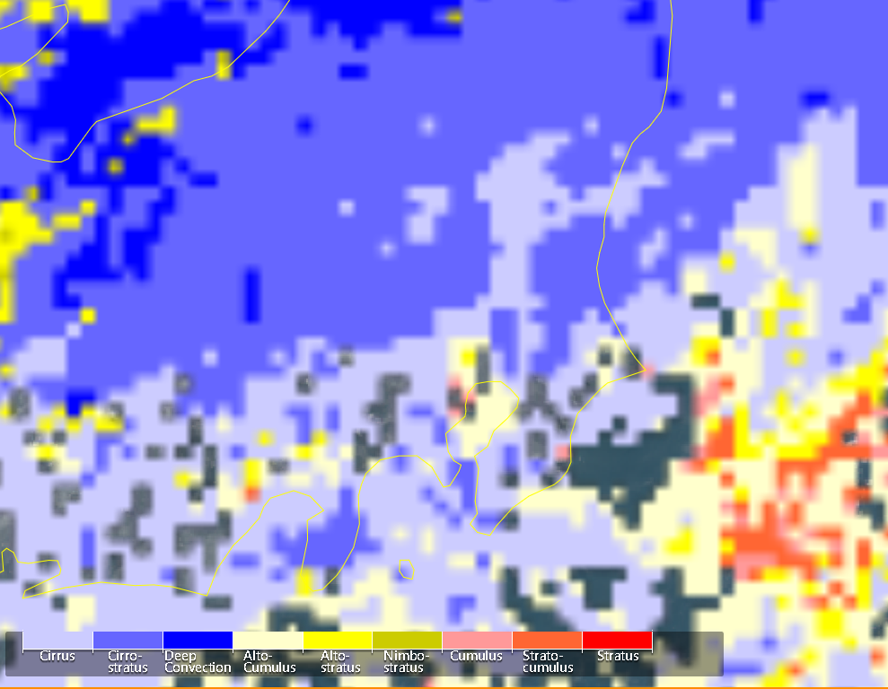
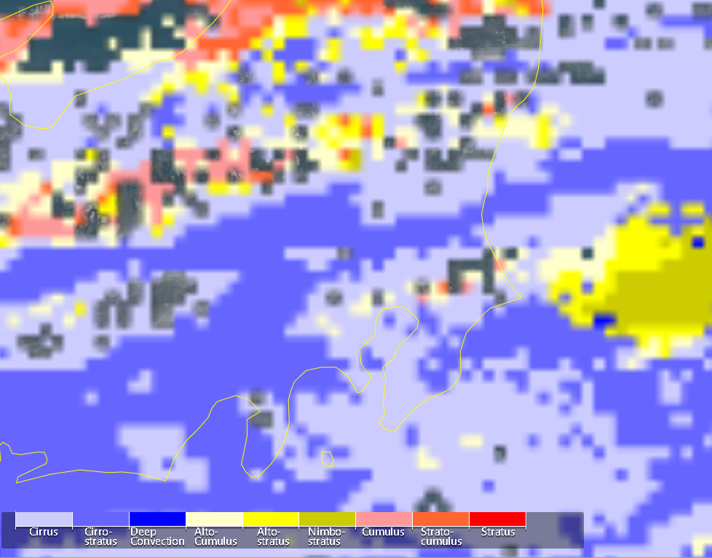
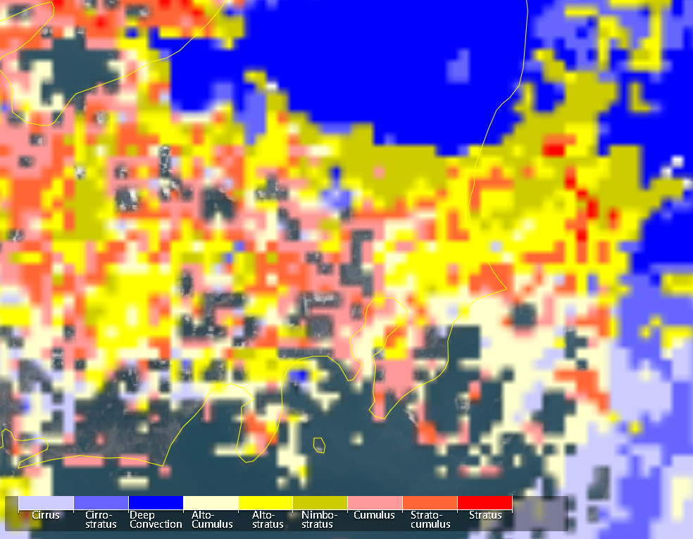
Cloud types (H-8 monitor)
Jul. 11
Jul. 12
Jul. 13
Jul. 14
Jul. 15
Jul. 16
Jul. 17
Jul. 18
※around noon

Slide 3
Topics
The RasPi pyranometer system is working well but comparisons with other pyranometers show occasional large differences. Need more tests.
Differences seen among 4AZ-MAXDOAS observations and their interpretation.
Temporal variations in aerosols seen from POM-02, CIMEL, and PM2.5.
Temporal variations in water vapor seen from CIMEL.
Characterization of SVA of POM-02.

Slide 4
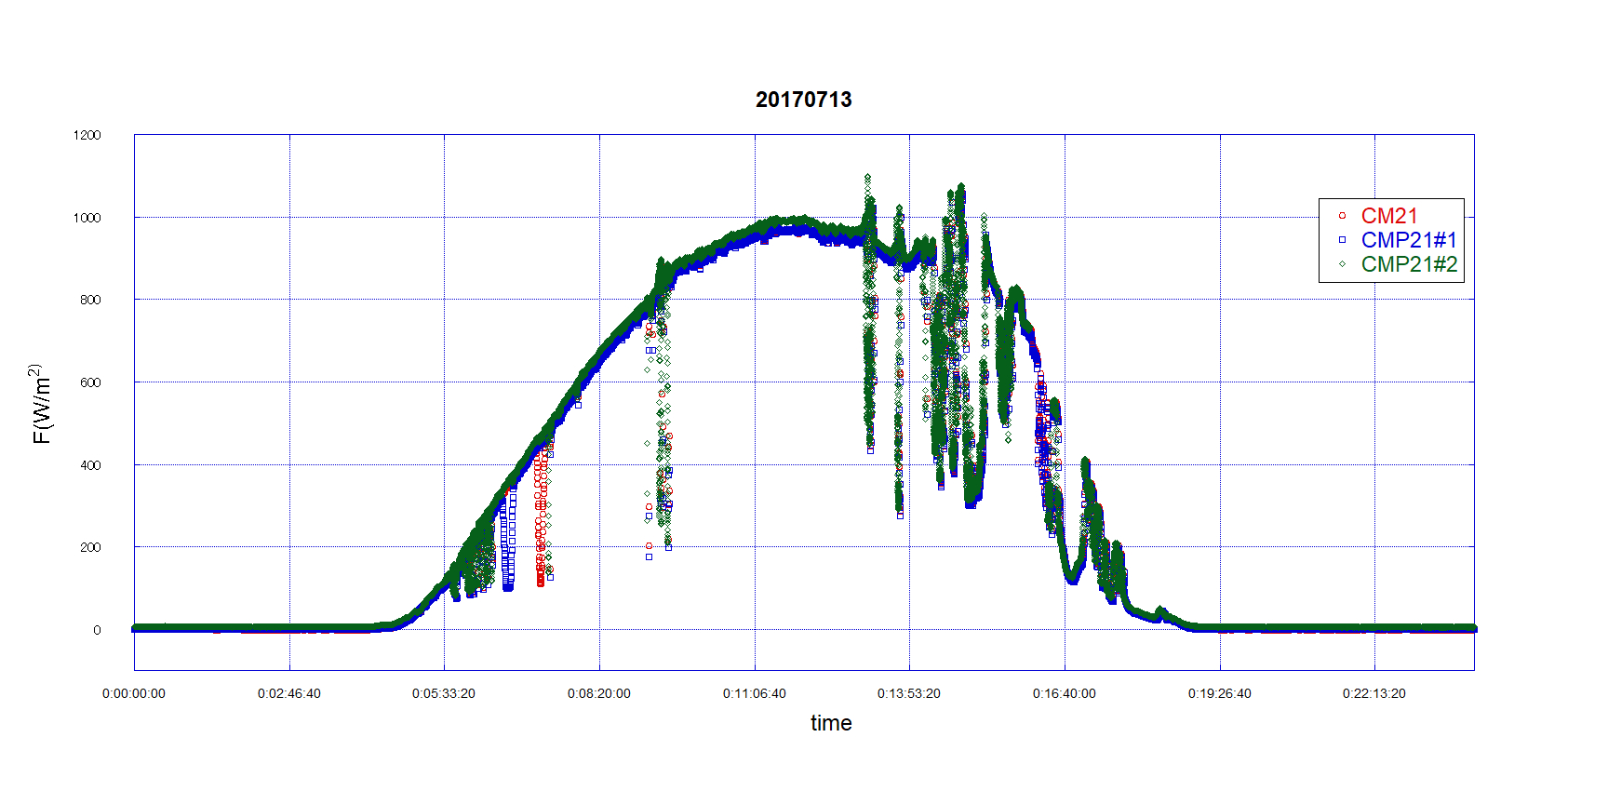
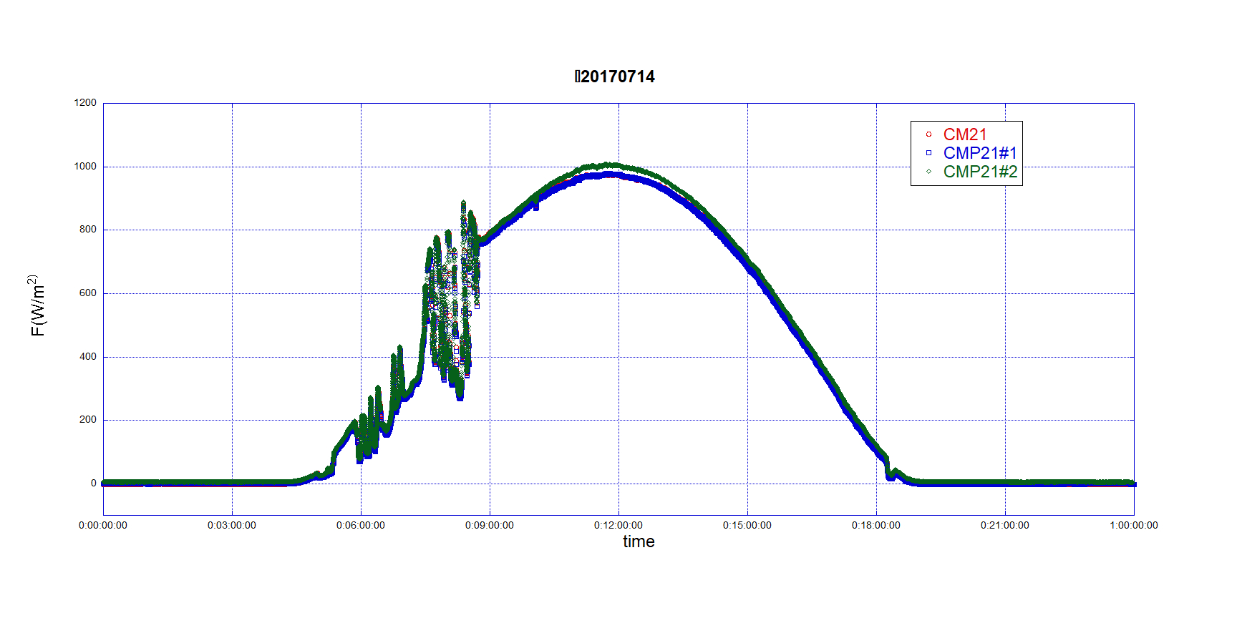
全天日射量（CMP21#2=raspberry Pi） Jul.14

Slide 5
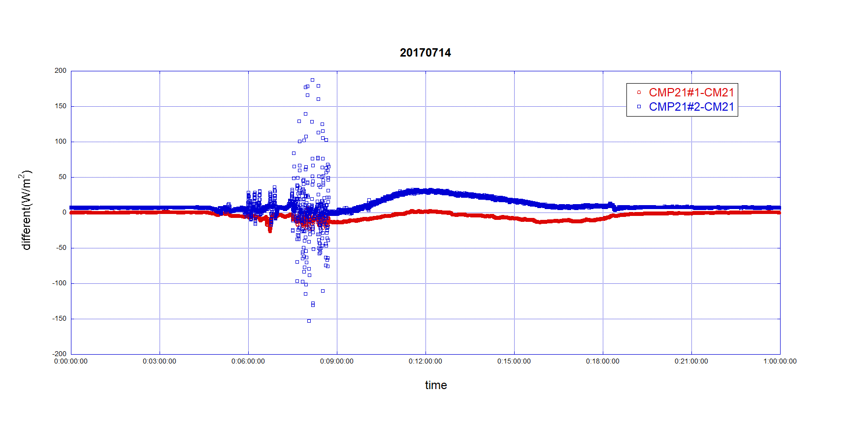
地上観測機器の精度 （CMP#2＝raspberry Pi Jul.14 every 2seconds）

Slide 6
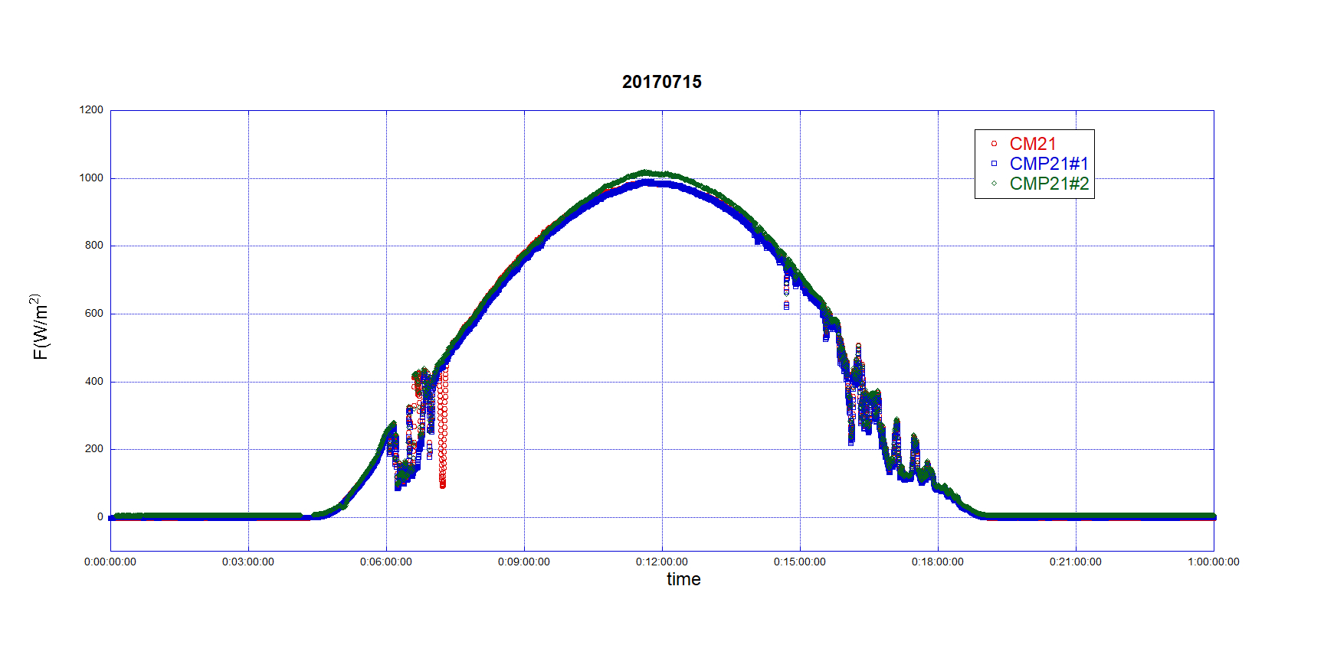
全天日射量（CMP21#2=raspberry Pi） Jul.15

Slide 7
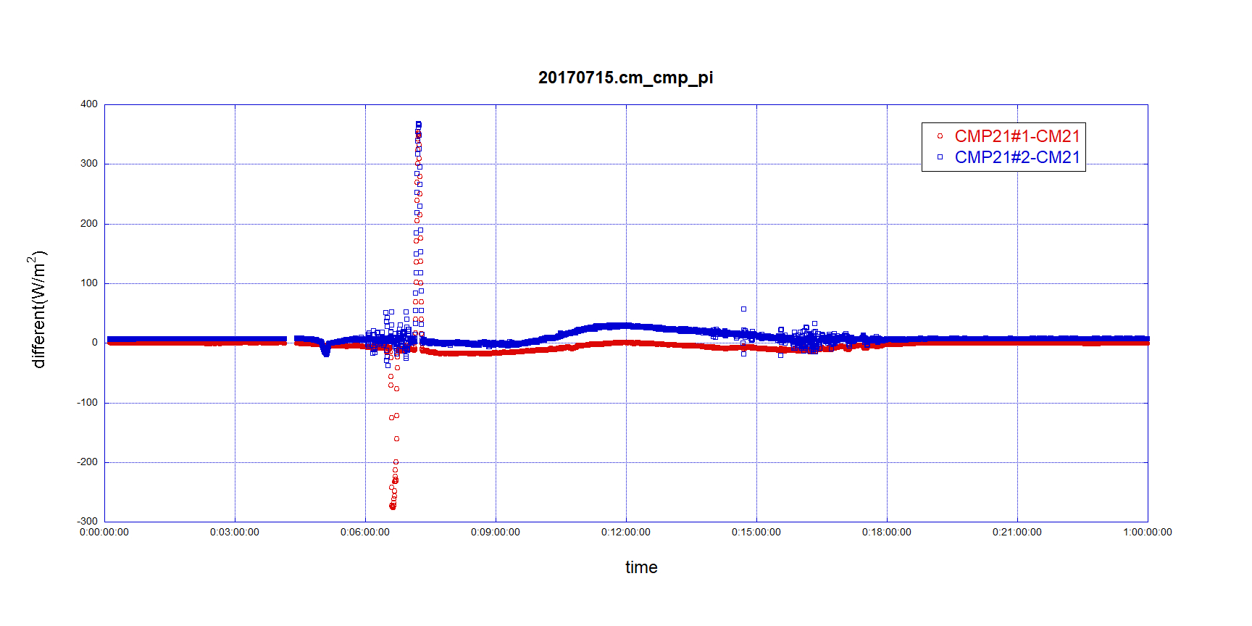
地上観測機器の精度 （CMP#2＝raspberry Pi Jul.15 every 10seconds）

Slide 8
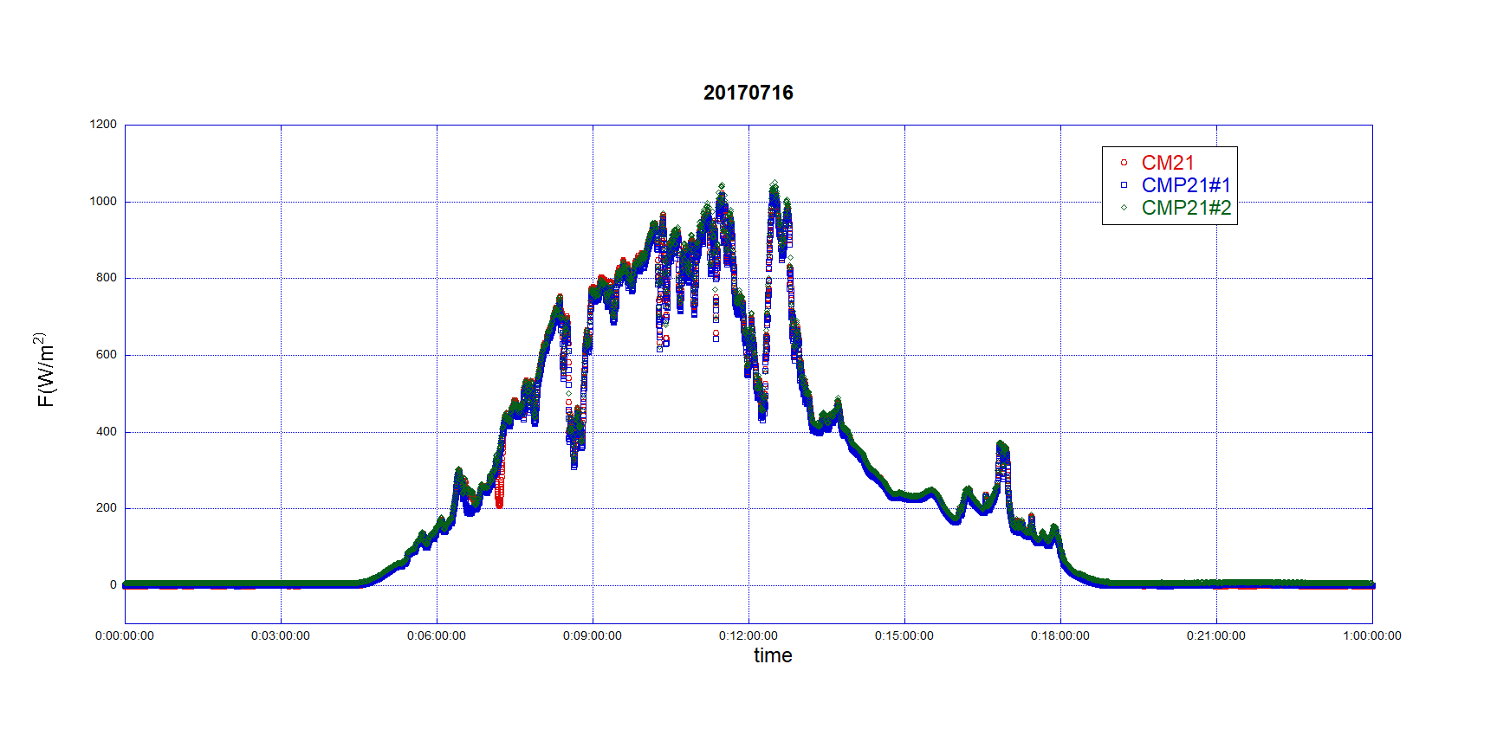
全天日射量（CMP21#2=raspberry Pi） Jul.16

Slide 9
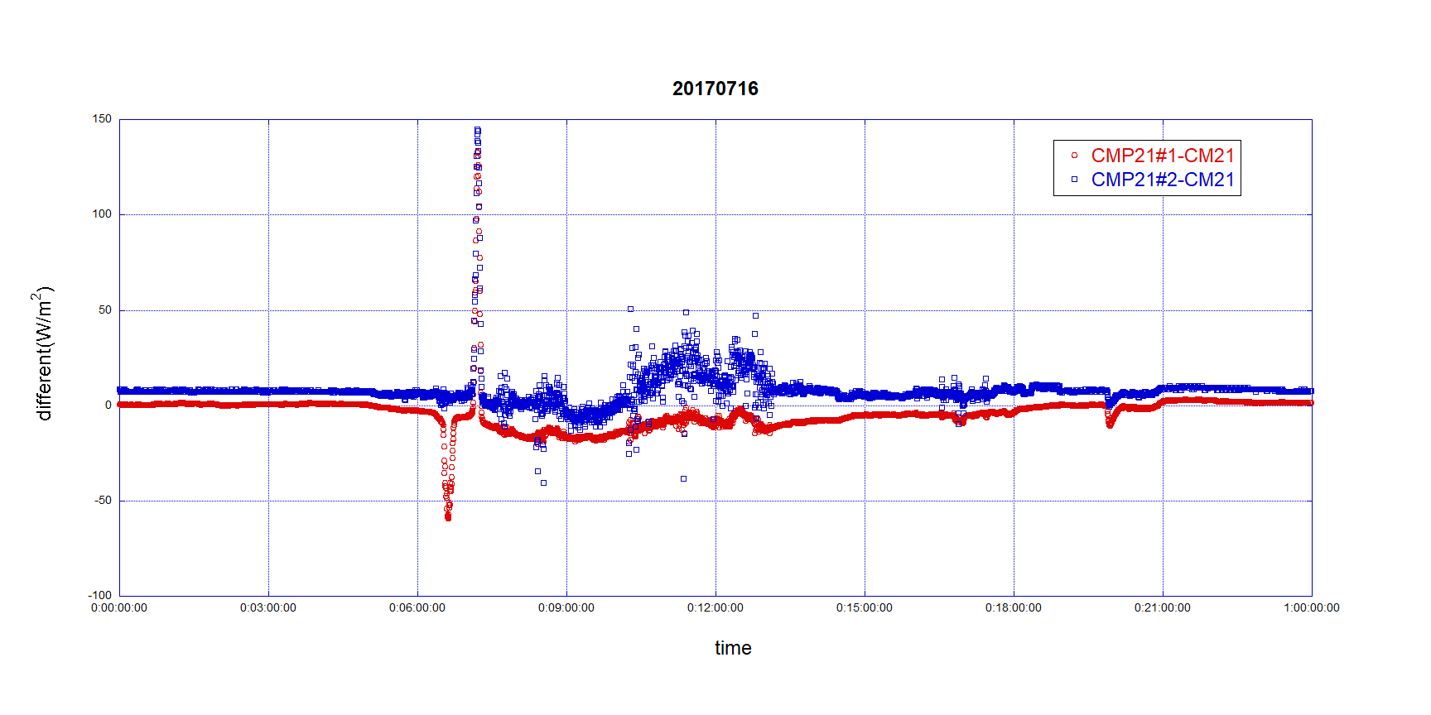
地上観測機器の精度 （CMP#2＝raspberry Pi Jul.16 every 20seconds）

Slide 10
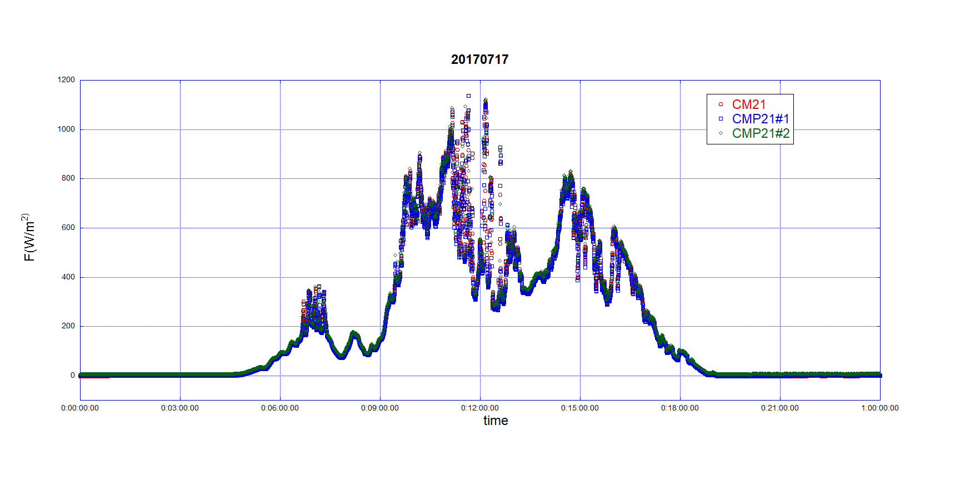
全天日射量（CMP21#2=raspberry Pi） Jul.17

Slide 11
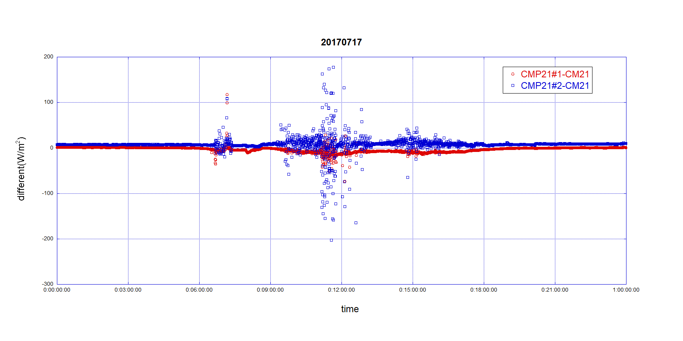
地上観測機器の精度 （CMP#2＝raspberry Pi Jul.17 every 30seconds）

Slide 12
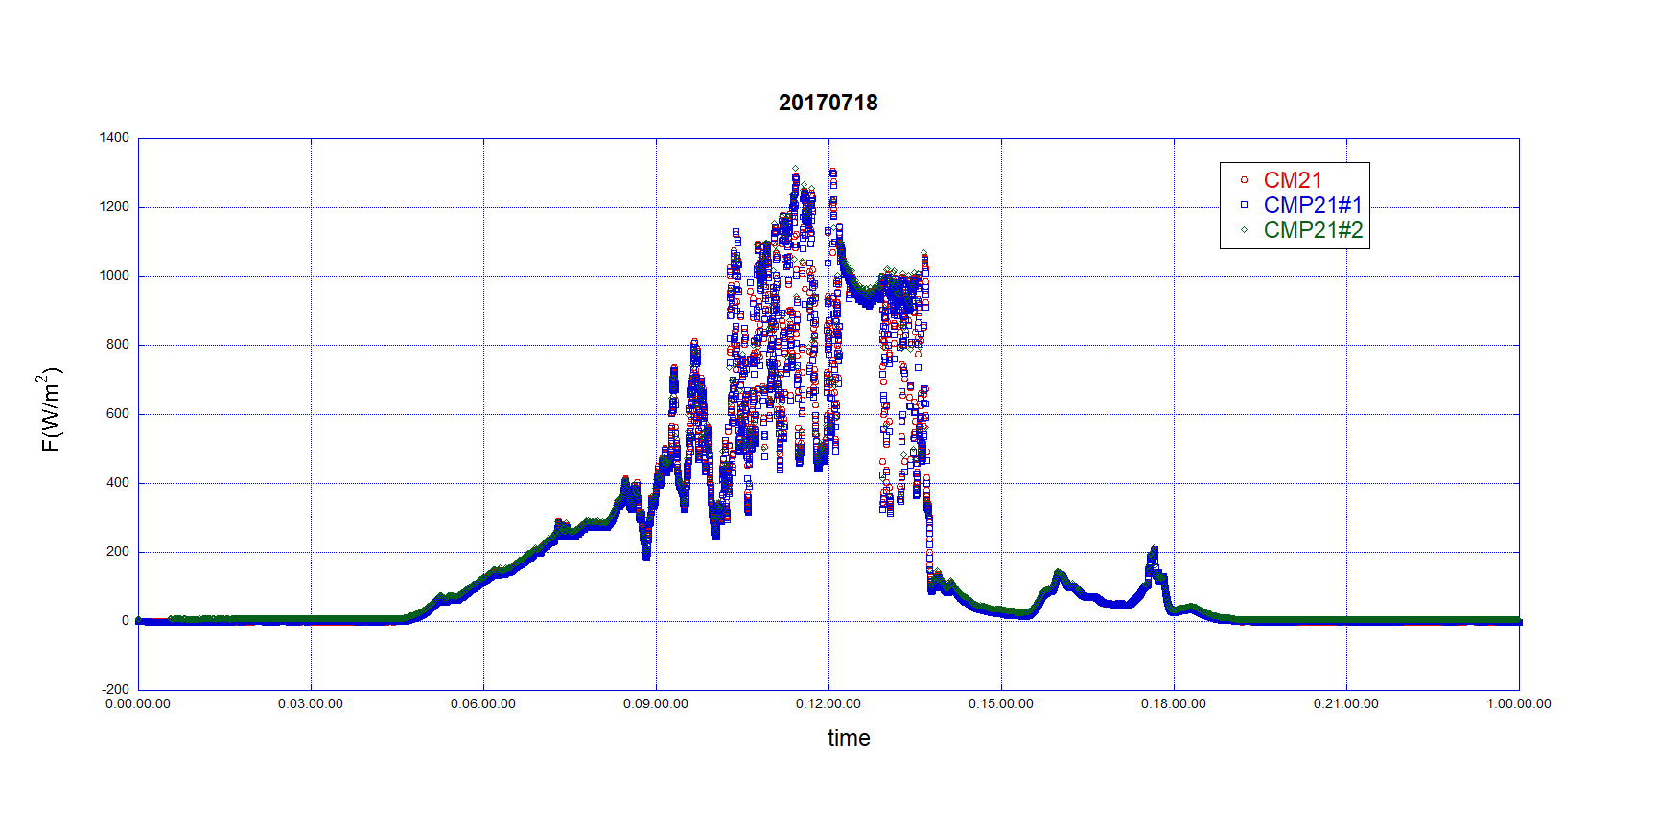
全天日射量（CMP21#2=raspberry Pi） Jul.17

Slide 13
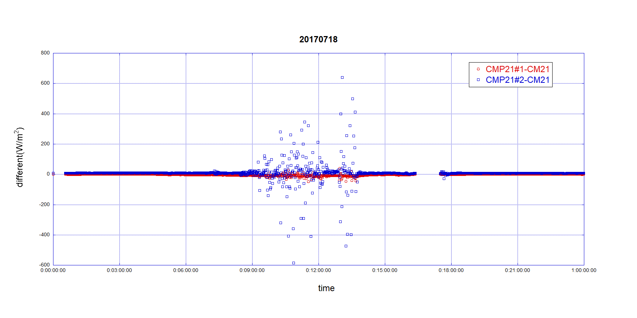
地上観測機器の精度 （CMP#2＝raspberry Pi Jul.17 every 60seconds）

Slide 14
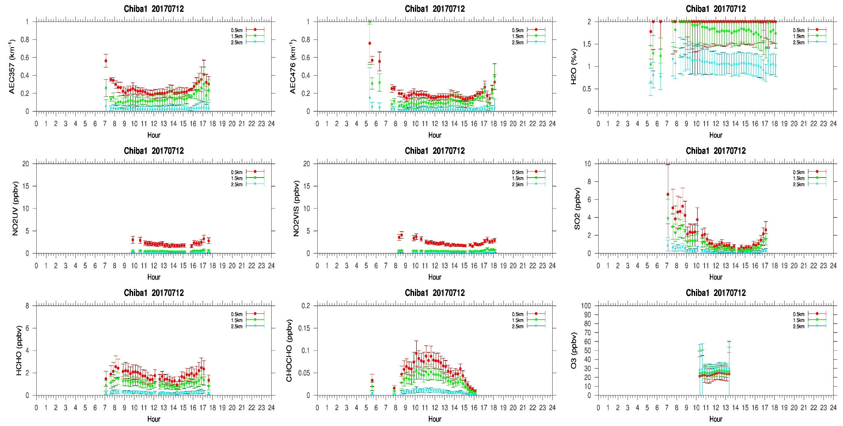
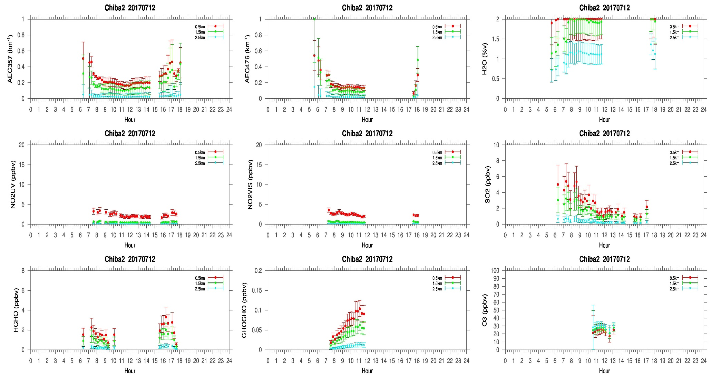
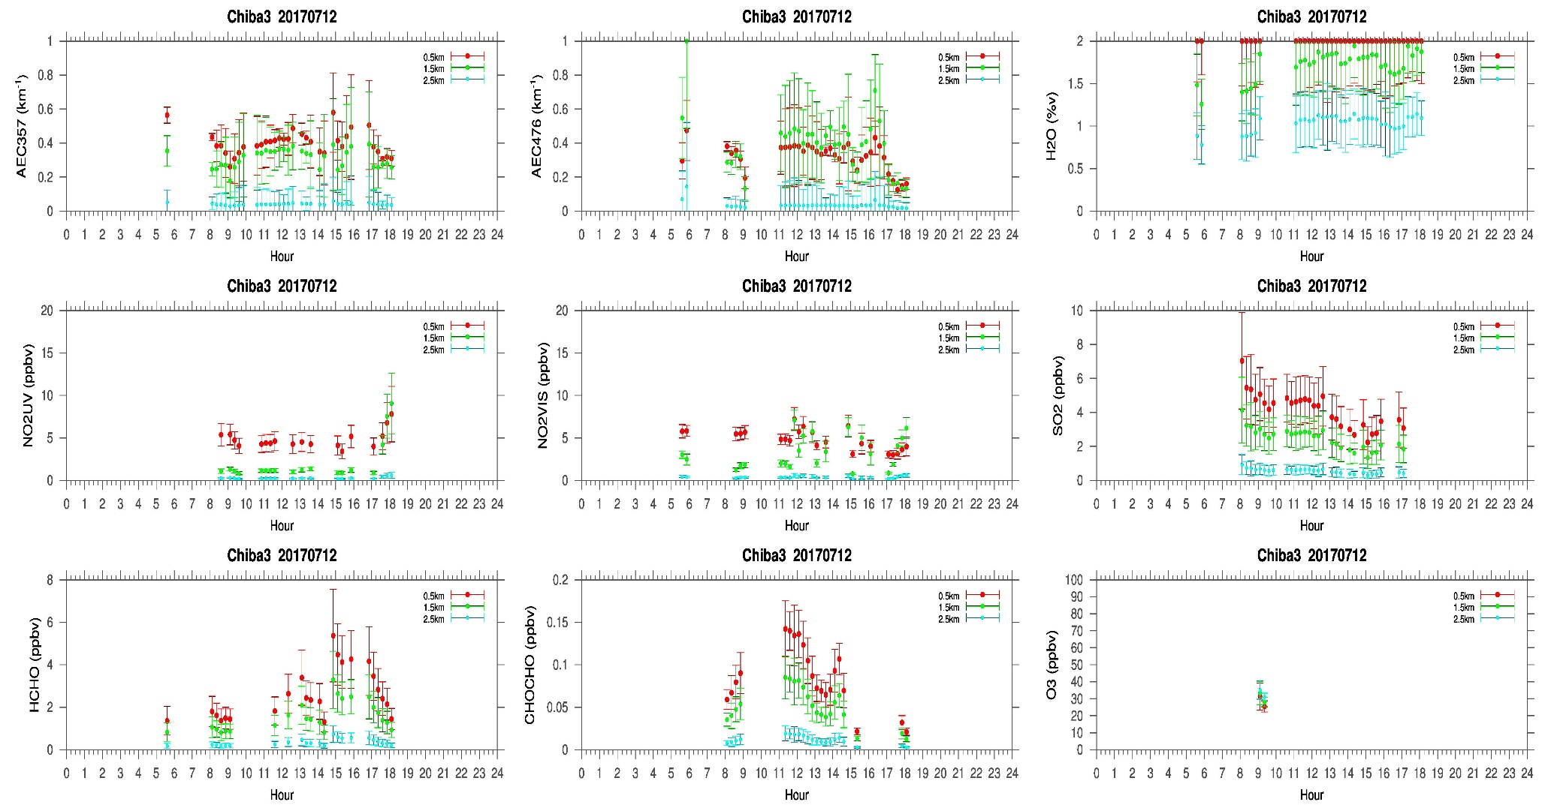
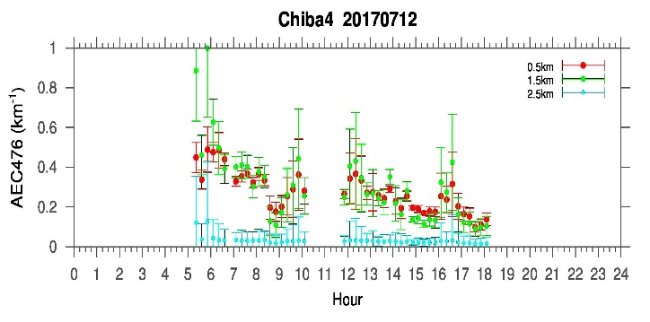
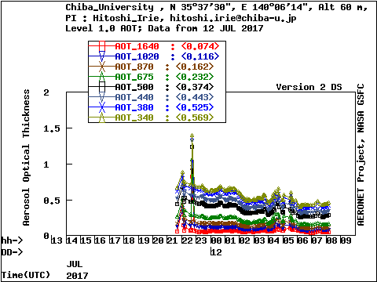
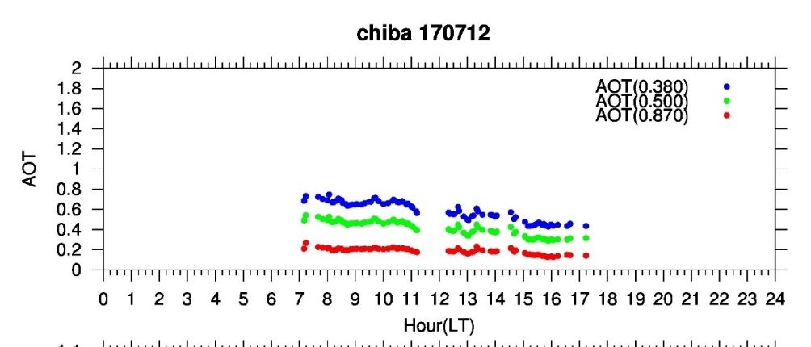

Slide 15
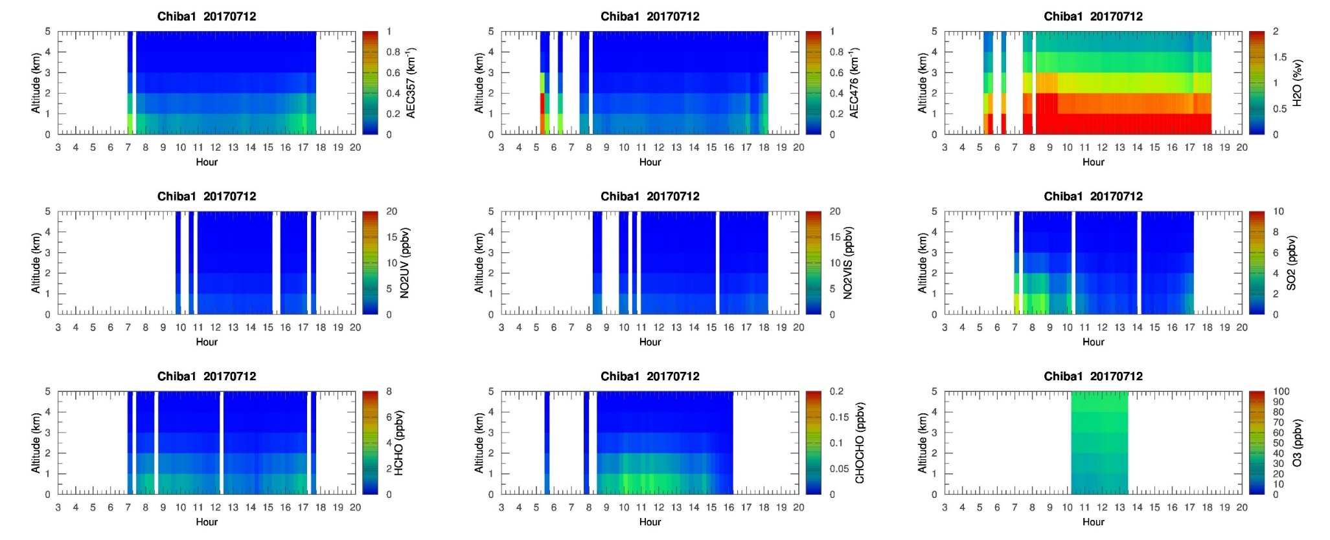
MAX-DOAS 1 (North)

Slide 16
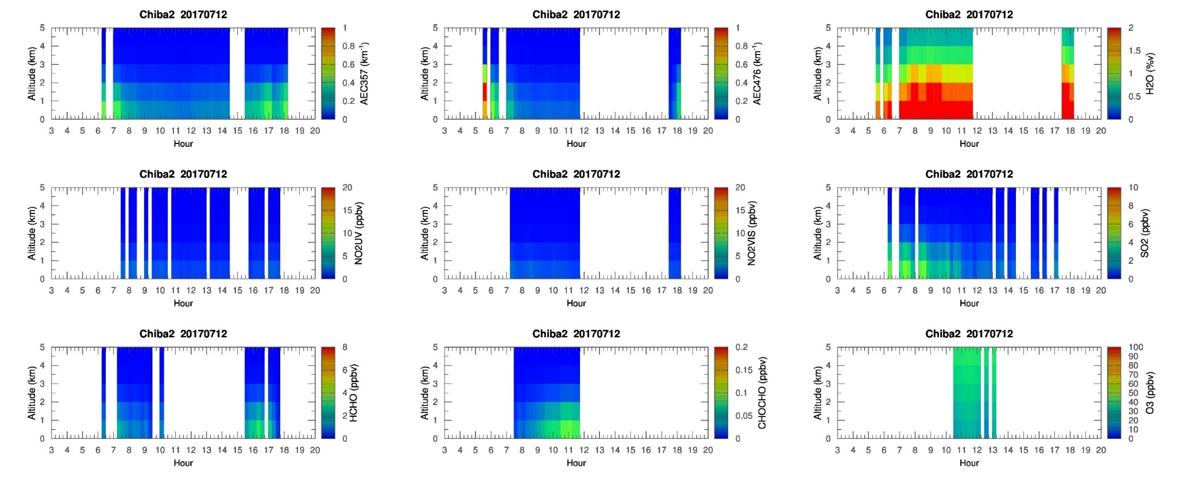
MAX-DOAS 2 (West)

Slide 17
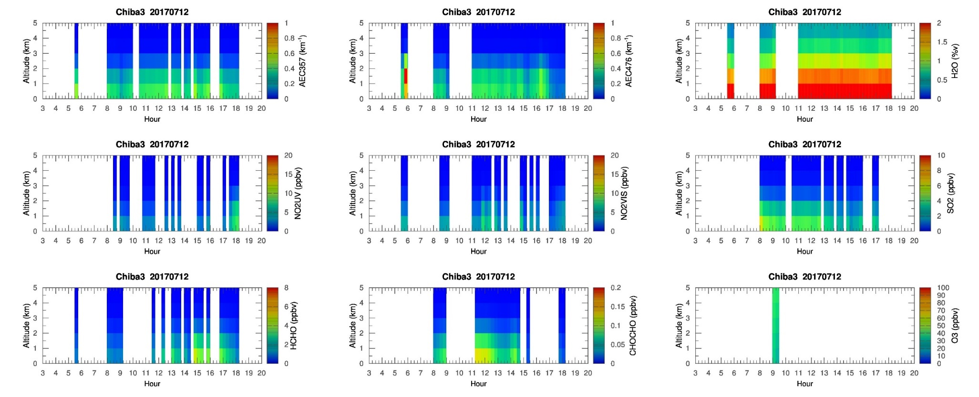
MAX-DOAS 3 (East)

Slide 18
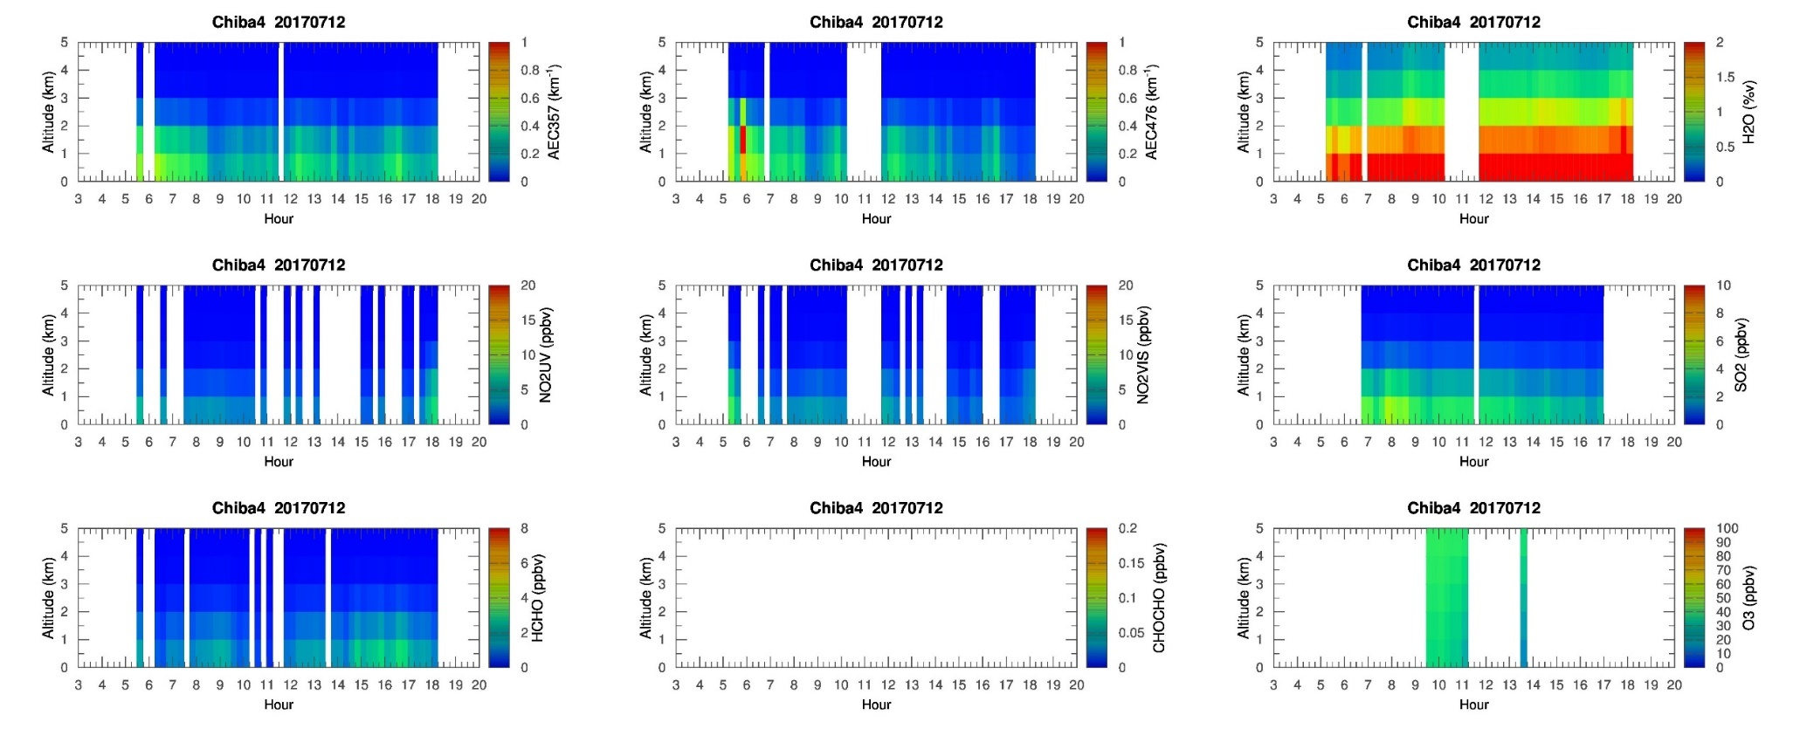
MAX-DOAS 4 (South)

Slide 19
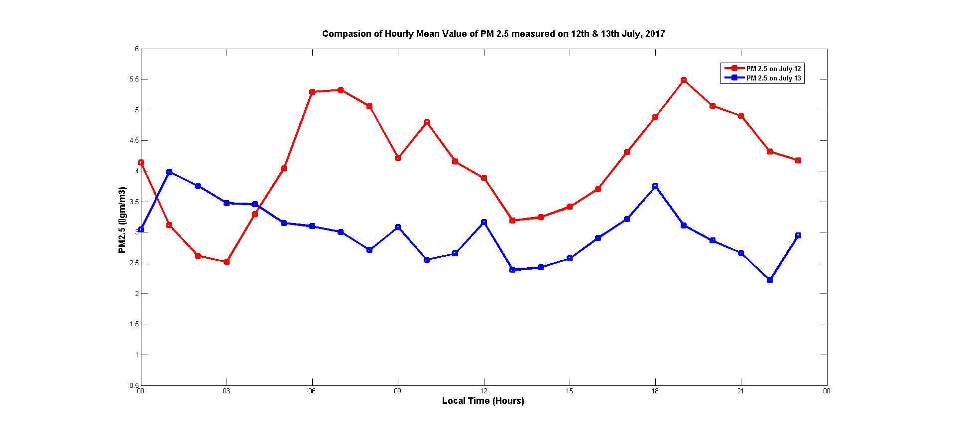
Scattering of PM 2.5 value measured on 12th & 13th July, 2017

Slide 20
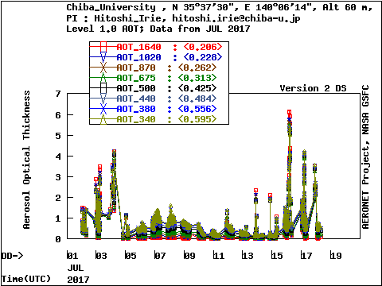
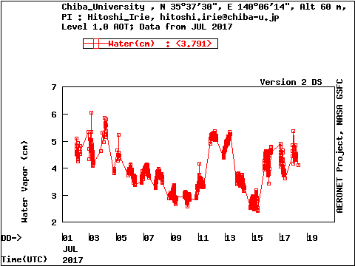

Slide 21
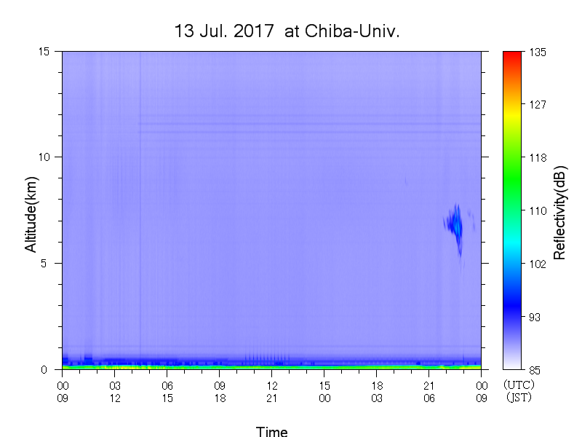

Slide 22
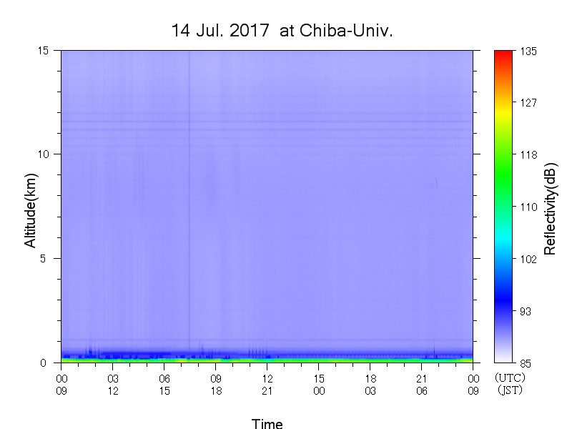

Slide 23
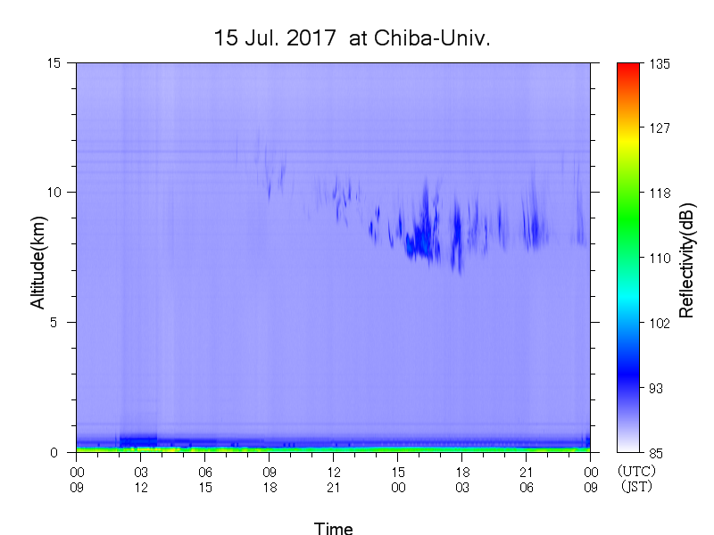

Slide 24
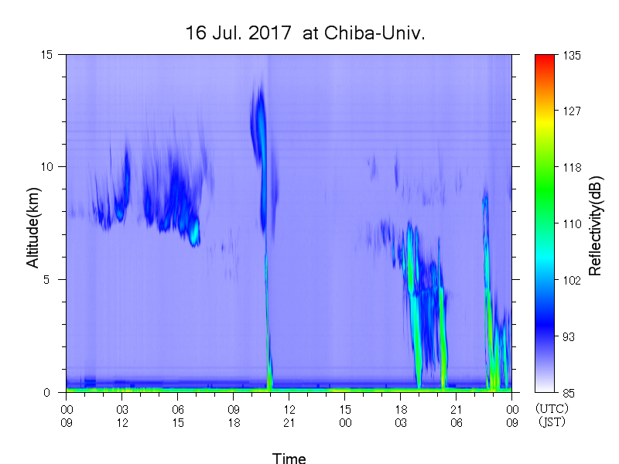

Slide 25
What to Do
Continue daily analysis.
Pyranometer comparisons under several conditions (e.g., without the RasPi CMP21, ...)
Check cloud interferences by clouds using whole-sky camera and lidar.
Characterization of Chiba’s atmospheric composition in July by using past MAX-DOAS data.
Seasonal variation in AOD and SSA.
Change in AOD and SSA before/after the end of rainy season.
Toward publications.

