Slide 1
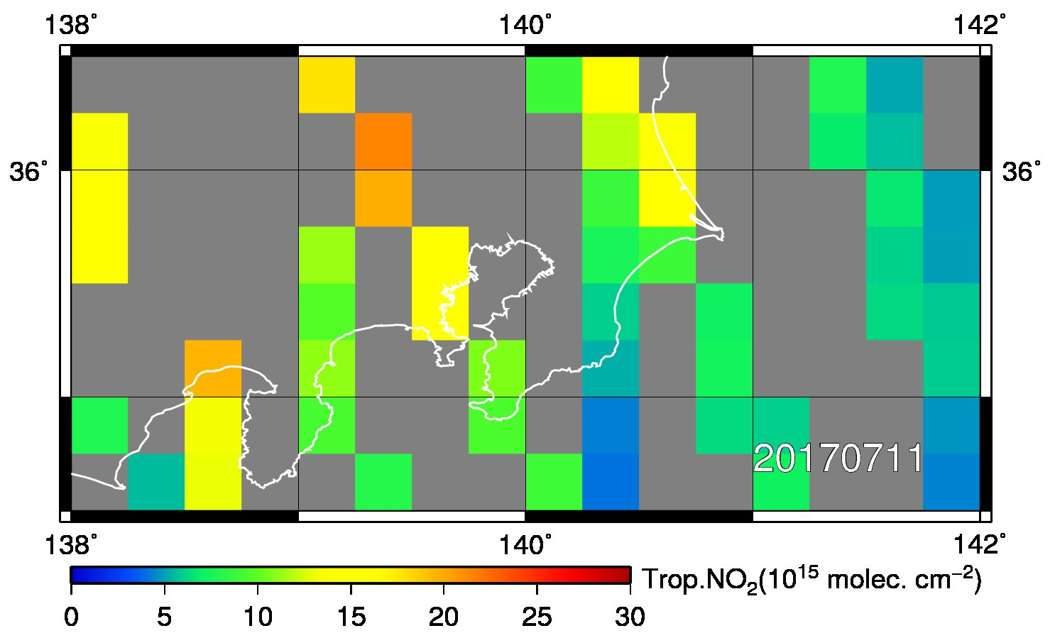
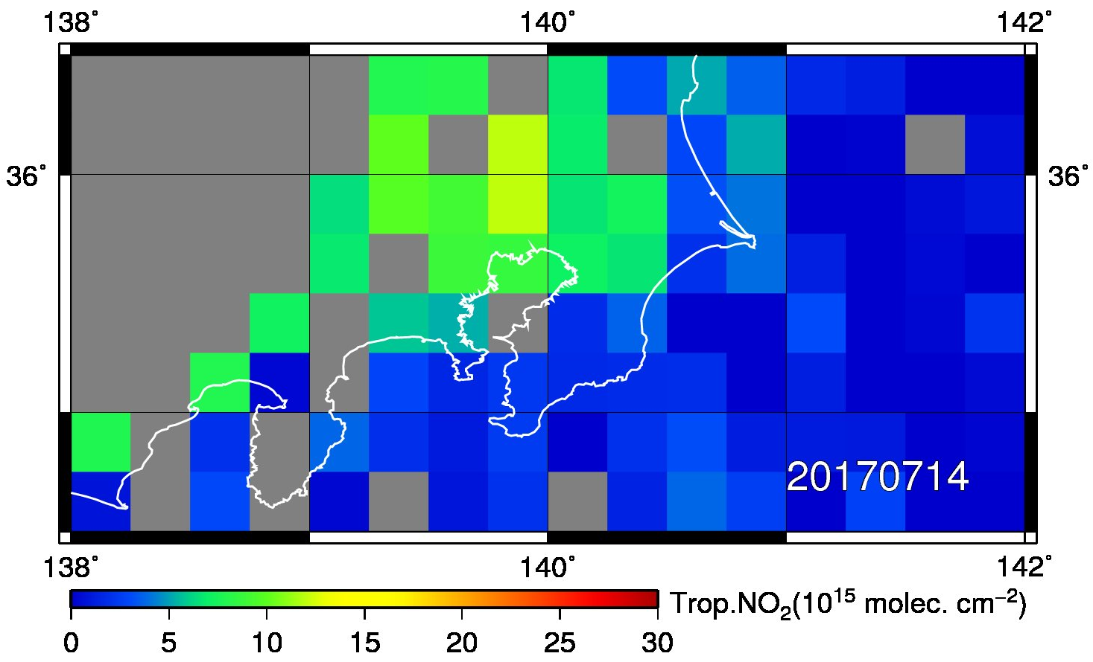
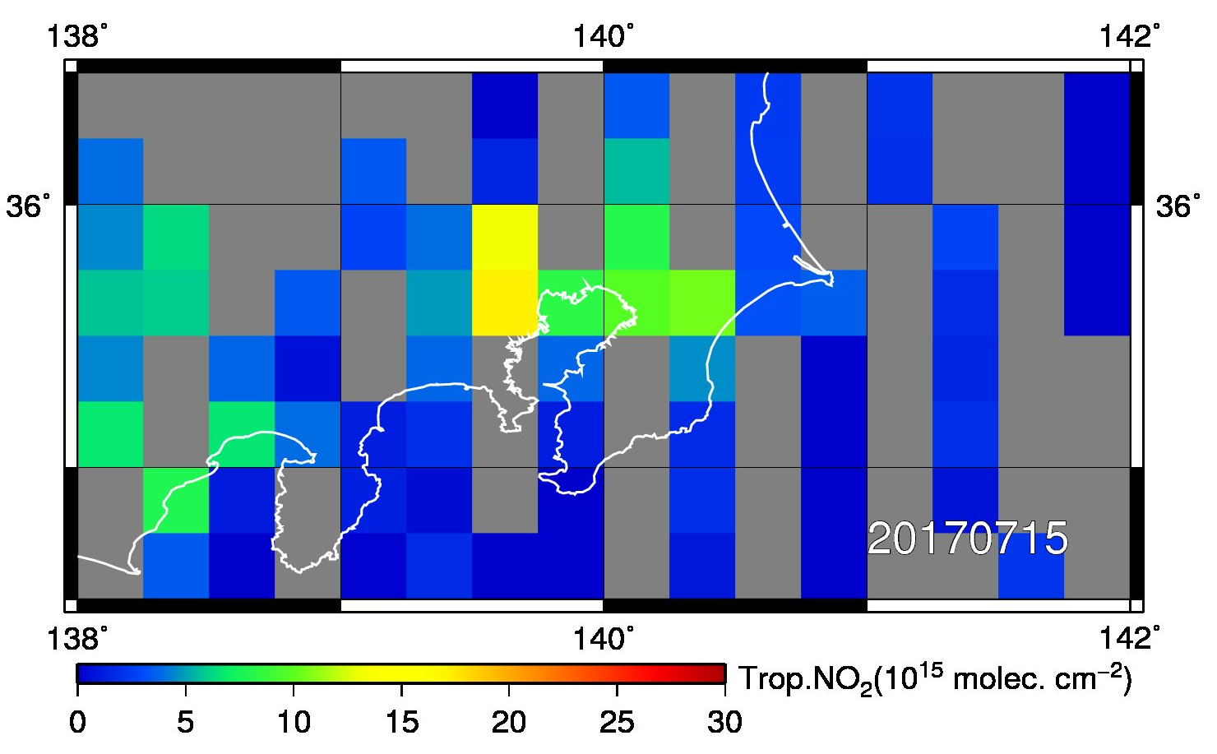
OMI tropospheric NO₂ maps
On July 12 and 13, no data is available around Kanto area due to clouds.

