Slide 1
Chiba Campaign 2017
ひまわりモニタ
fmt='%.18e'

Slide 2
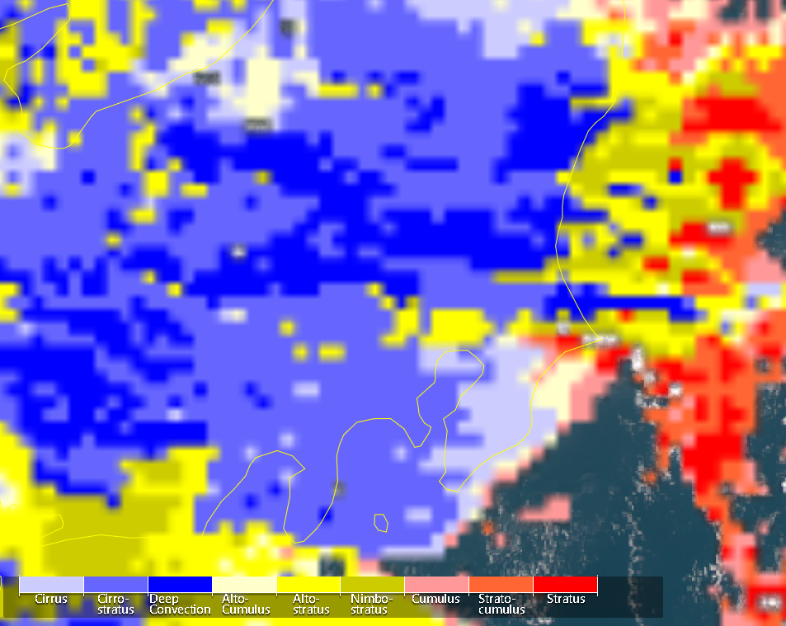
Cloud type Dec.4 at 12:00

Slide 3
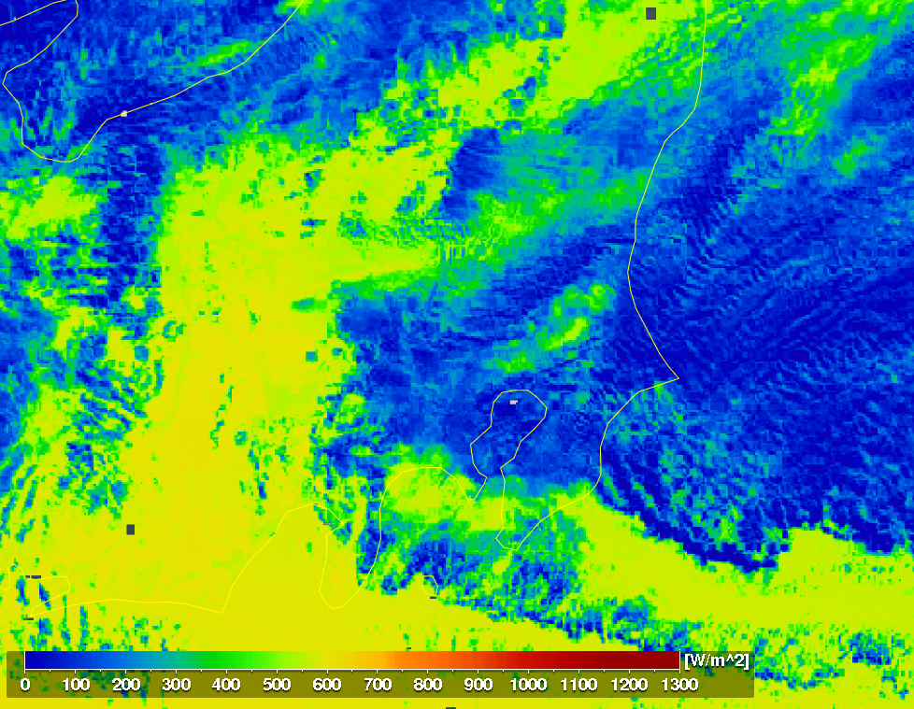
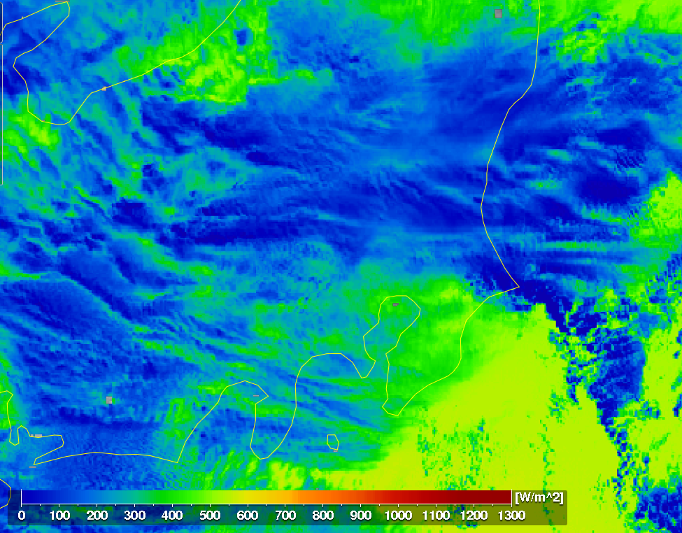
全天日射量 Dec.4 at 12:00

Slide 4
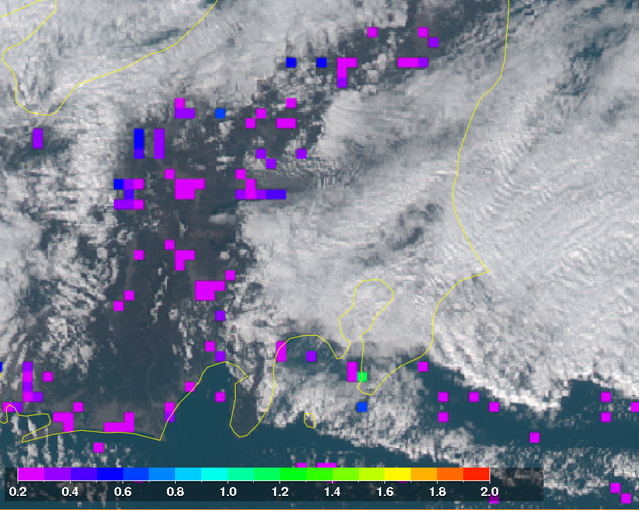
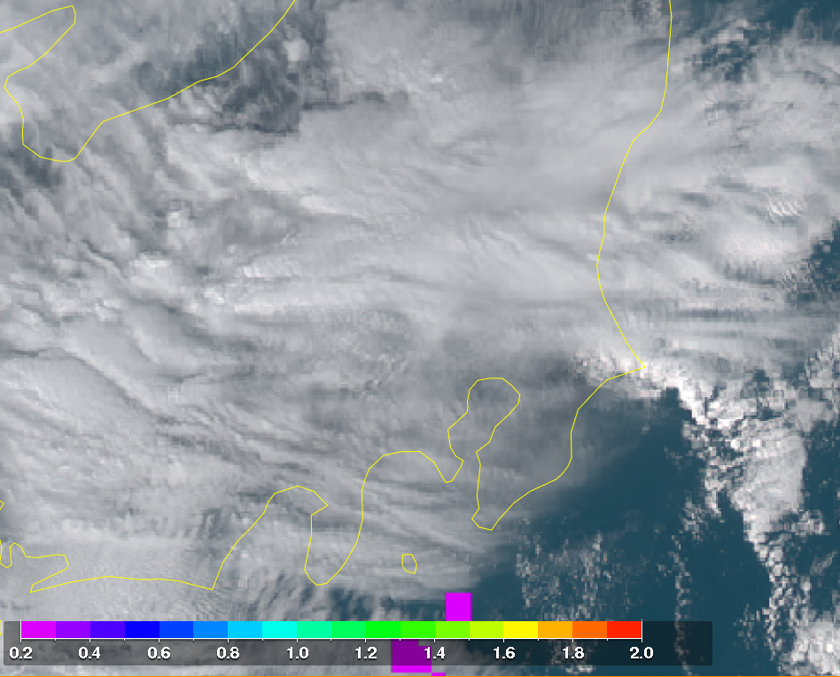
AOD Dec.4 at 12:00

