Slide 1
Chiba Campaign 2017
ひまわりモニタ
fmt='%.18e'

Slide 2
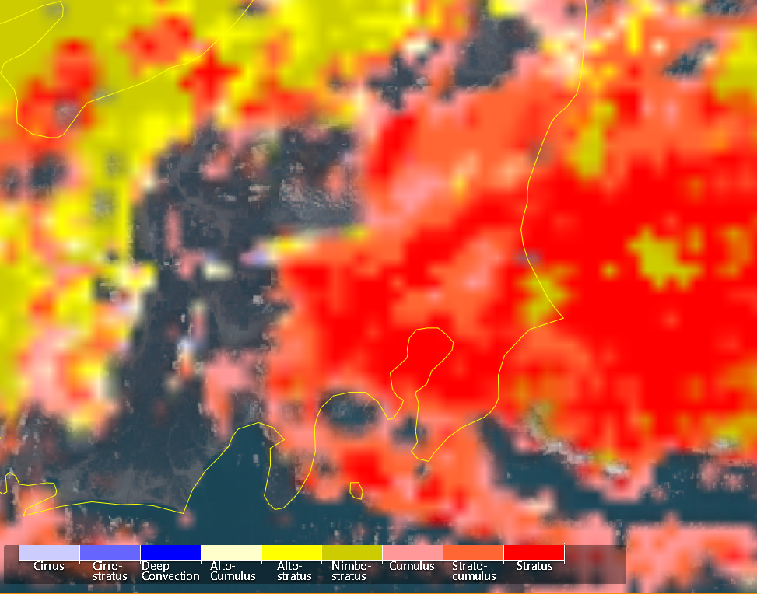
Cloud type Dec.1 at 12:00

Slide 3
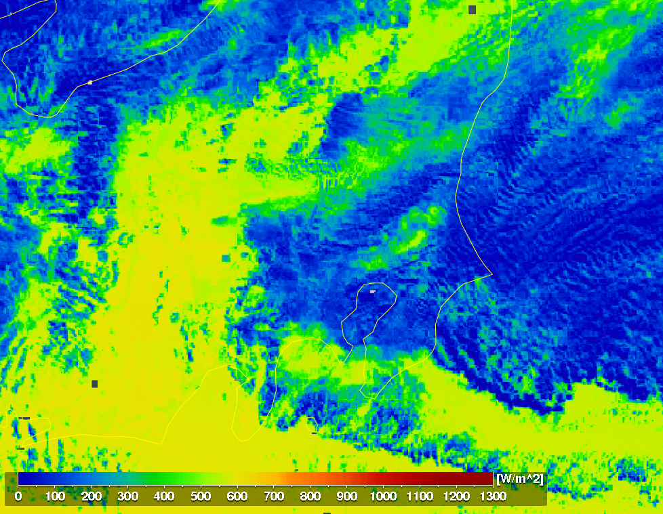
全天日射量 Dec.1 at 12:00

Slide 4
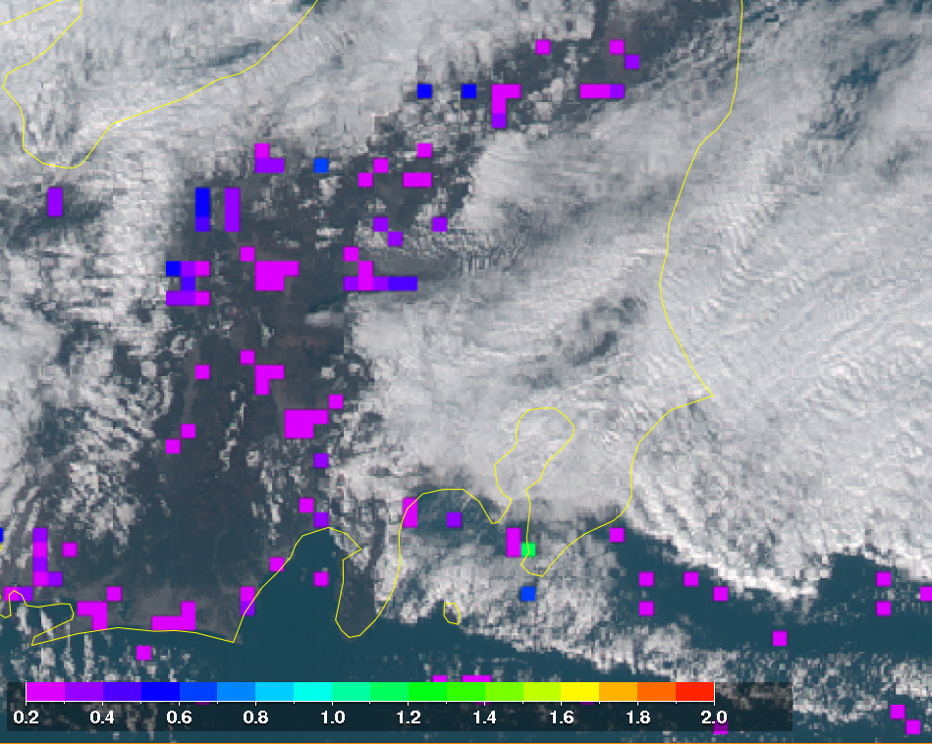
AOD Dec.1 at 12:00

