Slide 1
Chiba Campaign 2017
ひまわりモニタ
fmt='%.18e'

Slide 2
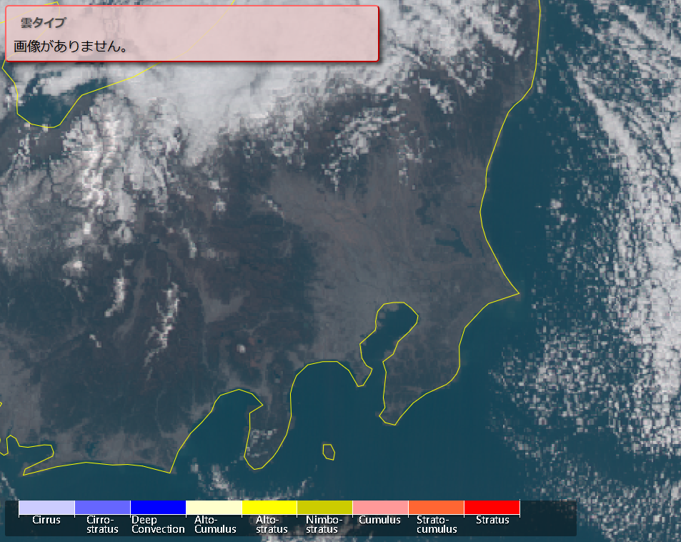
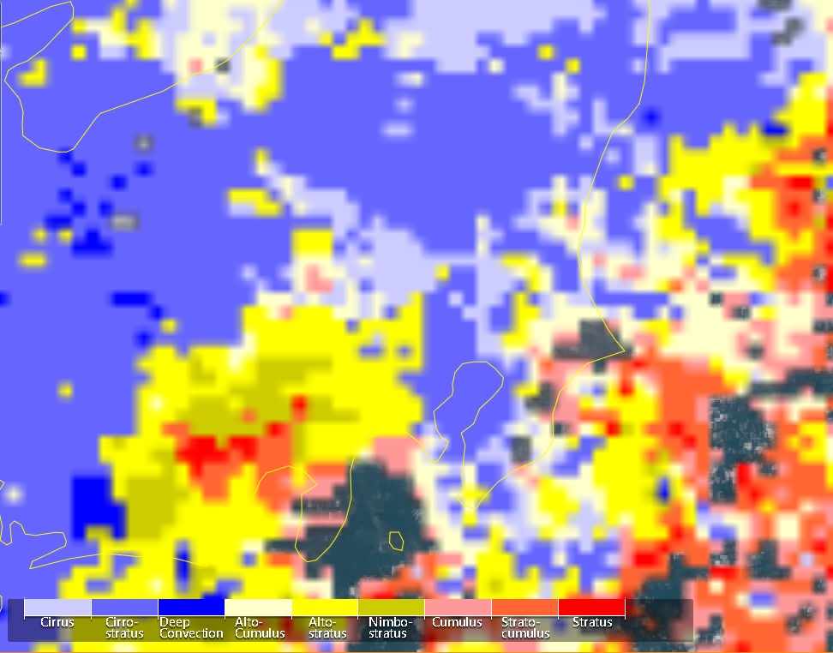
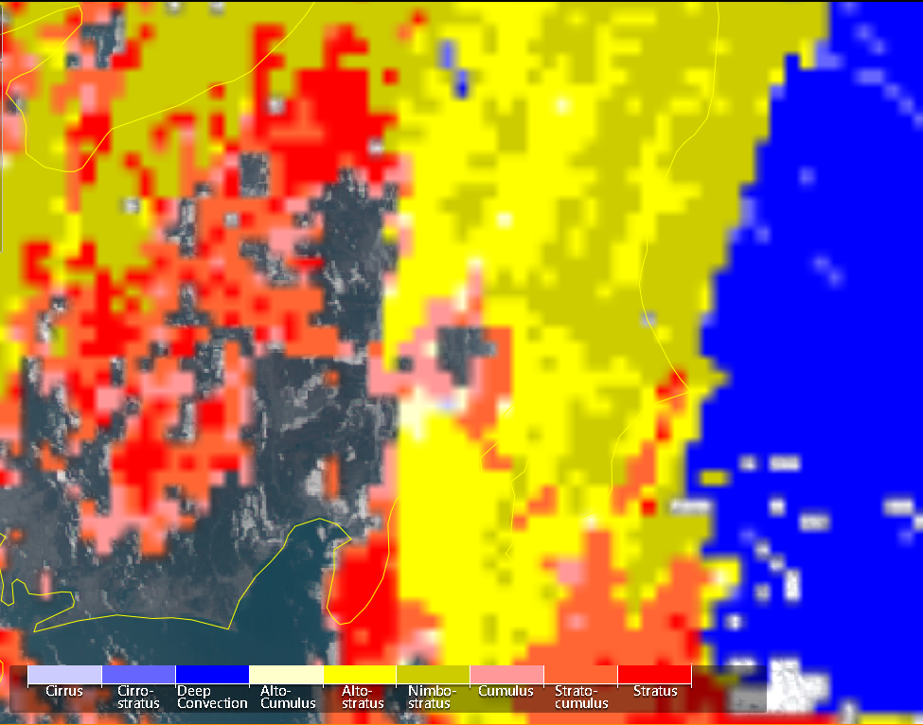
Cloud type Nov.23 at 12:00

Slide 3
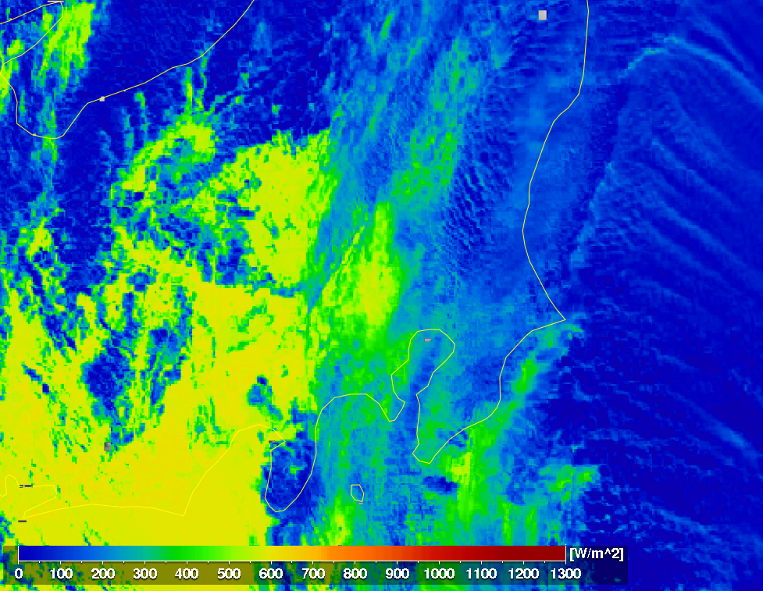
全天日射量 Nov.23 at 12:00

Slide 4
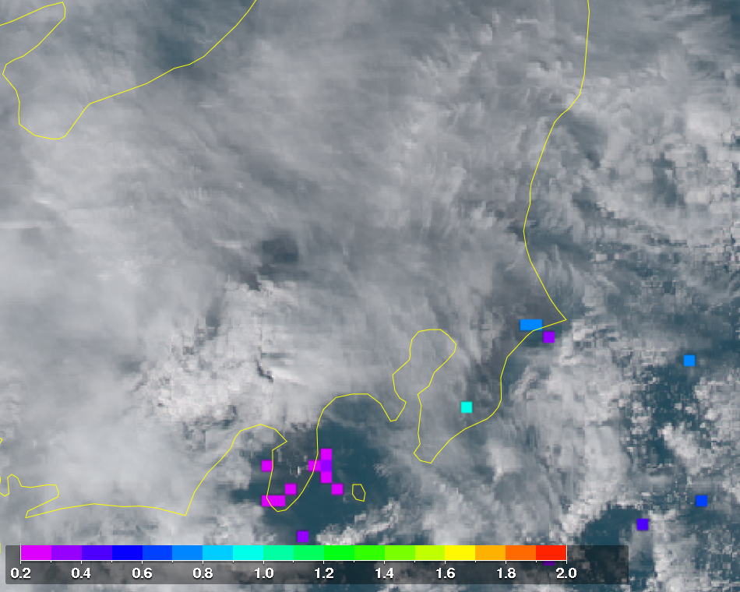
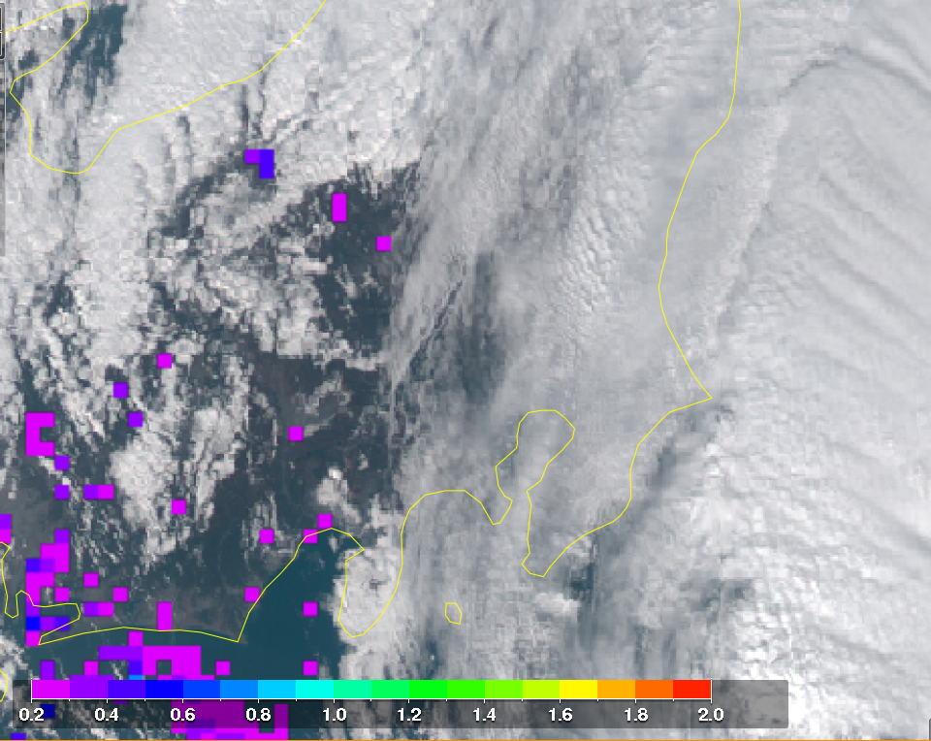
AOD Nov.23 at 12:00

Slide 5
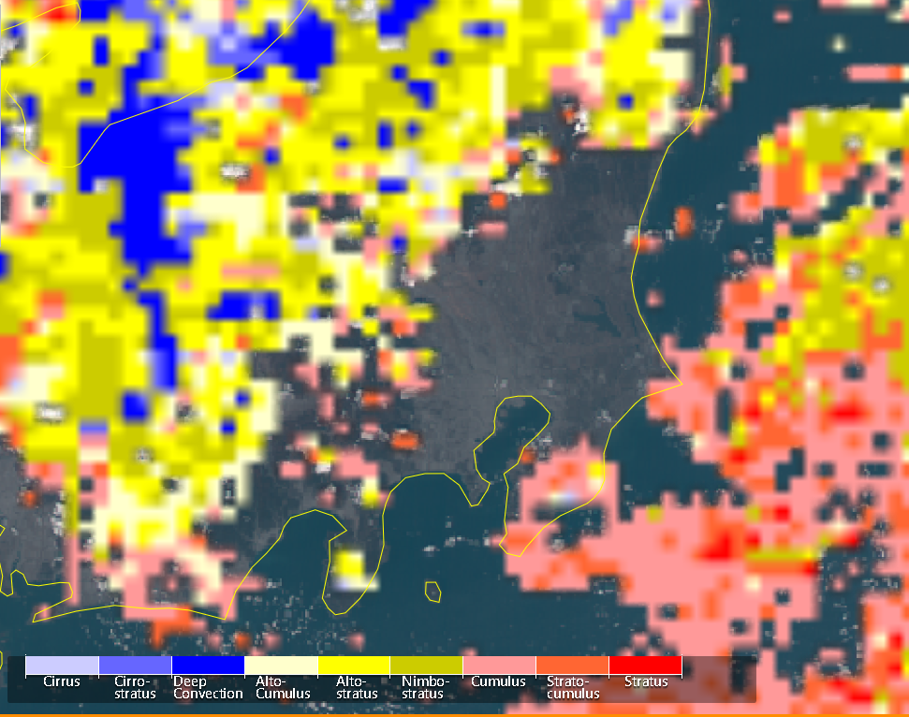
Cloud type Nov.24 at 12:00

Slide 6
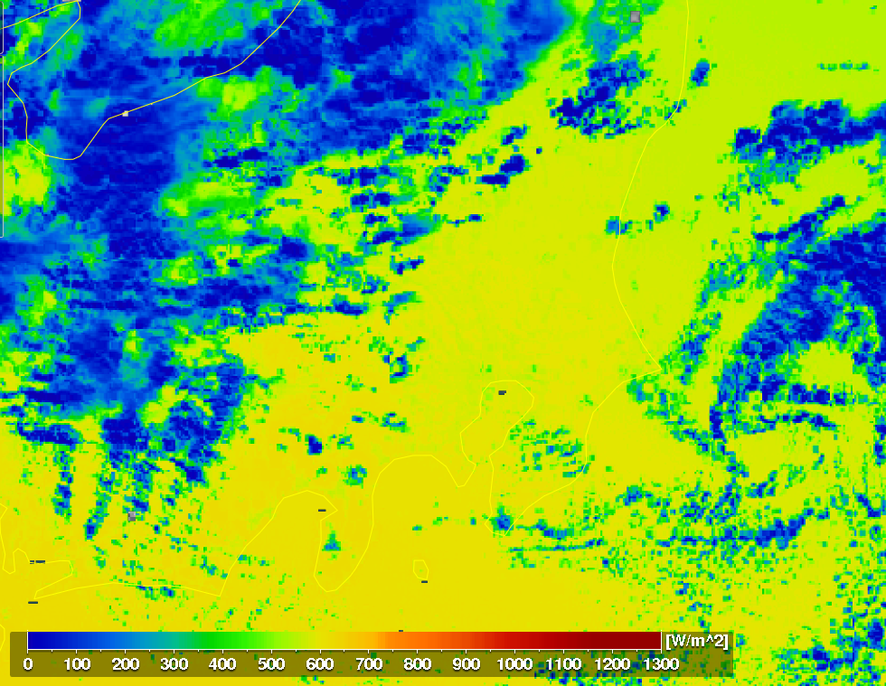
全天日射量 Nov.24 at 12:00

Slide 7
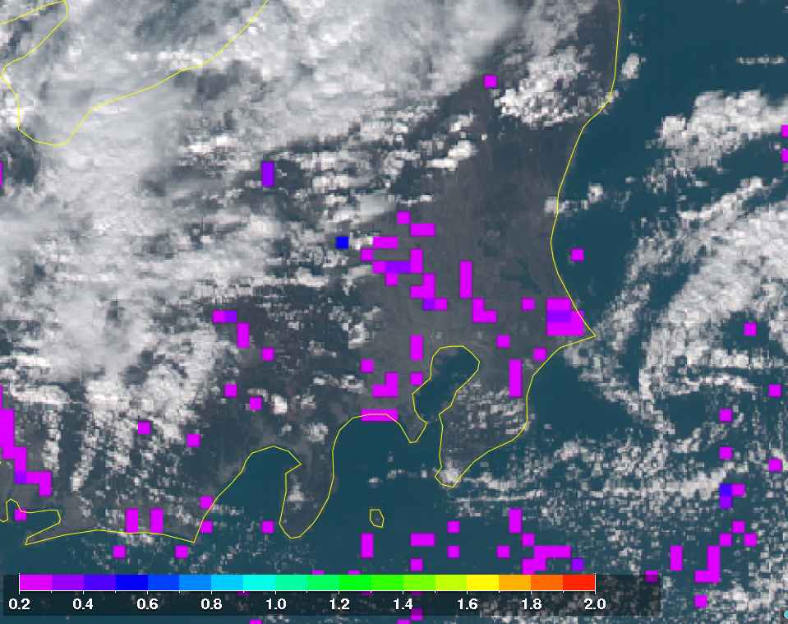
AOD Nov.24 at 12:00

