Slide 1
Chiba Campaign 2017
ひまわりモニタ
fmt='%.18e'

Slide 2
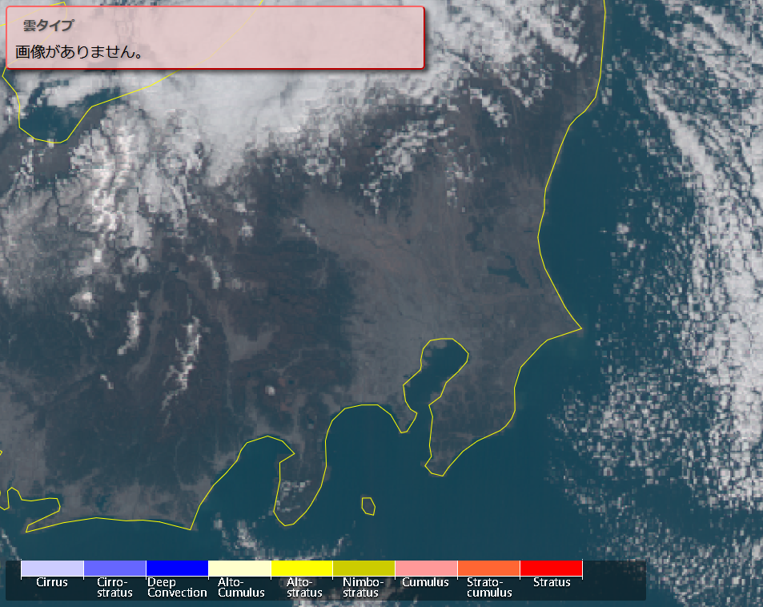
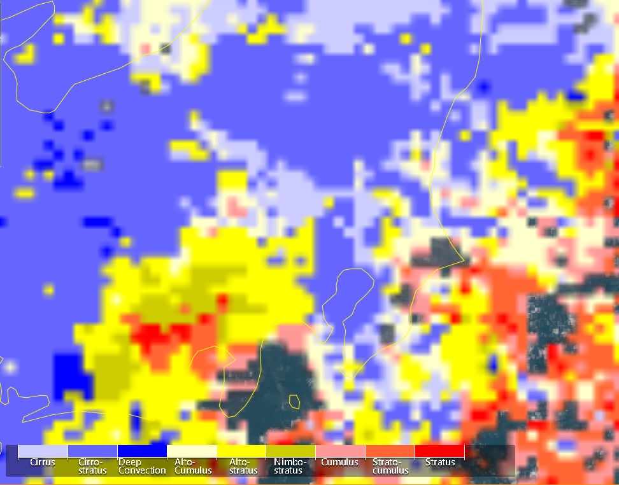
Cloud type Nov.22 at 12:00

Slide 3
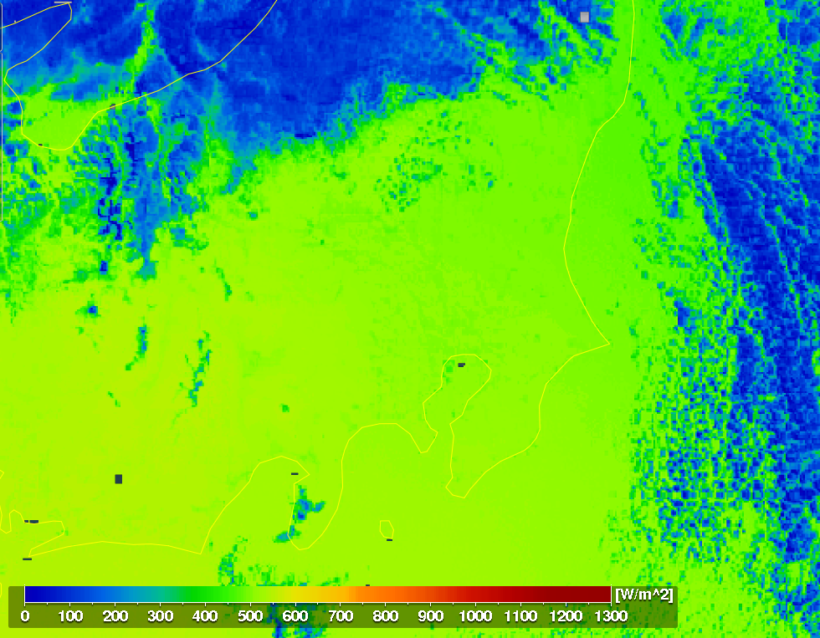
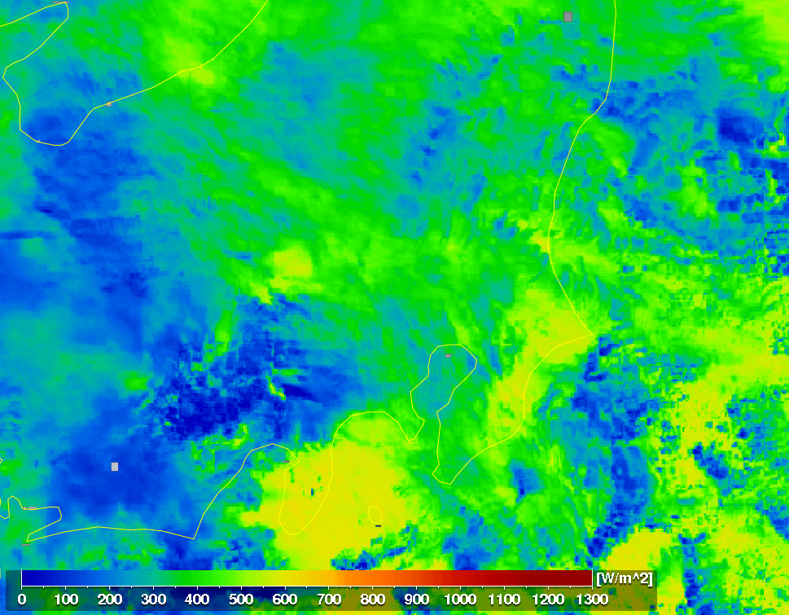
全天日射量 Nov.22 at 12:00

Slide 4
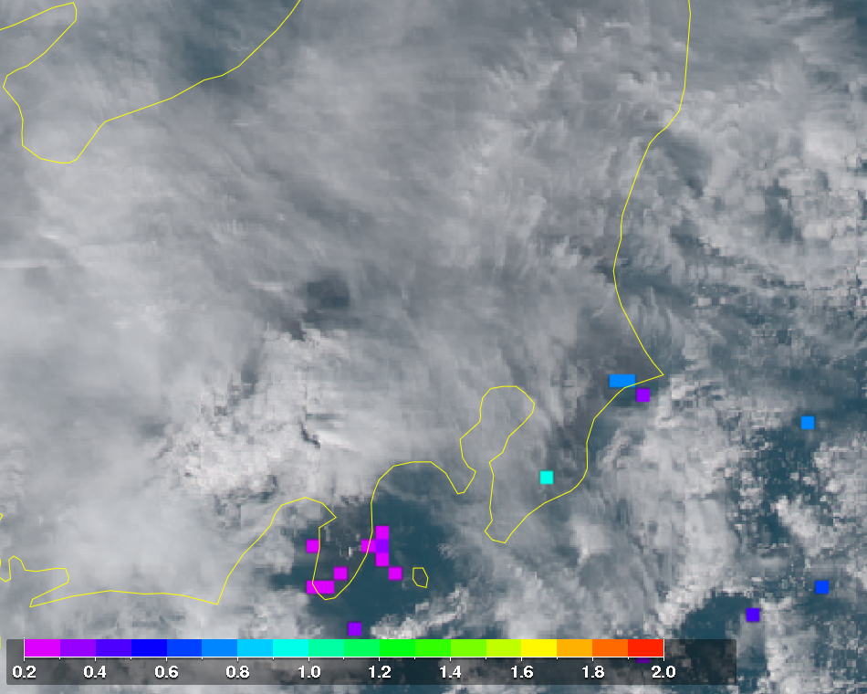
AOD Nov.22 at 12:00

