Slide 1
Chiba Campaign 2017
ひまわりモニタ

Slide 2
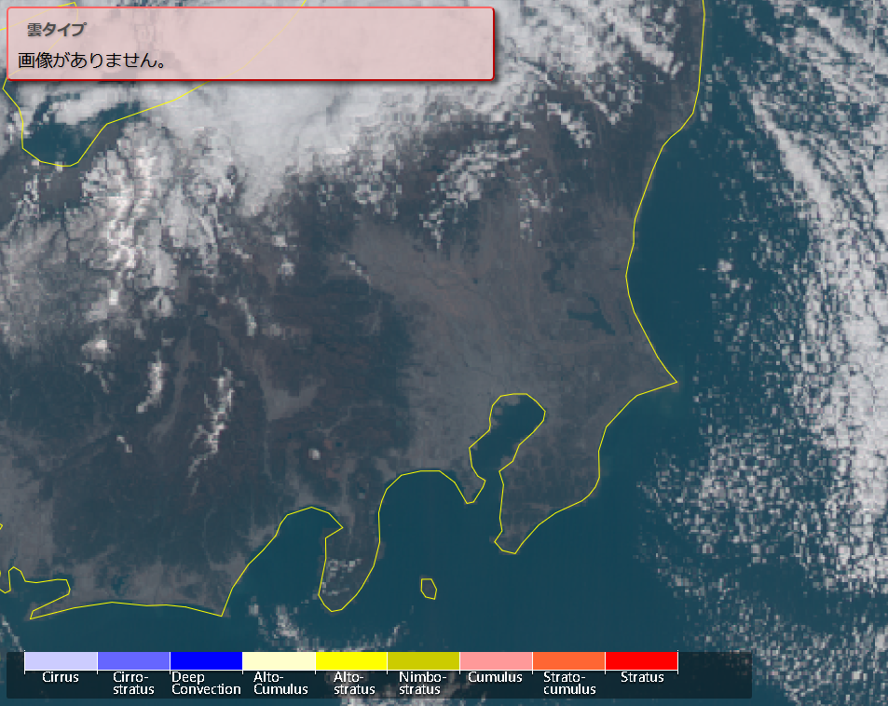
Cloud type Nov.21 at 12:00

Slide 3
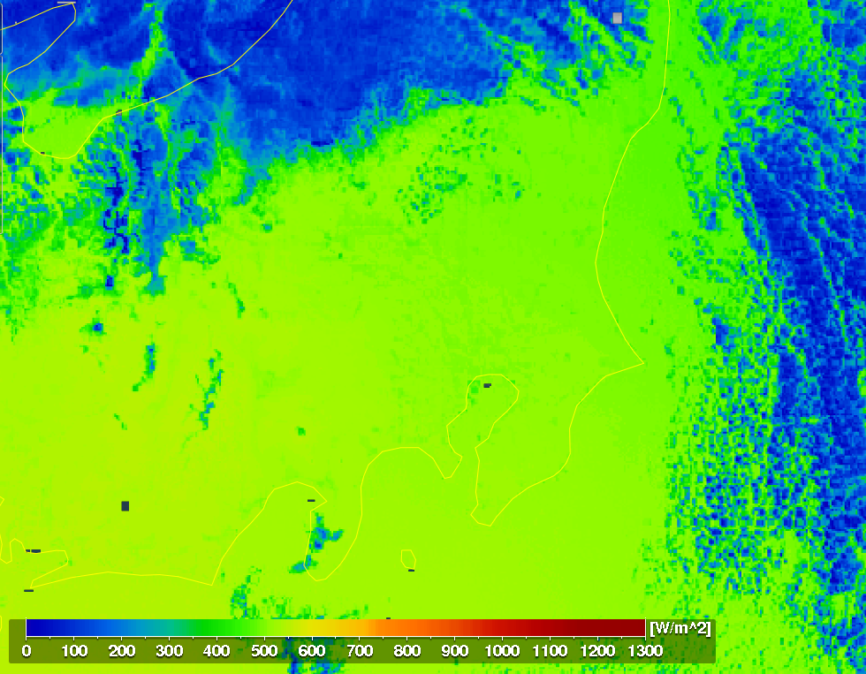
全天日射量 Nov.21 at 12:00

Slide 4
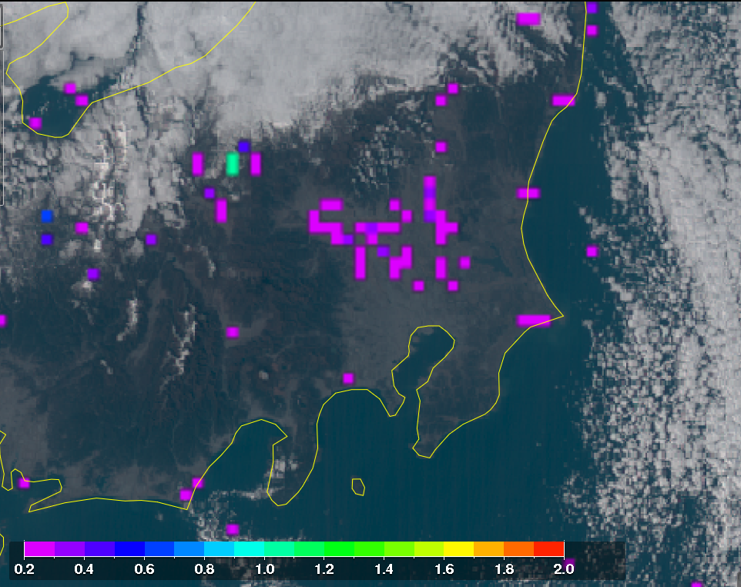
AOD Nov.21 at 12:00

