Slide 1
Chiba Campaign 2017
ひまわりモニタ

Slide 2
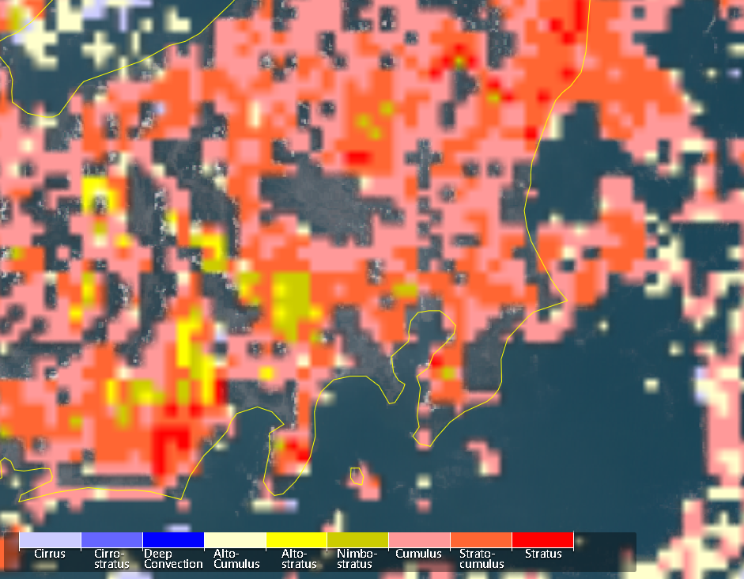
Cloud type Jul.19 at 12:00

Slide 3
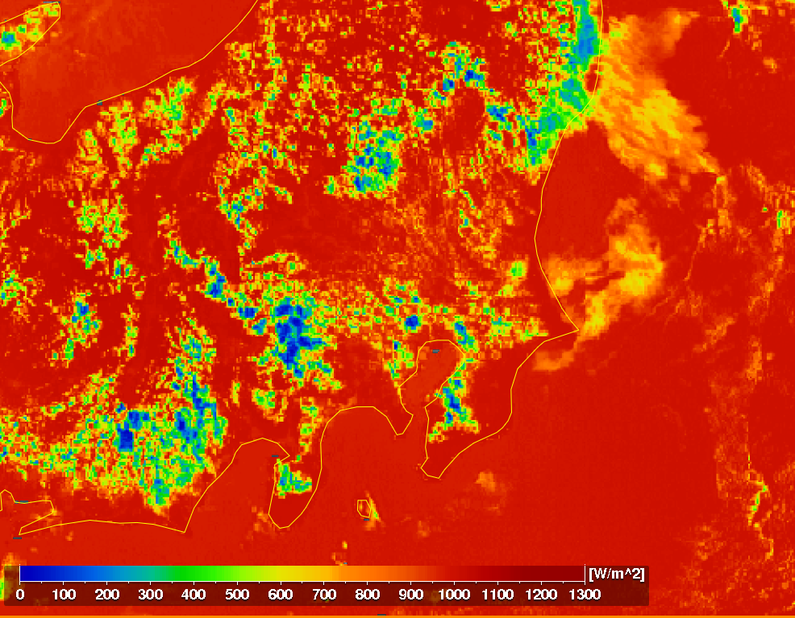
全天日射量 Jul.19 at 12:00

Slide 4
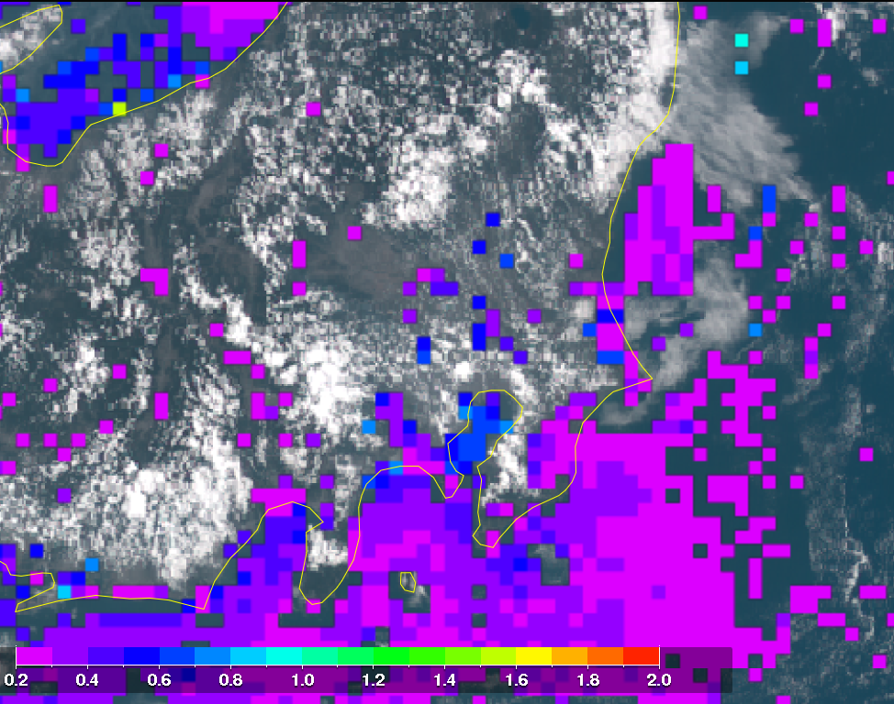
AOD Jul.19 at 12:00

