Slide 1
MAX-DOAS 2d plots for Chiba Campaign 2017 Observation day 11: 07/21/2017 Hoque

Slide 2
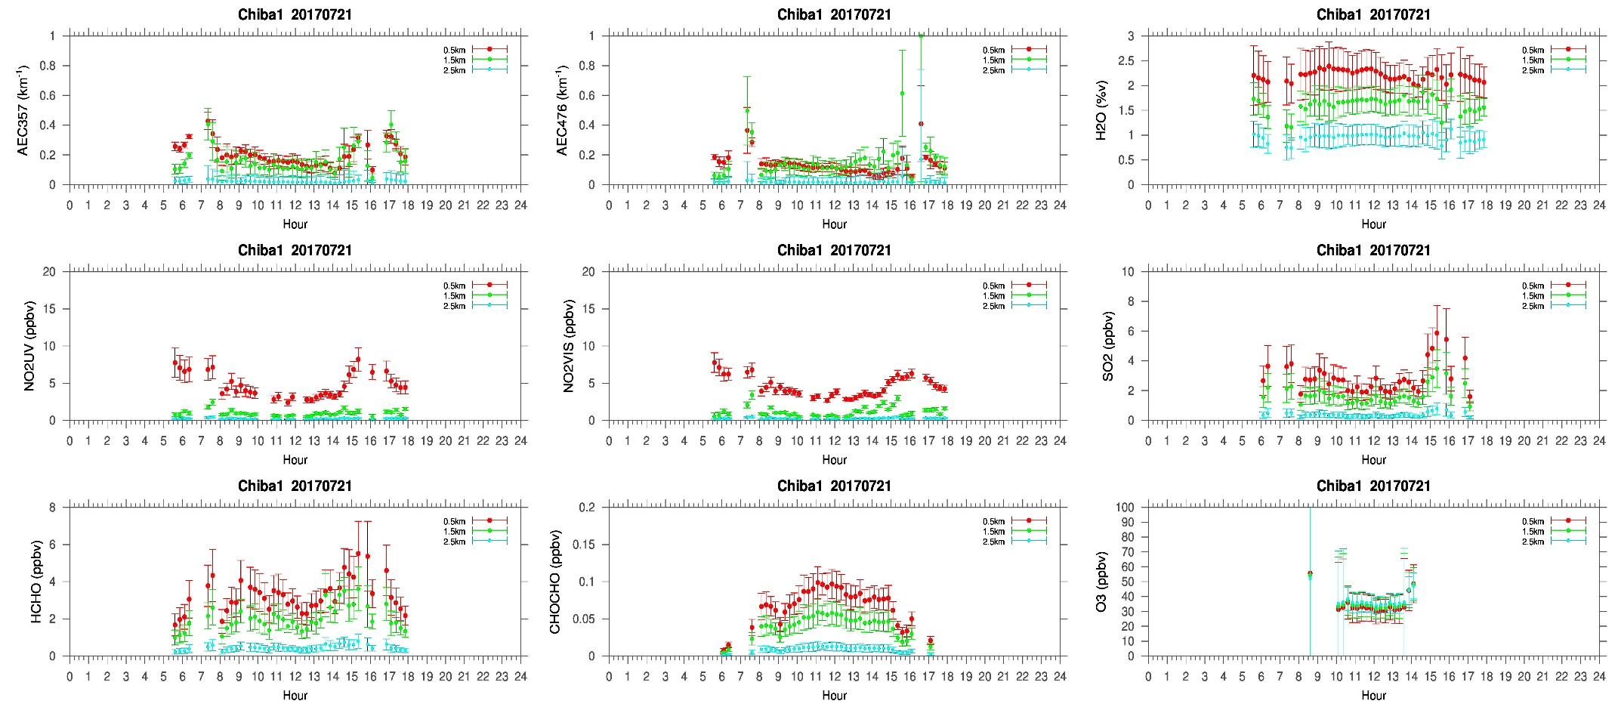
MAX-DOAS#1, North Direction

Slide 3
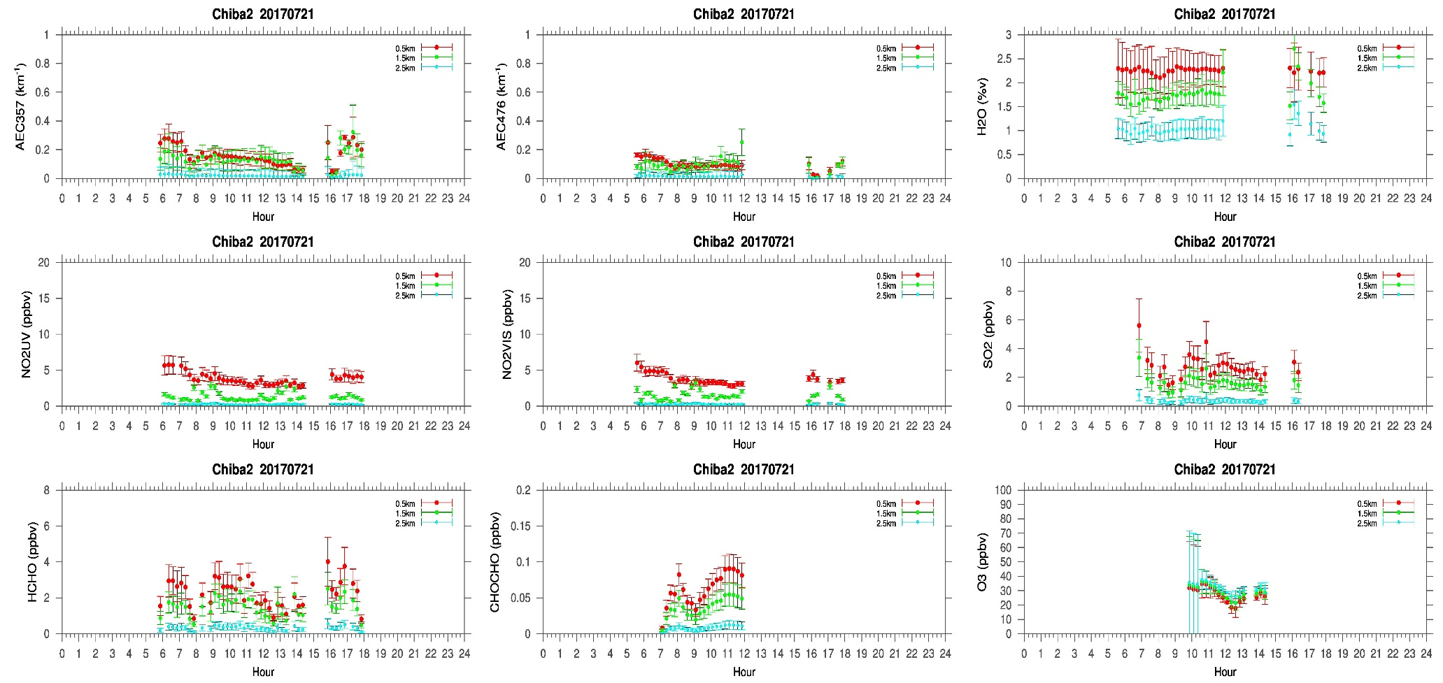
MAX-DOAS#2, West Direction

Slide 4
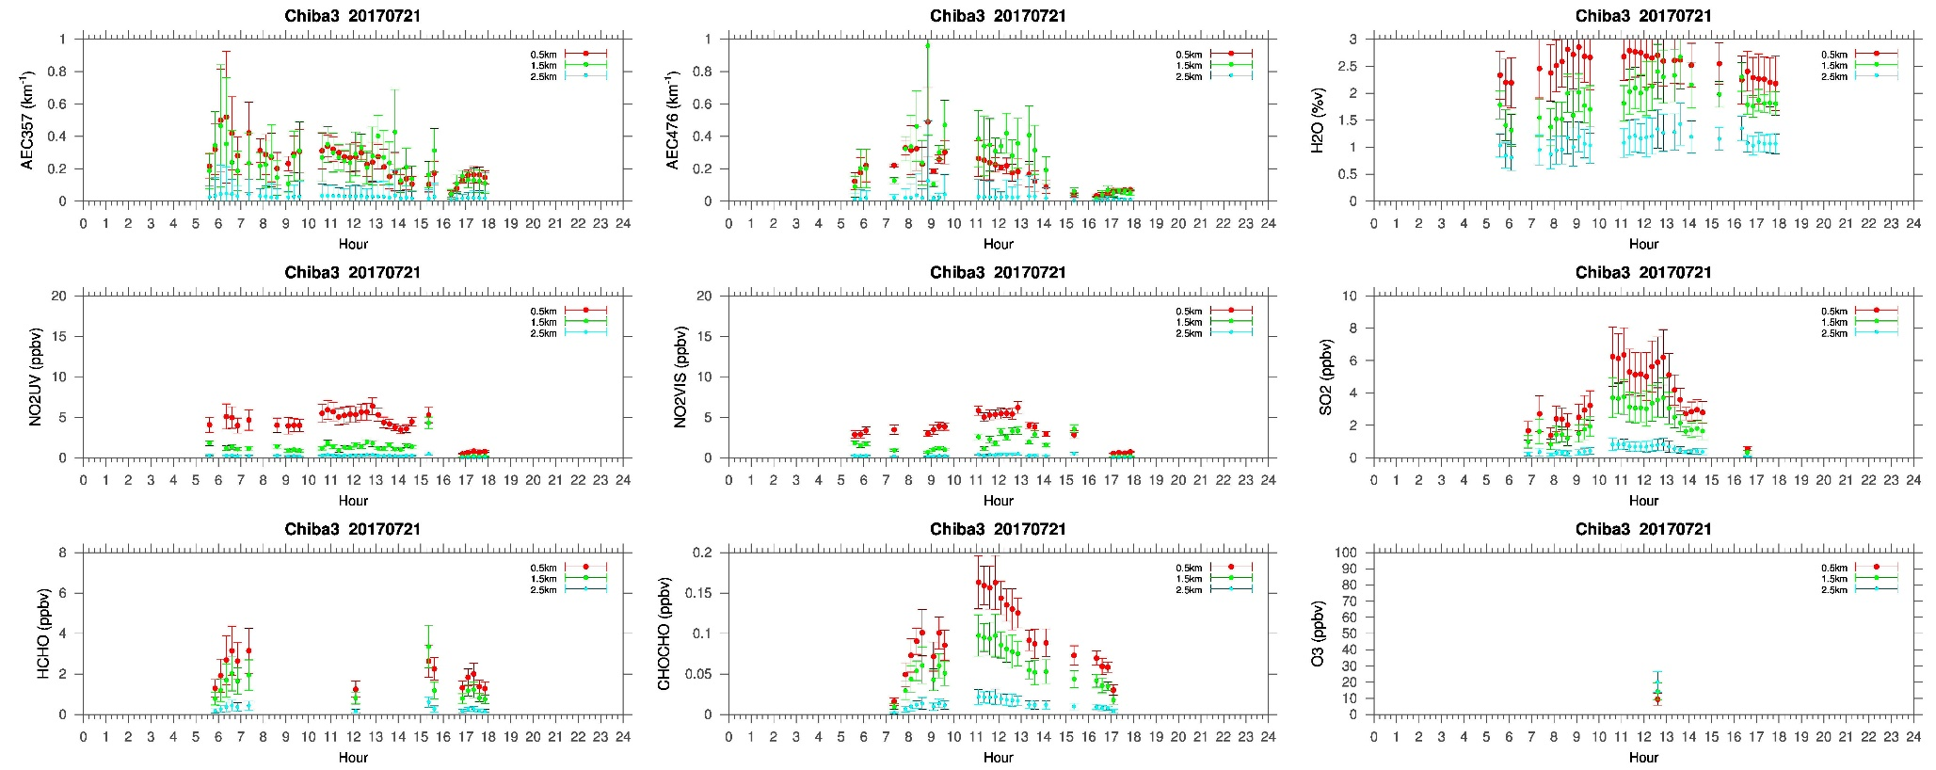
MAX-DOAS#3, East Direction

Slide 5
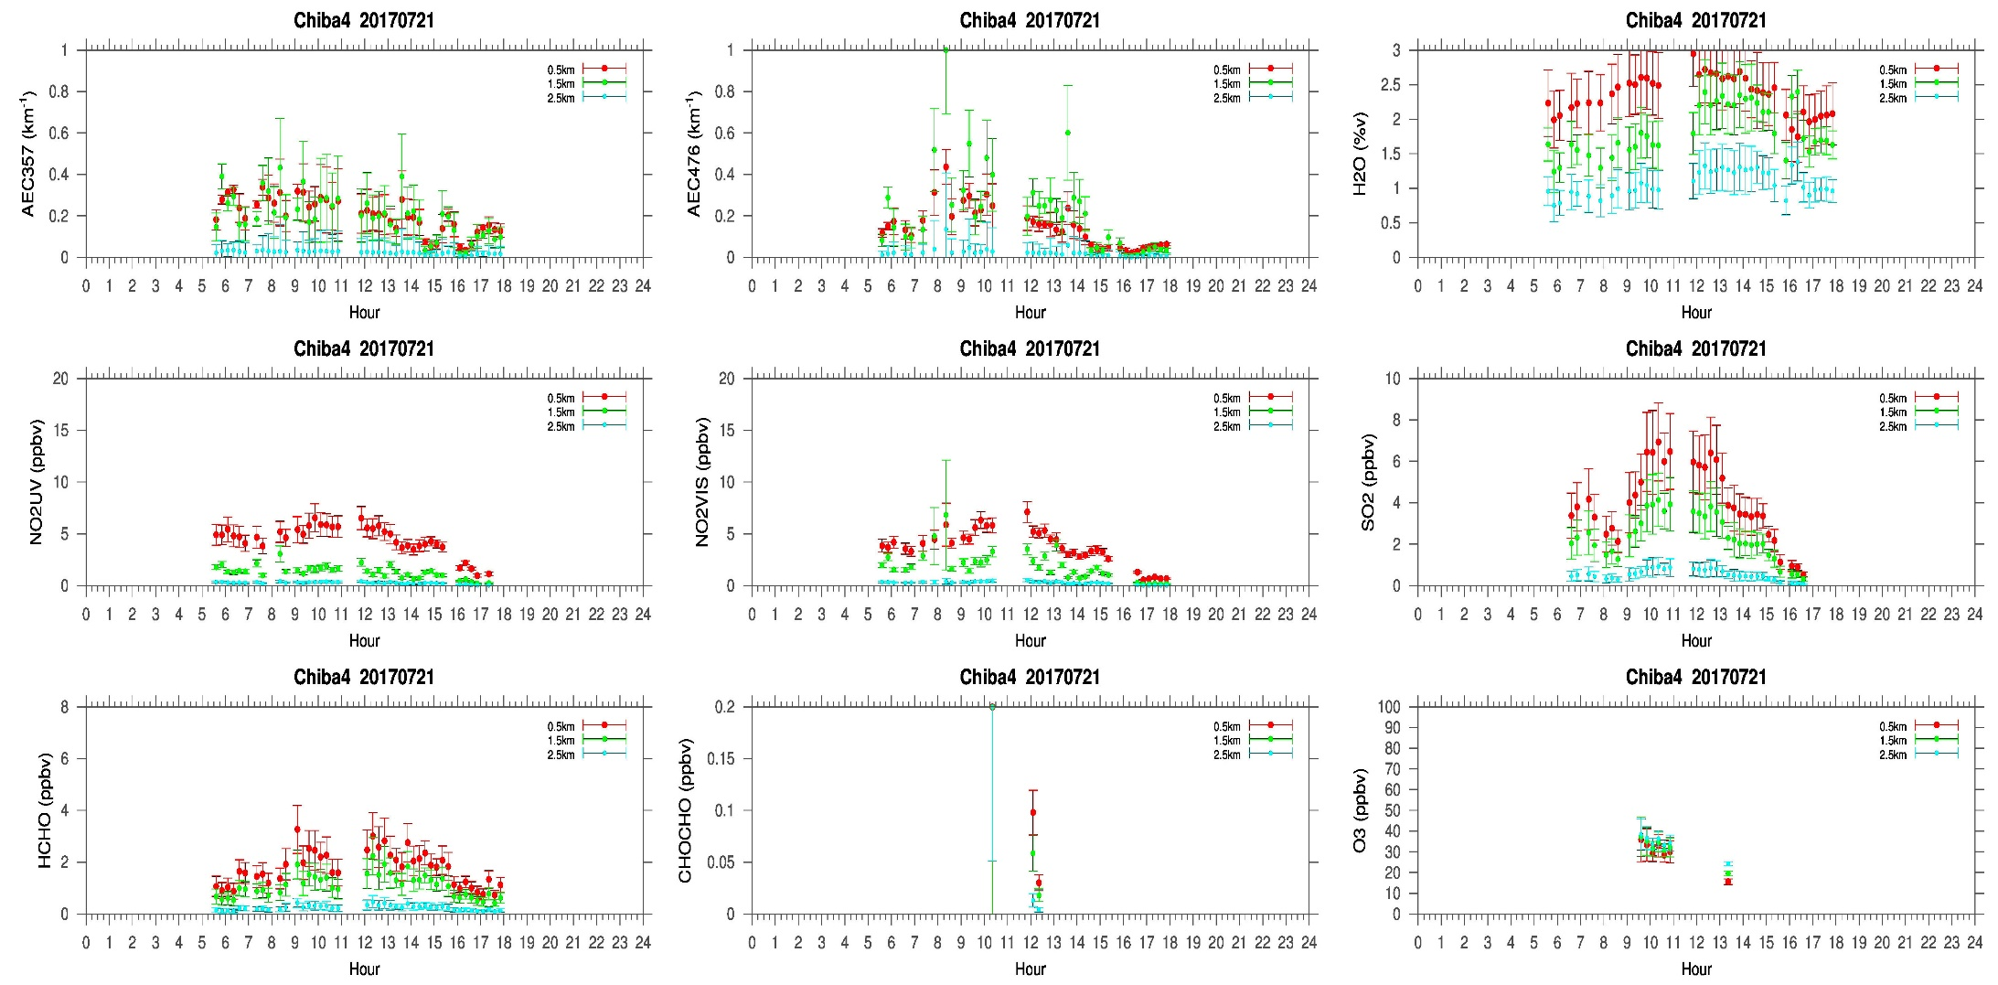
MAX-DOAS#4, South Direction

Slide 6
Comments after a quick look of the plots
Not a very clear day. Mostly clouds were observed after noon and the cloud height was below 2km. The AEC distribution in the north (#1) and west (#2) direction were different compared to the east(#3) and south (#4) direction. The AOT distribution from the NASA sun photometer and Sky radiometer were similar to the pattern we observed in the north (#1) and west (#2) direction of the 4AZ MAX-DOAS system. The SO2 concentration was also higher in the east(#3) and south (#4) direction, although the NO2 concentration were same (~5ppbv) in the all 4 directions. Therefore, the first guess is the influence of some anthropogenic activities in the respective directions. PM2.5 prediction by Yumimoto san, showed that on 21st the PM2.5 concentration will be higher. The animation by Yumimoto san also shows that, such influence is coming from the south of Tokyo and mostly affecting the eastern . We also observe a higher SO2 concentration in south (#4) and east (#3) direction. So, such influence could be the reason of different temporal distribution of the SO2 and AEC in the east and south direction.

