Slide 1
MAX-DOAS 2d plots for Chiba Campaign 2017
Observation day 9: 07/19/2017
Hoque

Slide 2
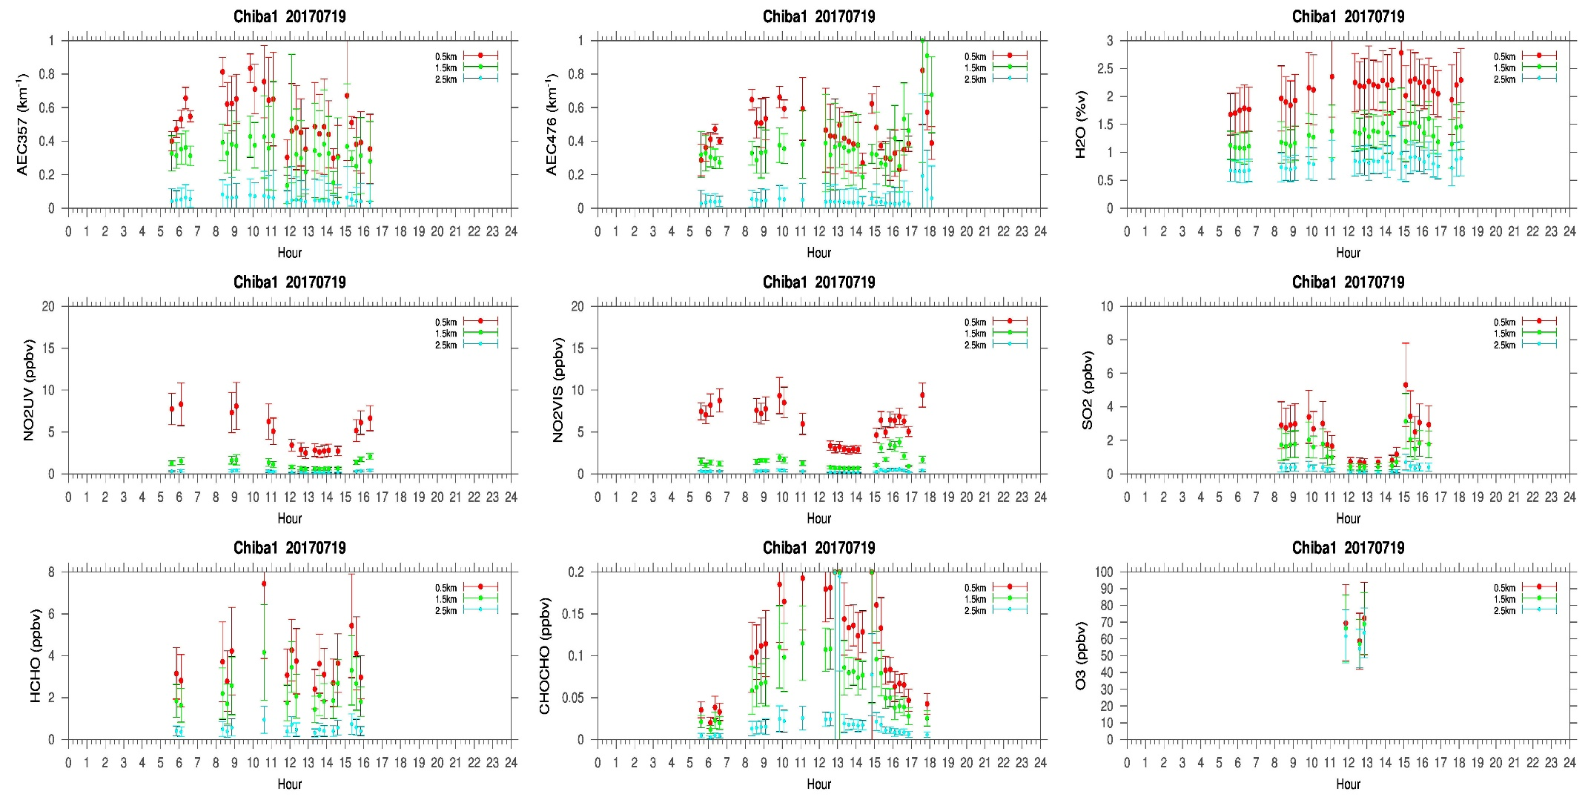
MAX-DOAS#1, North Direction

Slide 3
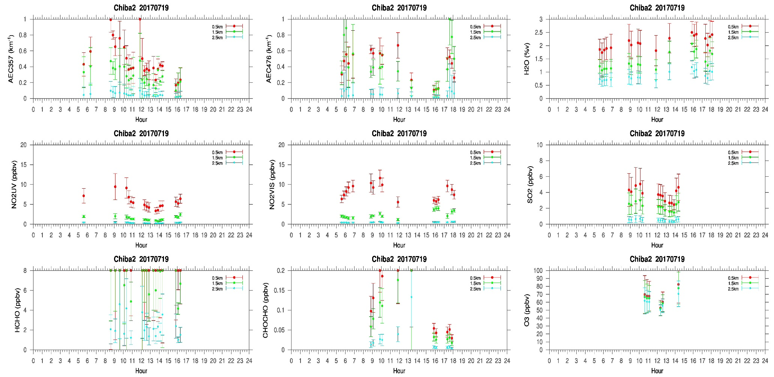
MAX-DOAS#2, West Direction

Slide 4
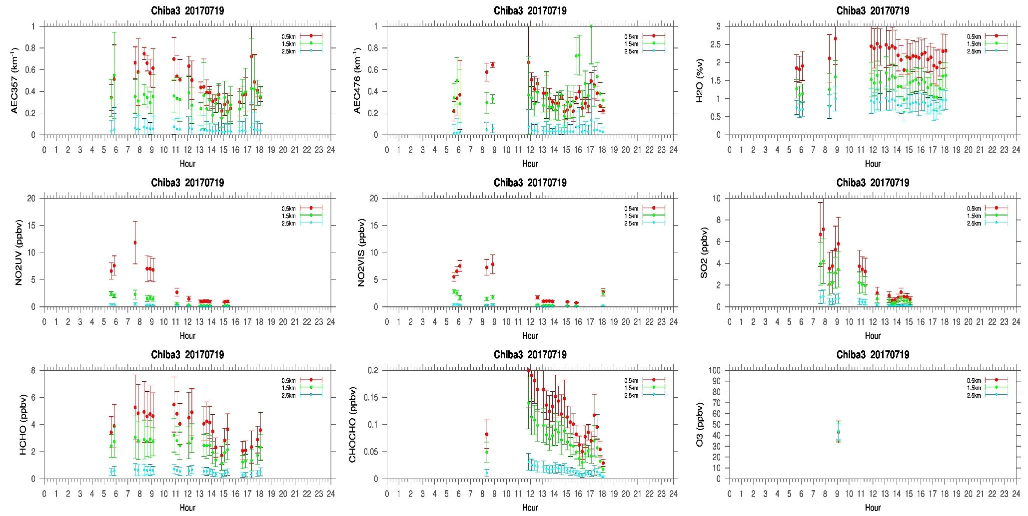
MAX-DOAS#3, East Direction

Slide 5
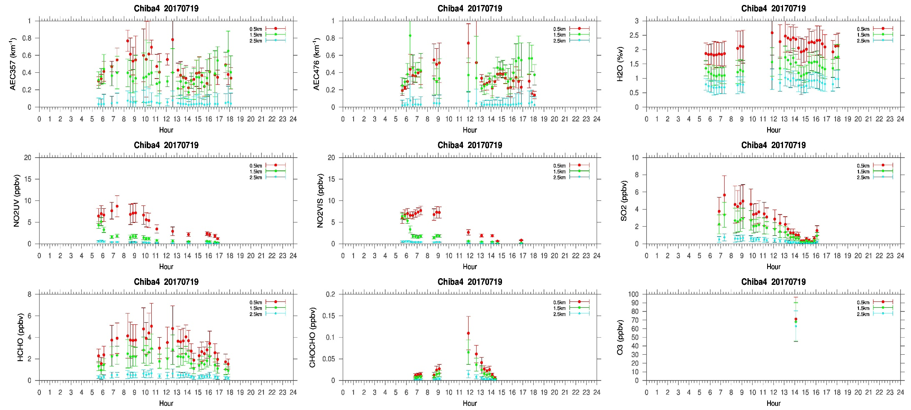
MAX-DOAS#4, South Direction

Slide 6
Comments after a quick look of the plots
A very cloudy day on the ninth day of the campaign. Clouds were detected between 1 to 3 km. Both the Aerosol and trace gas distribution did not show the similar distribution pattern in the four directions. NO2 and SO2 concentrations were higher compared to the 18th July measurements. SO2 in the east (#3) and south (#4) direction shows lower concentration at the end of the day whereas towards the north (#1) and west (#2) direction it seems to increase in the late afternoon. The morning time SO2 concentration in the four direction were almost similar (>~4ppbv). Yumimoto san’s assimilation predicted that, the PM2.5 on 19th will be higher compared to 18th July. Therefore, higher SO2 concentration could be related to some other processes addition to local emissions.

