Slide 1
MAX-DOAS 2d plots for Chiba Campaign 2017 Observation day 7: 07/17/2017 Hoque

Slide 2
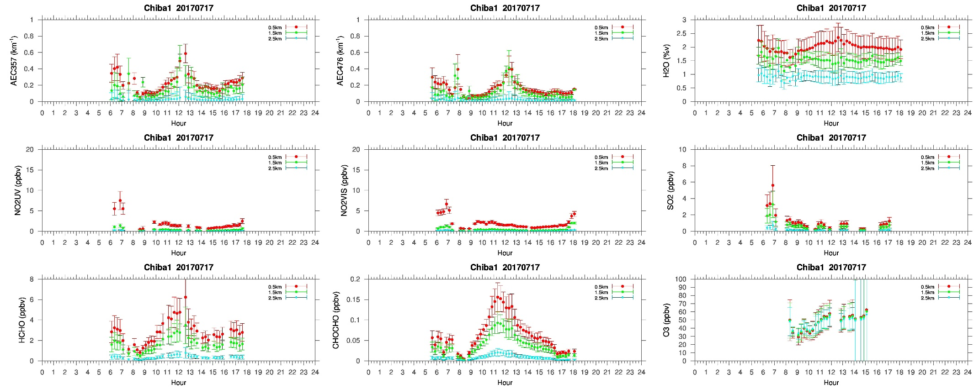
MAX-DOAS#1, North Direction

Slide 3
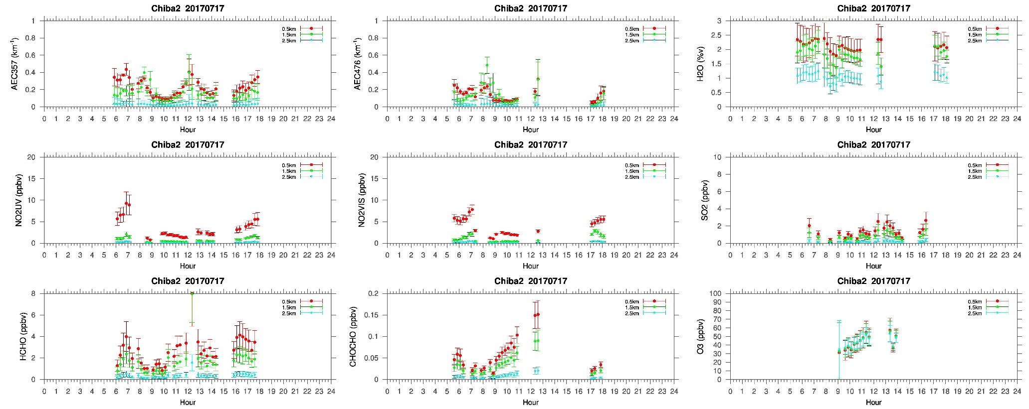
MAX-DOAS#2, West Direction

Slide 4
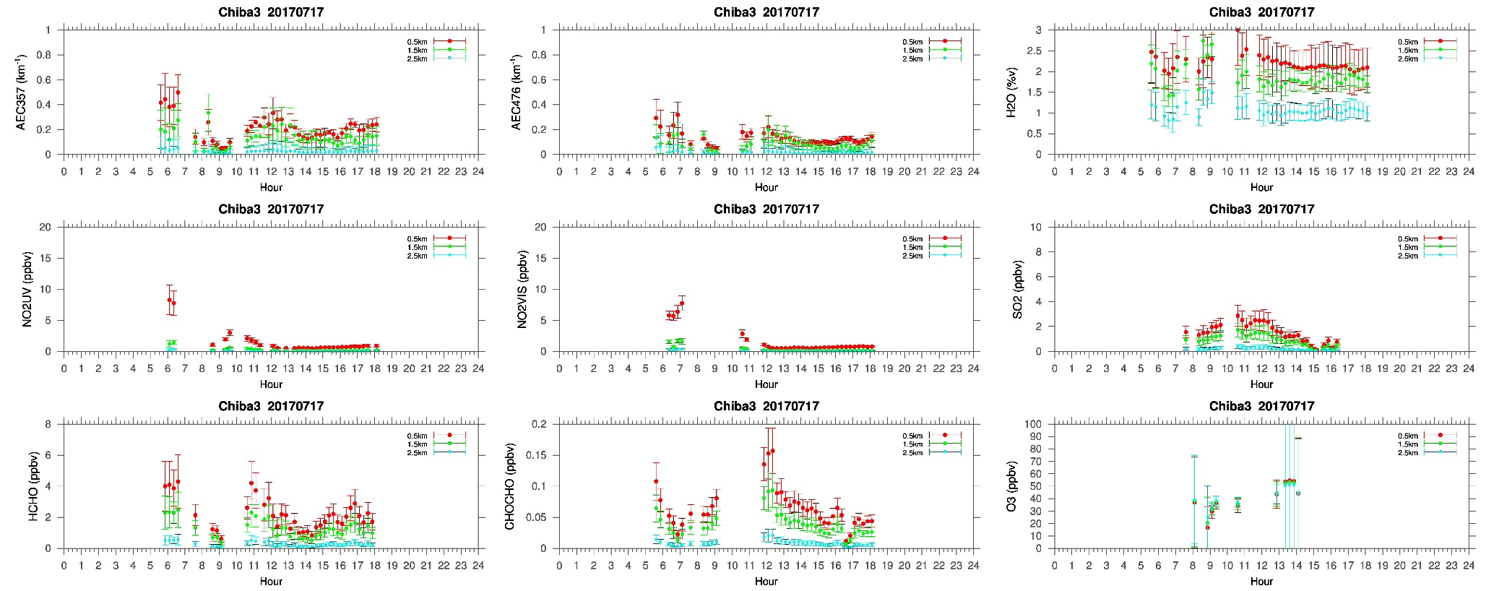
MAX-DOAS#3, East Direction

Slide 5
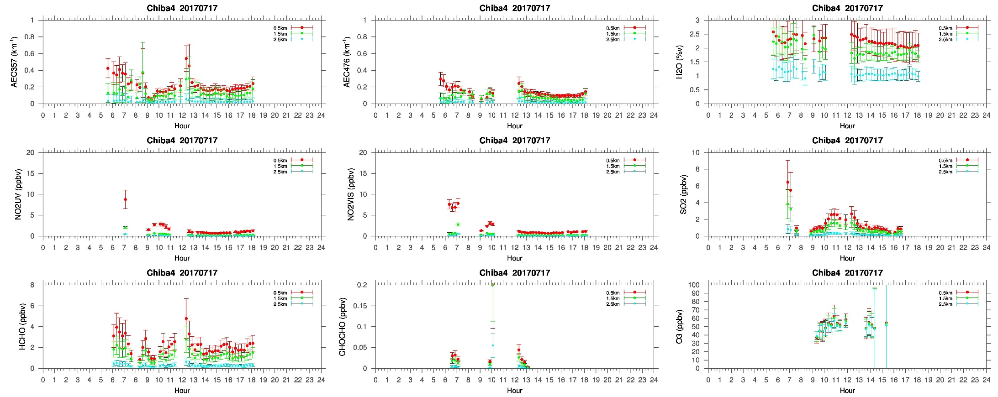
MAX-DOAS#4, South Direction

Slide 6
Comments after a quick look of the plots
Clouds were observed all day long on the 7th day of the campaign (07/17/2017). As there were no LIDAR observations, the height of the clouds are unknown. But looking at the AEC distribution from our 4 AZ MAX-DOAS system and from the initial understanding from our preliminary results of the previous days of the campaign, it seems that clouds were above 3 km , as we see a uniform distribution in all the four directions. NO2 and SO2 also show such uniform behavior in all the direction. The concentration of both the trace gases were much lower (NO2: <4ppbv , SO2: ~2ppbv) compared to the concentration on the last two days (07/15, 07/16) where in some cases SO2 reached up to 10 ppbv. Moreover, the last two days were weekends. So , it seems that, within the horizontal resolution ( ~10km) of our MAX-DOAS instrument there might me some enhanced anthropogenic activities which might lead to such higher concentration of SO2 and NO2. Additionally, there is also a probability of long range transport of SO2. Additional trajectory analysis can give us a better insight.

