Slide 1
MAX-DOAS 2d plots for Chiba Campaign 2017 Observation day 5: 07/15/2017 Hoque

Slide 2
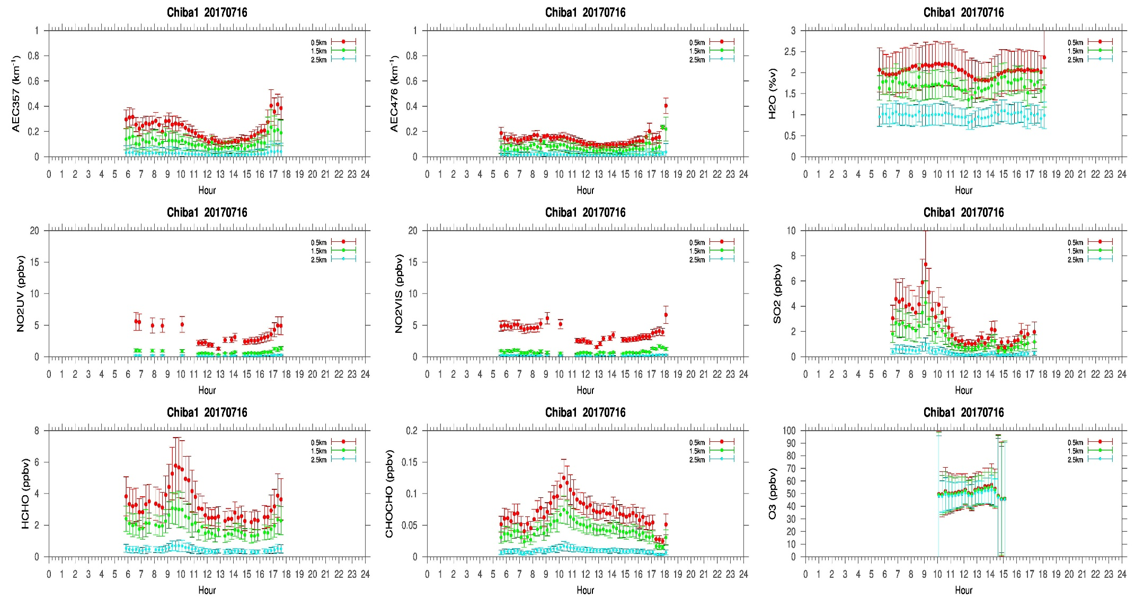
MAX-DOAS#1, North Direction

Slide 3
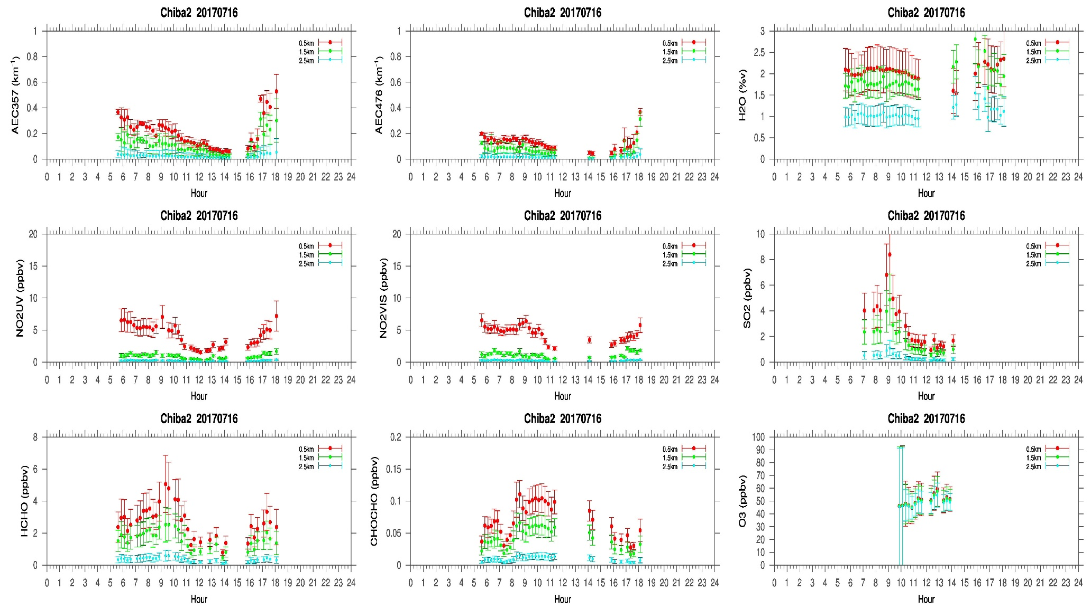
MAX-DOAS#2, West Direction

Slide 4
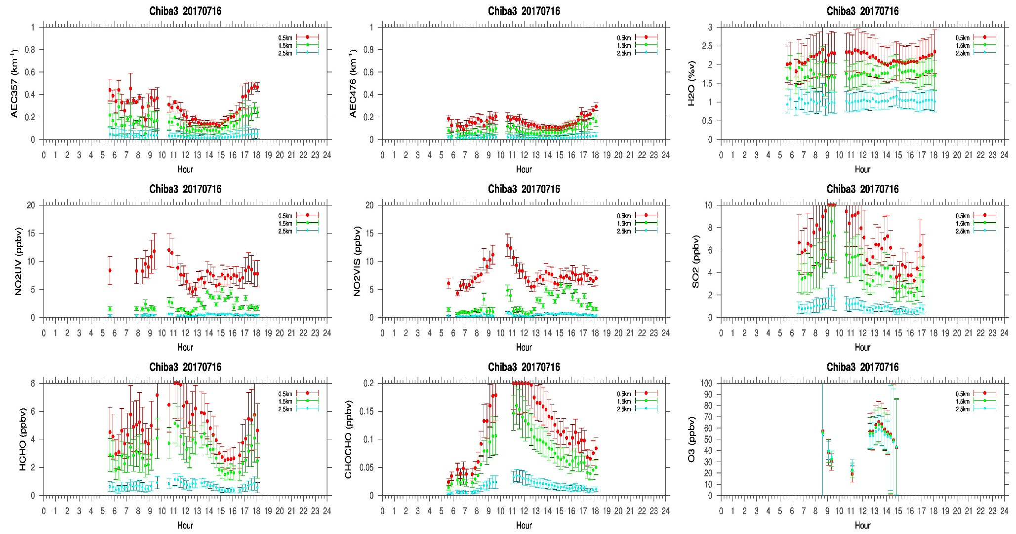
MAX-DOAS#3, East Direction

Slide 5
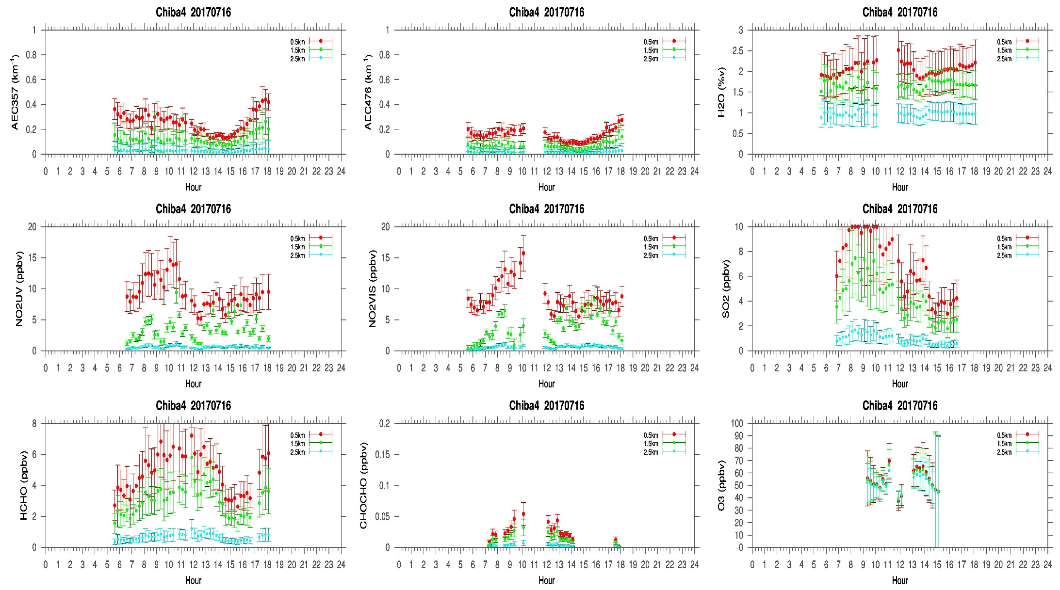
MAX-DOAS#4, South Direction

Slide 6
Comments after a quick look of the plots
The cloud heights (>6km) were similar as the previous day (07/15/2017). Homogeneous AEC distribution is observed from the MAX-DOAS measurements. The trace gas concentrations were lower compared to the concentration measured on 15th July (fifth day of the campaign) except the east (#3) and west (#4) direction. In both the directions NO2 concentration exceeded 5ppbv which was also associated with SO2 concentration reaching up to ~10ppbv. Additionally, HCHO concentration was also higher (>4ppbv) in the respective directions. Therefore, it seems that, MAX-DOAS measurements in the east (#3) and west (#4) is capturing some enhanced anthropogenic activities compared to the other two directions.

