Slide 1
MAX-DOAS 2d plots for Chiba Campaign 2017 Observation day 5: 07/15/2017 Hoque

Slide 2
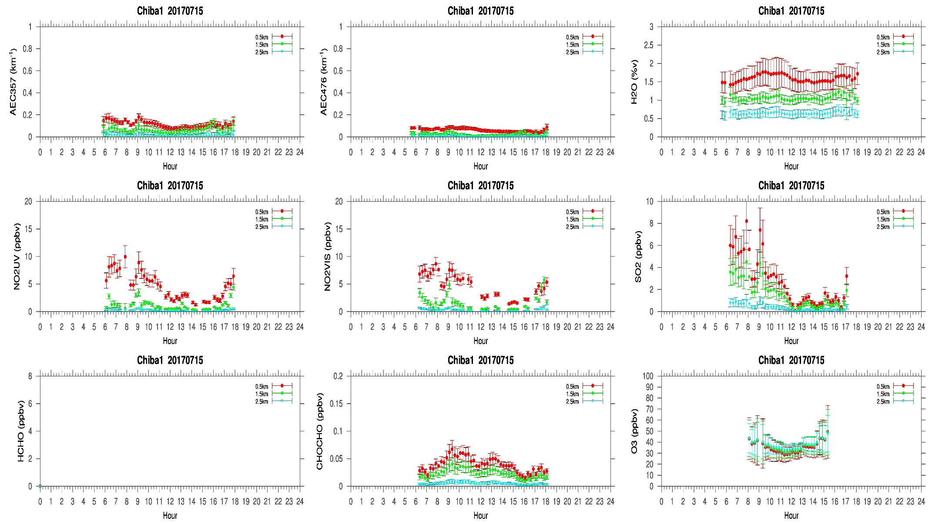
MAX-DOAS#1, North Direction

Slide 3
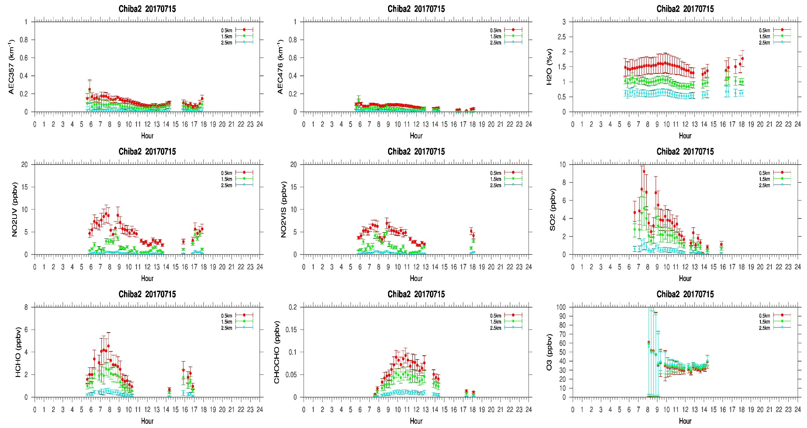
MAX-DOAS#2, West Direction

Slide 4
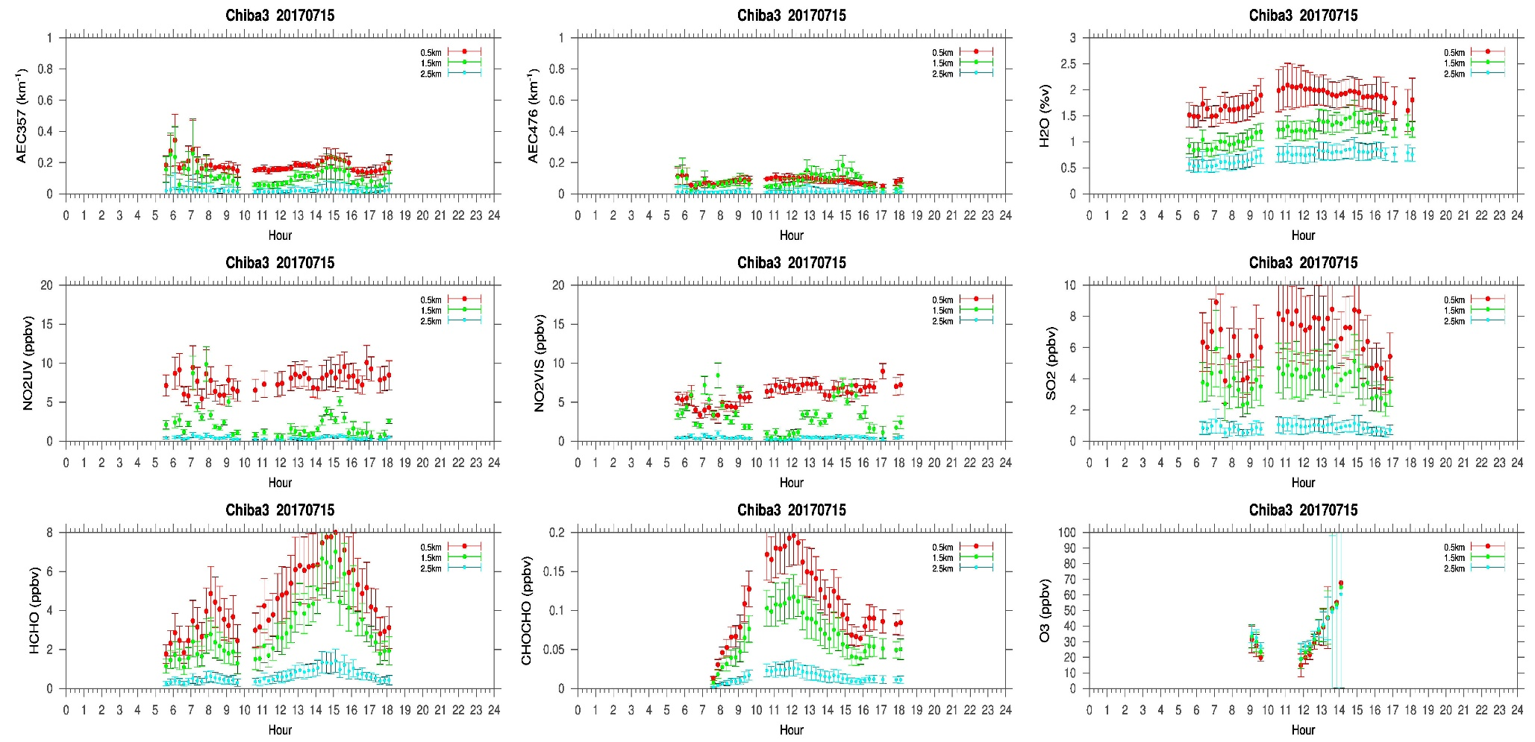
MAX-DOAS#3, East Direction

Slide 5
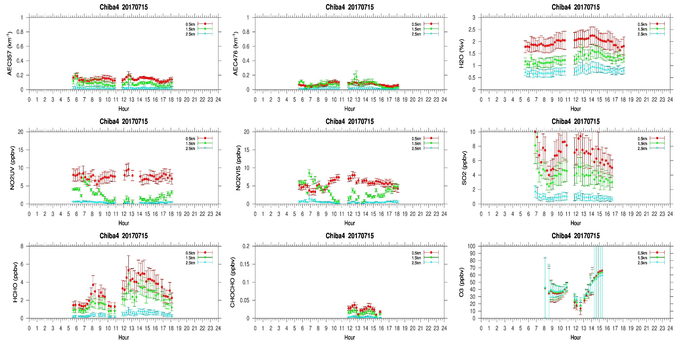
MAX-DOAS#4, South Direction

Slide 6
Comments after a quick look of the plots
Another great day for measurements. Very clear sky with very few thin cirrus clouds above 6km [according to Masuda-san’s (Tohuku University) measurements, LIDAR and sky view camera]. So the aerosol measurements from our 4 AZ MAX-DOAS system were homogenous in all the directions. Interestingly, the trace gas concentrations (NO2(>5ppbv),SO2(>4ppbv, HCHO(>3 ppbv) in all the four directions are higher comparative to the previous day (07/14/2017), although it was Saturday. Besides, the SO2 concentration reached up to 10ppbv in the east (#3) and south (#4) direction, whereas concentration in the north (#1) and west (#1) direction were >4ppbv.The reason is not clear whether it is due to enhanced local emissions or anthropogenic activities or long range transport. From the two very clear sky day measurements it seems that, the aerosol distribution around Chiba is almost homogenous. Although Damiani san’s comparison shows that, the correlation between MAX-DOAS and Himawari 8 AOD varies in different directions. But more observations and further analysis are required to reach a comprehensive conclusion.

