Slide 1
MAX-DOAS 2d plots for Chiba Campaign 2017
Observation day 4: 07/14/2017
Hoque

Slide 2
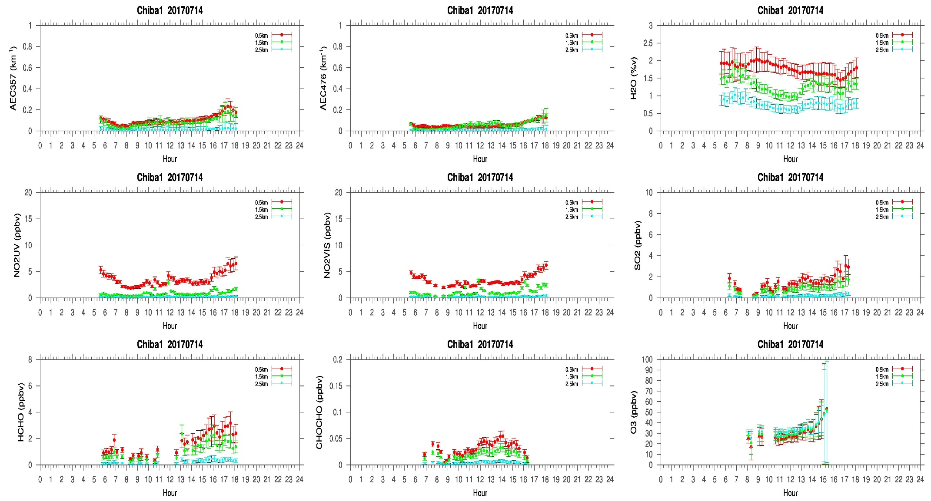
MAX-DOAS#1, North Direction

Slide 3
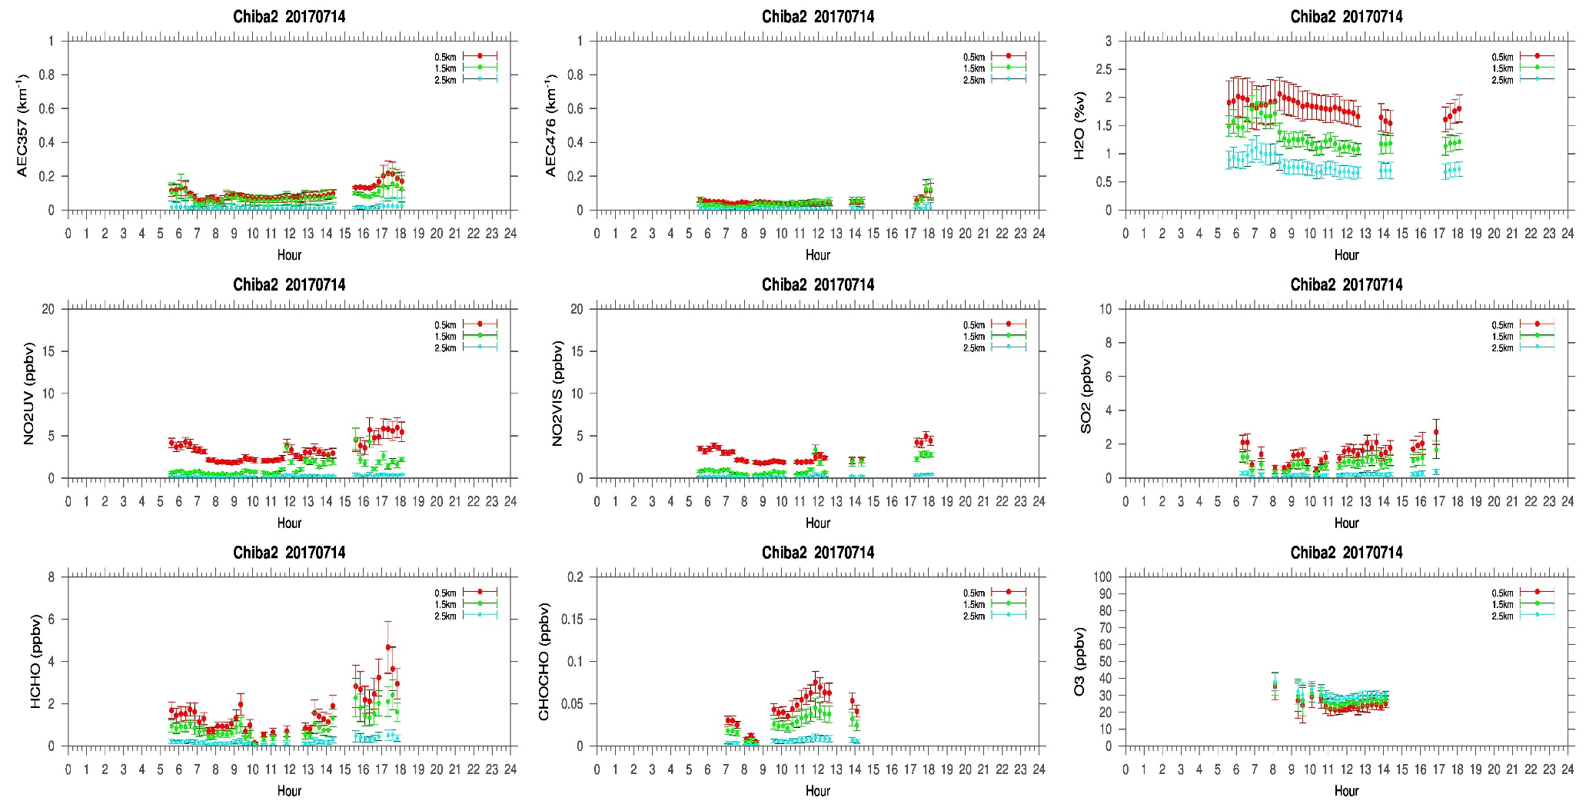
MAX-DOAS#2, West Direction

Slide 4
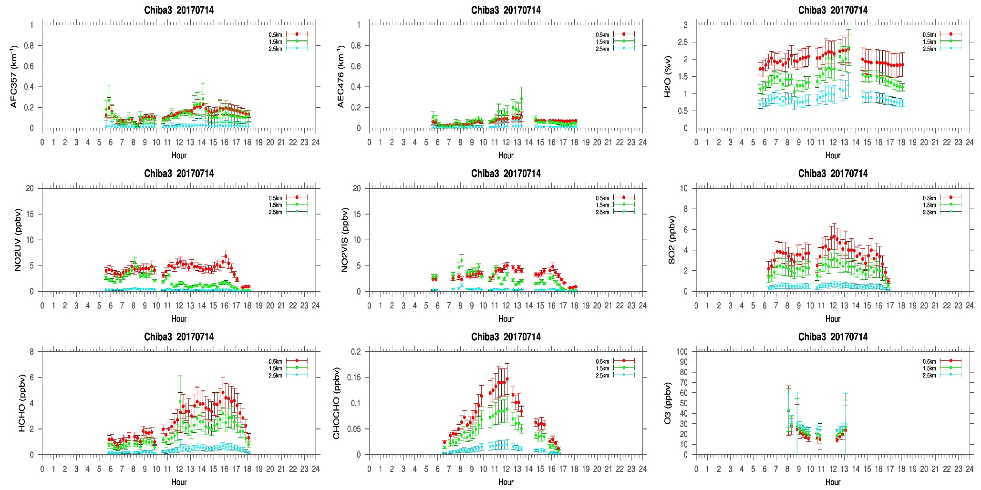
MAX-DOAS#3, East Direction

Slide 5
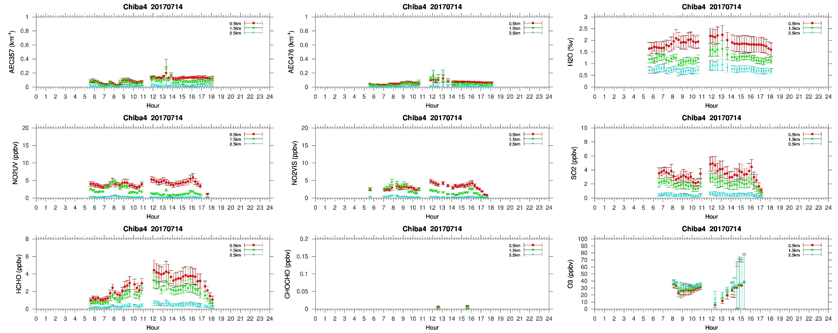
MAX-DOAS#4, South Direction

Slide 6
Comments after a quick look of the plots
A fantastic day for measurement, I would say. No clouds were observed during the whole day. And for the first time during the campaign, our 4-AZ MAX-DOAS system shows similar temporal variation in the AECs in all the directions. NO₂ concentration in the North (#1) and West (#2) shows similar diurnal pattern. The NO₂ diurnal pattern in the East (#3) and South (#4) direction is a bit different compared to the other two directions. We also see higher SO₂ and HCHO concentration in the East and South direction compared to the north and west direction. So, MAX-DOAS measurements in the east and south could be capturing some local emissions in their respective directions.

