Slide 1
MAX-DOAS 2d plots for Chiba Campaign 2017
Observation day 3: 07/13/2017
Hoque

Slide 2
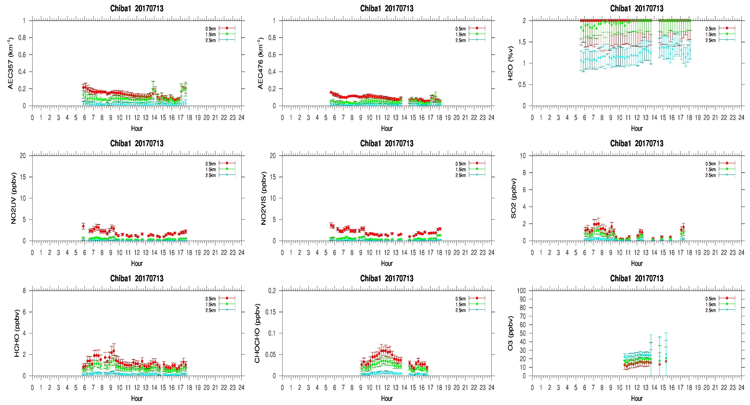
MAX-DOAS#1, North Direction

Slide 3
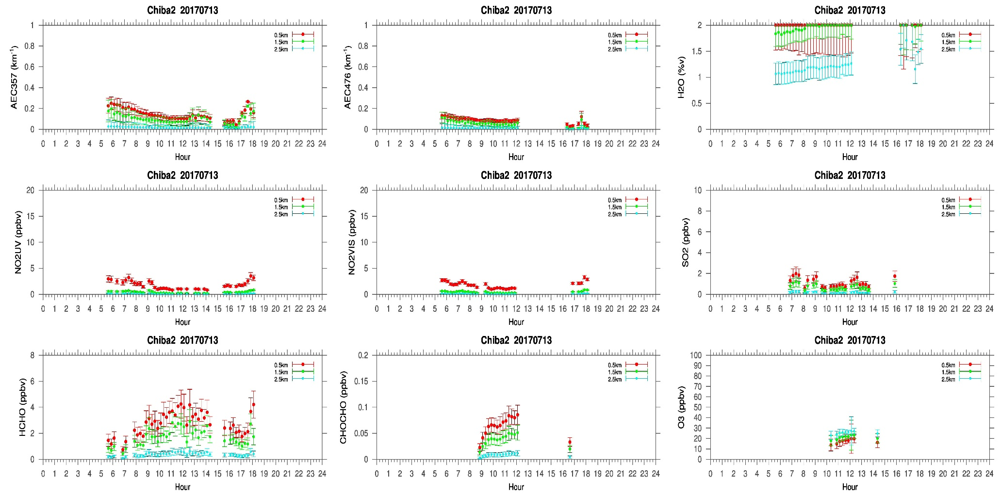
MAX-DOAS#2, West Direction

Slide 4
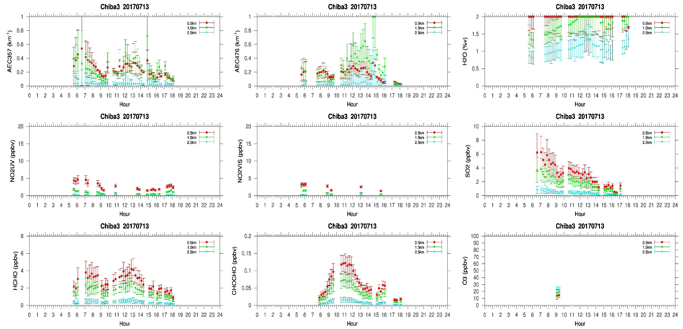
MAX-DOAS#3, East Direction

Slide 5
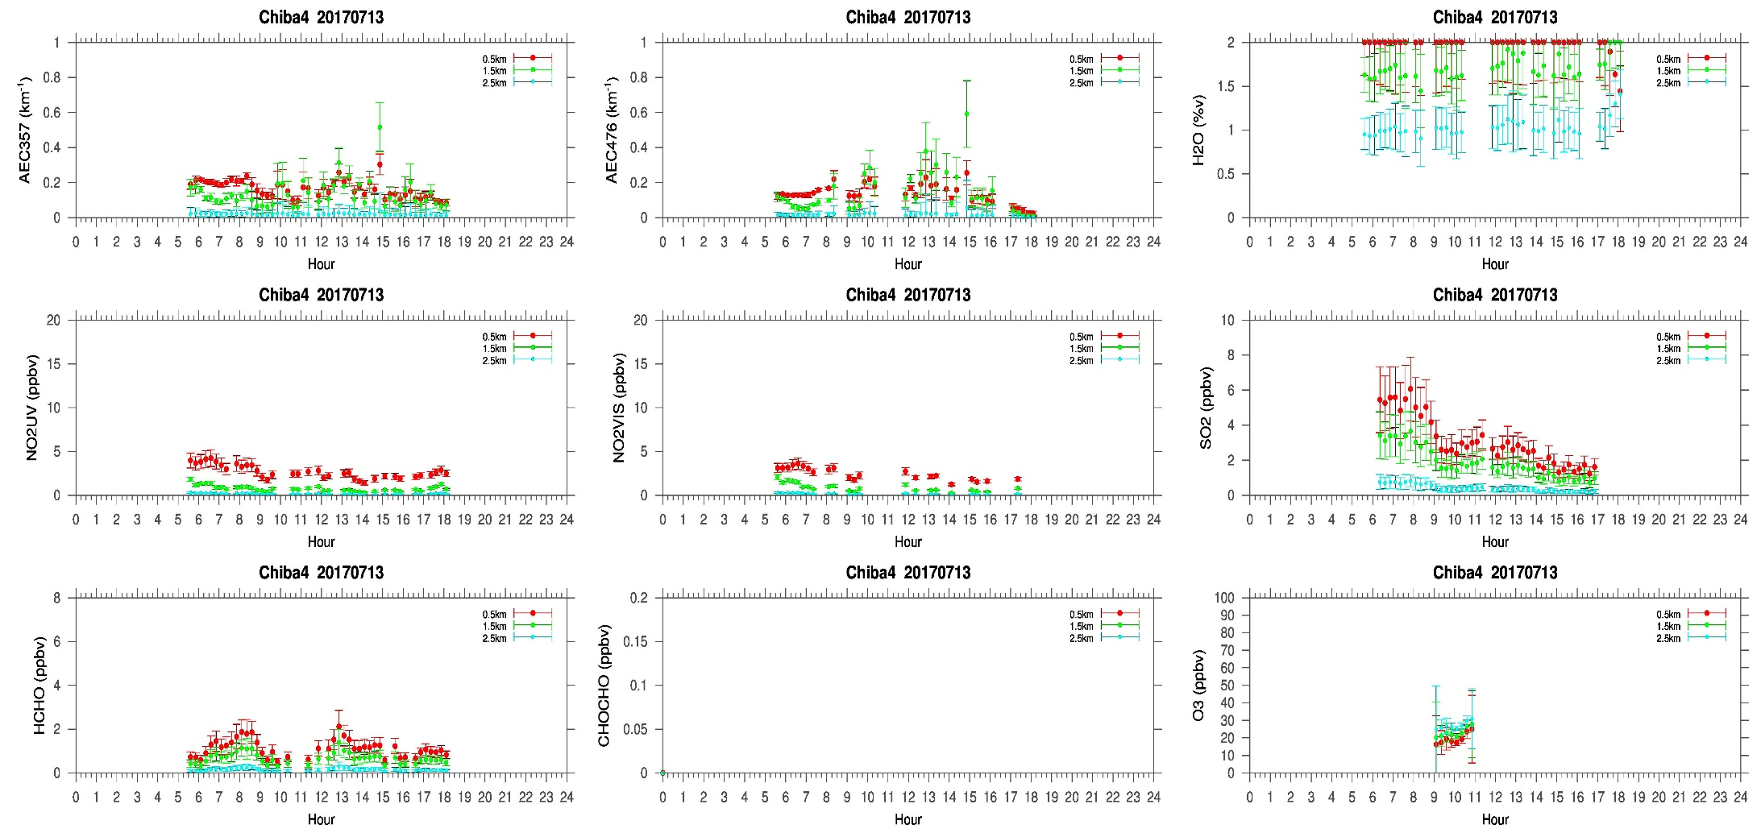
MAX-DOAS#4, South Direction

Slide 6
Comments after a quick look of the plots
Another vey clear sky day during the campaign. According to the LIDAR image no clouds were seen below 3 km. Similar to yesterday, the MAX-DOAS instrument facing east (#3) shows a different temporal variation compared to the other three instruments. According to Damiani san’s initial comparison between MAX-DOAS and Himawari-8 AOD, different correlation were observed in the four directions. The initial guess is that, the instruments are capturing some local features in their respective directions. So, clouds might not be the primary or the only reason for such different temporal distribution observed from the 4AZ MAX-DOAS system.

