Slide 1
MAX-DOAS 2d plots for Chiba Campaign 2017 Observation day 1: 07/11/2017 Hoque

Slide 2
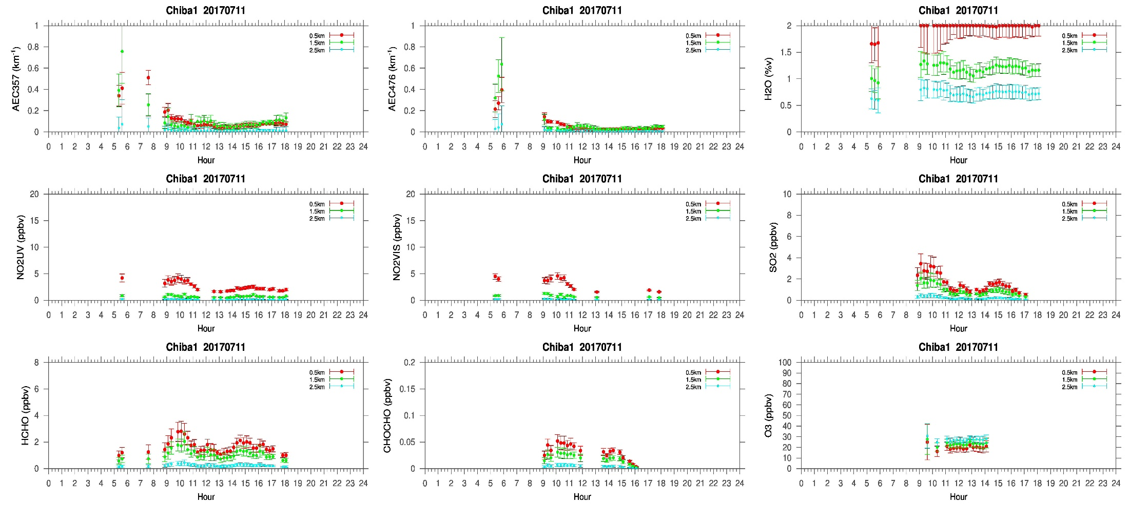
MAX-DOAS#1, North Direction

Slide 3
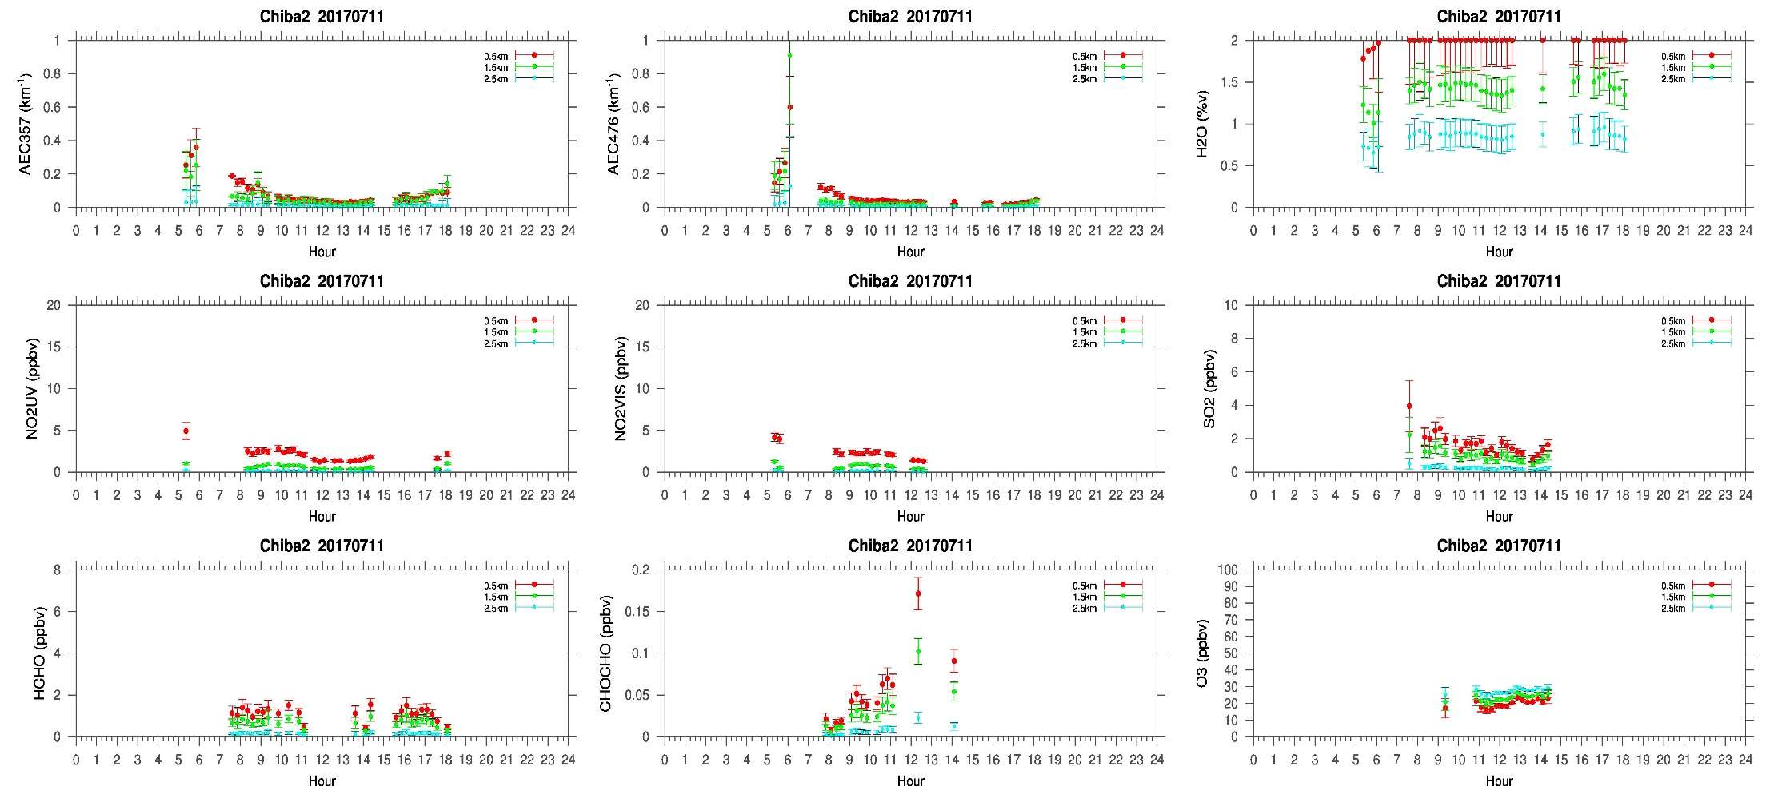
MAX-DOAS#2, West Direction

Slide 4
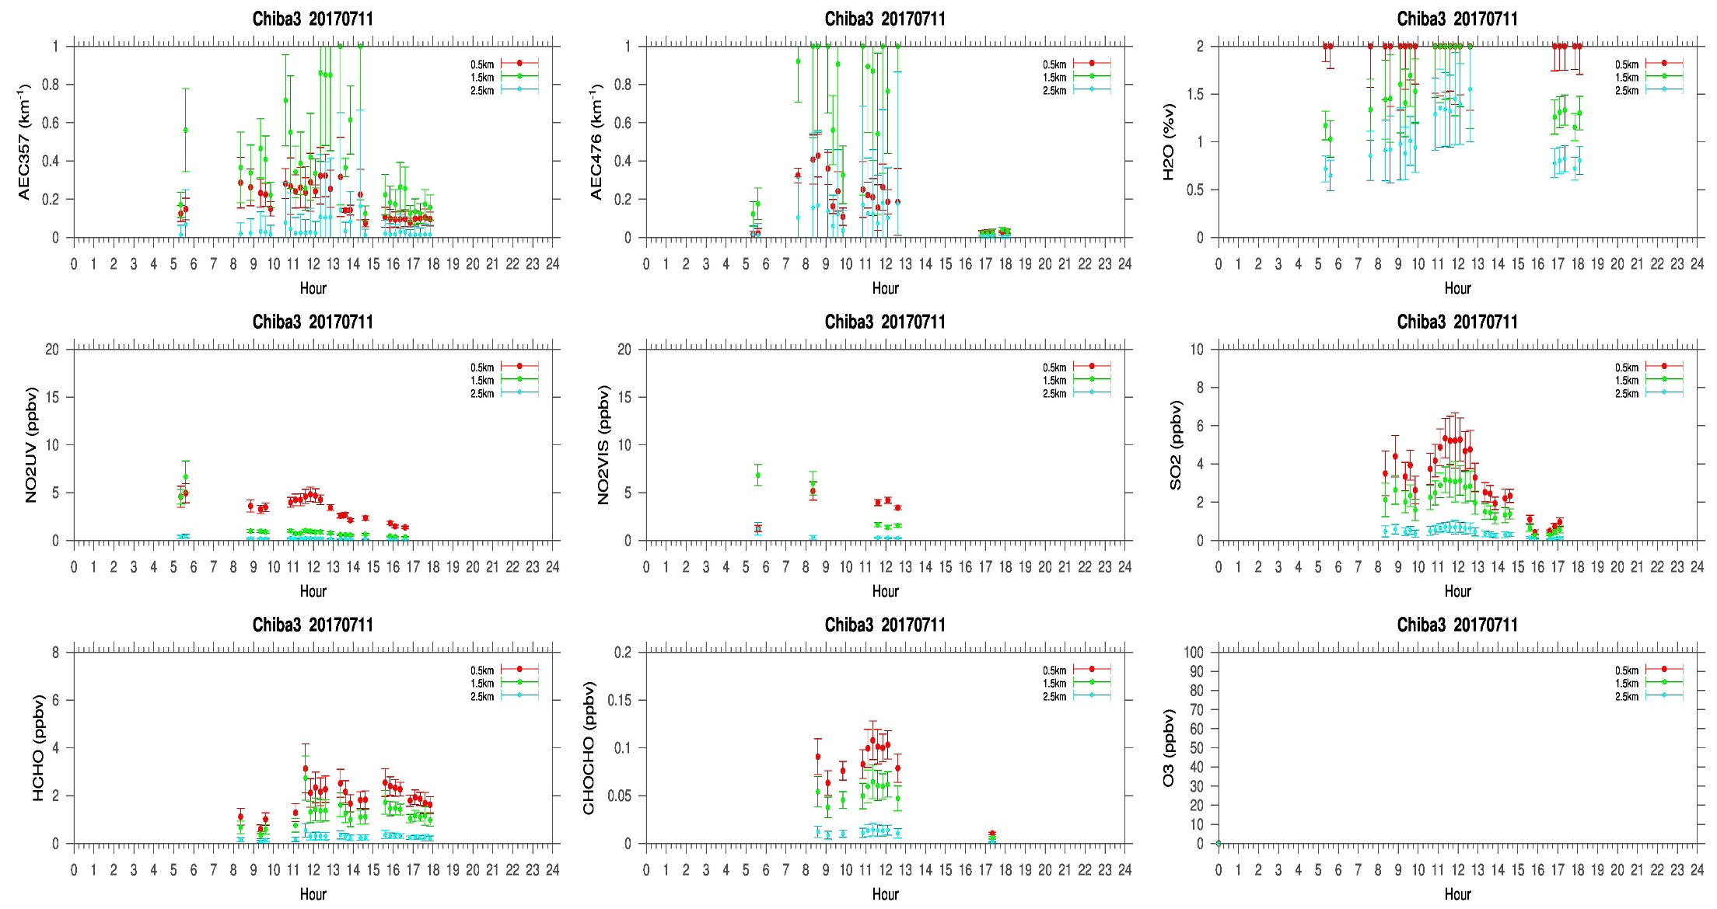
MAX-DOAS#3, East Direction

Slide 5
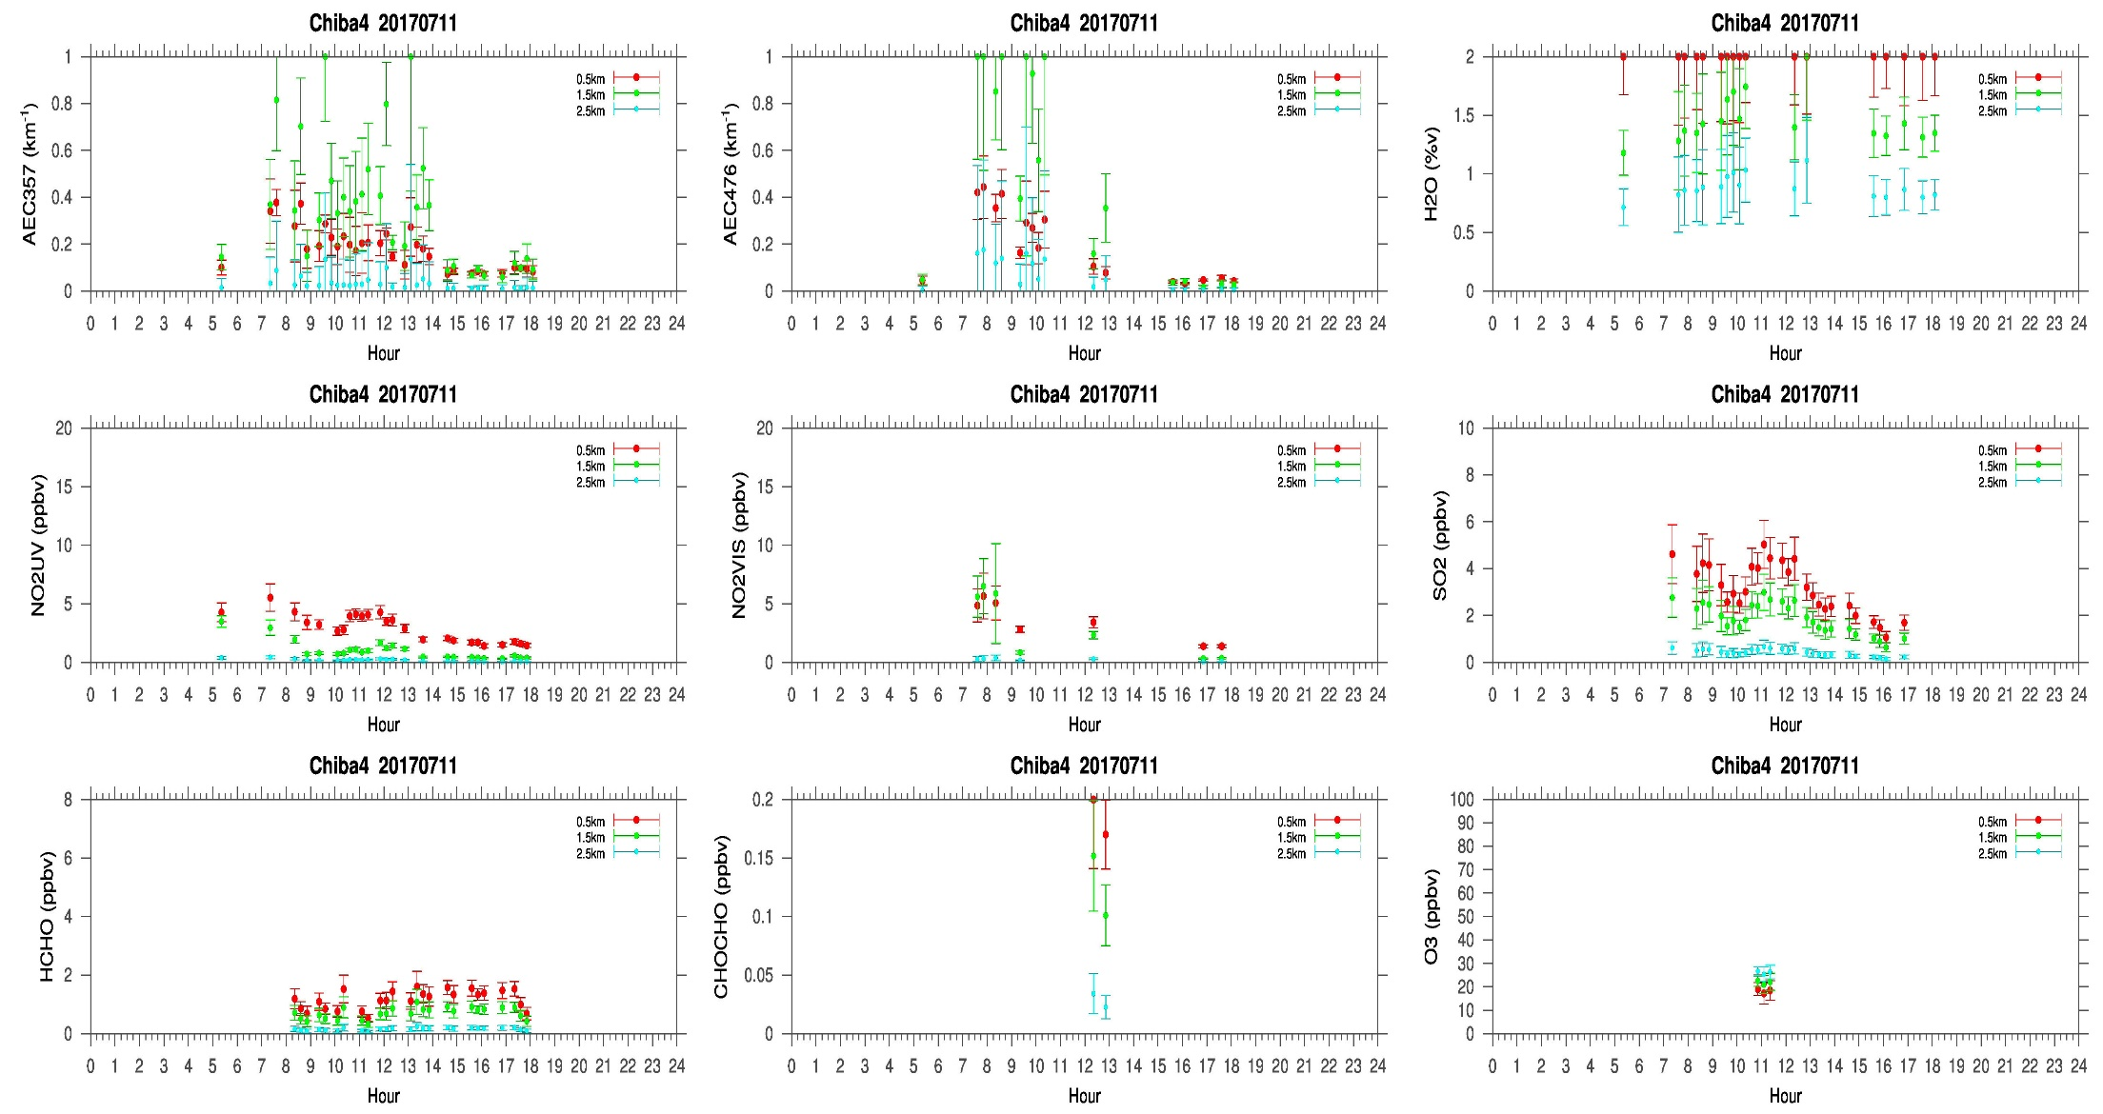
MAX-DOAS#4, South Direction

Slide 6
Comments after a quick look of the plots
A higher difference in the temporal distribution of the retrieved compounds is observed in the East(MAX-DOAS#3) and South (MAX-DOAS#4) direction compared to the other two directions. According to the sky view and LIDAR observations, clouds below 2km were observed almost during the whole observation period. This might be one of the reason of such difference observed in different directions. But a comprehensive conclusion can be drawn after further detailed analysis.

