Slide 1
Chiba Campaign (POM & CIMEL data)
Data observed for 25th November, 2017
Al Mashroor Fatmi

Slide 2
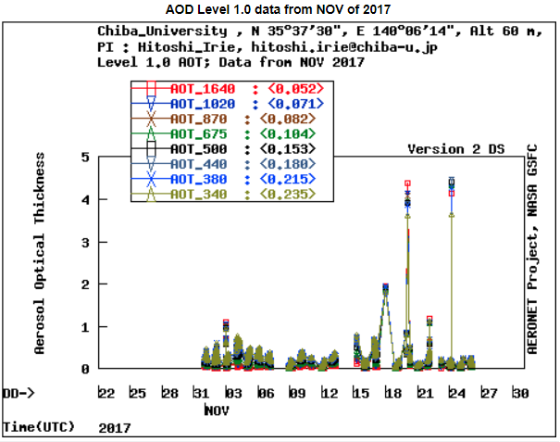
CIMEL data until 25th November, 2017

Slide 3
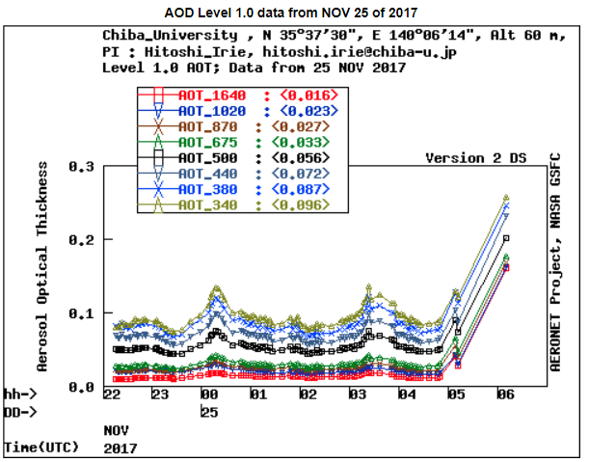
CIMEL data on 25th November, 2017

Slide 4
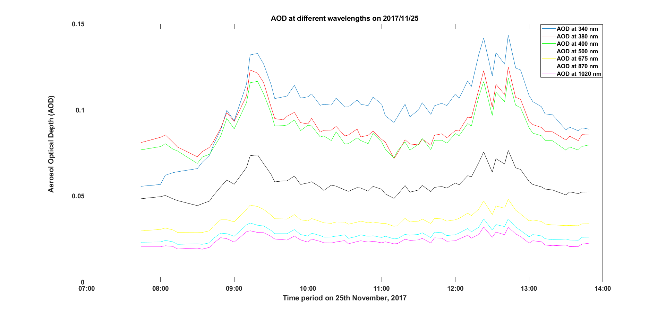
AOD at different wavelengths using Skynet on 25th November, 2017

Slide 5
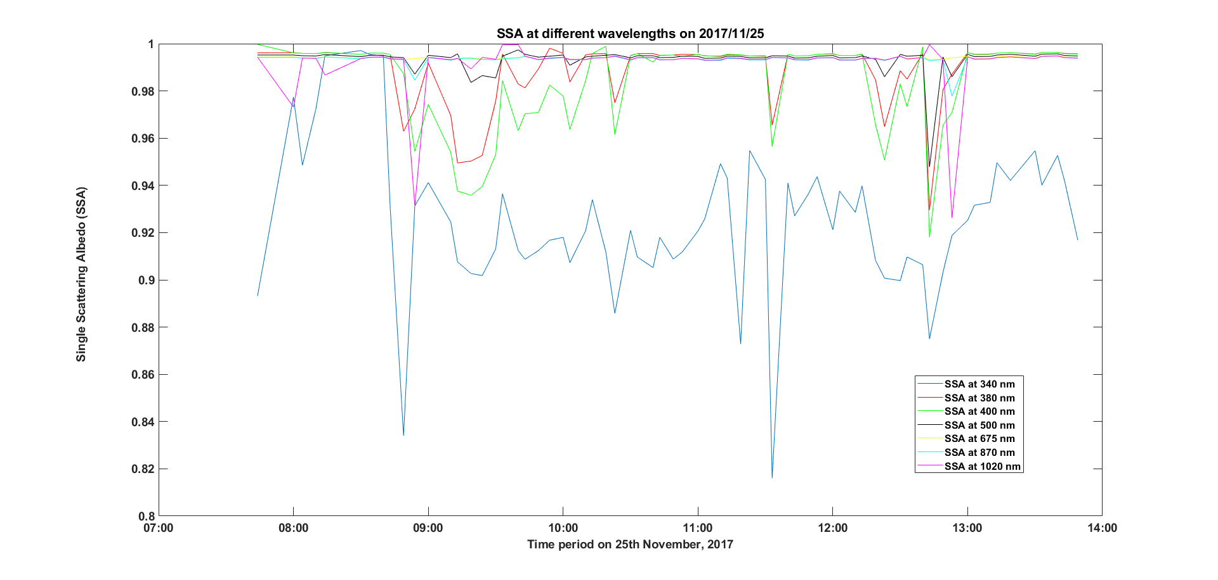
SSA at different wavelengths using Skynet on 25th November, 2017

Slide 6
Observations (考察)
Wavelength dependency against AOD was established, while for SSA, wavelength dependency cannot be assumed

