Slide 1
Chiba Campaign (POM & CIMEL data)
Data observed for 22nd & 24th November, 2017
Al Mashroor Fatmi

Slide 2
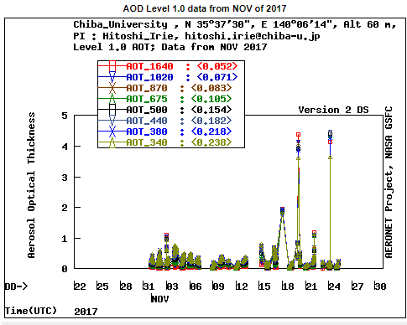
CIMEL data until 24th November, 2017

Slide 3
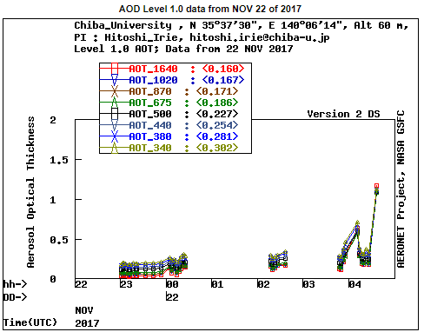
CIMEL data on 22nd November, 2017

Slide 4
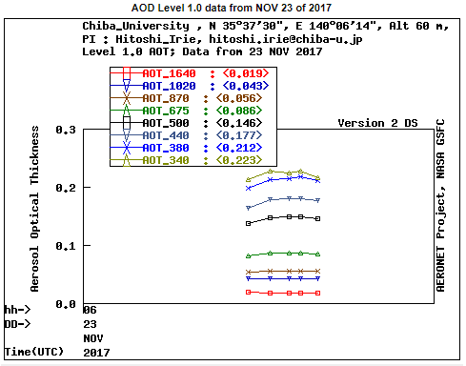
CIMEL data on 23rd November, 2017

Slide 5
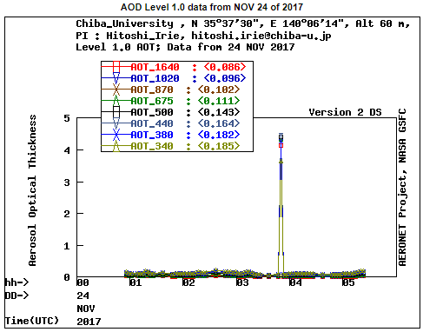
CIMEL data on 24th November, 2017

Slide 6
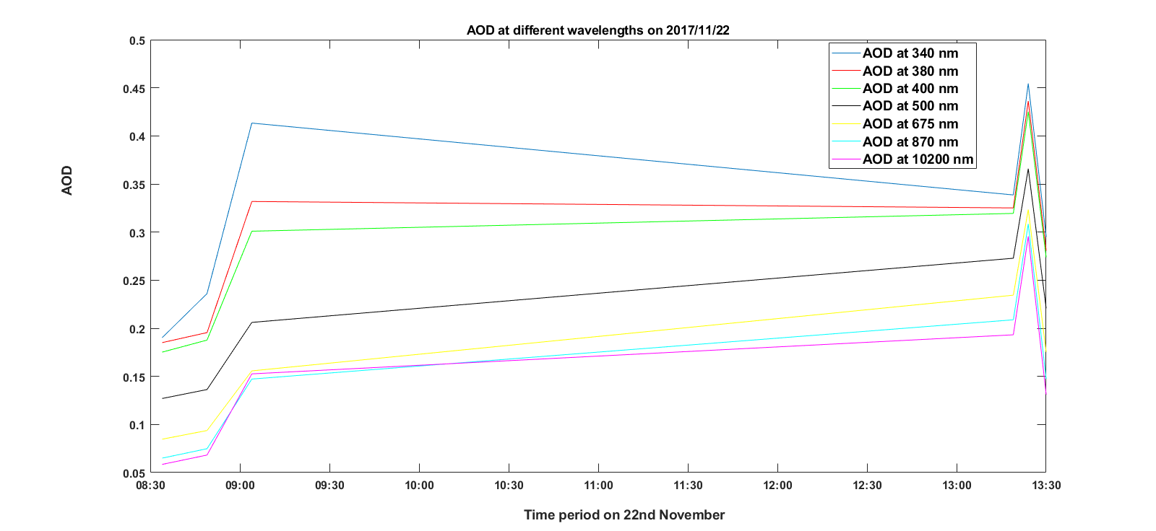
AOD at different wavelengths using Skynet on 22nd November, 2017

Slide 7
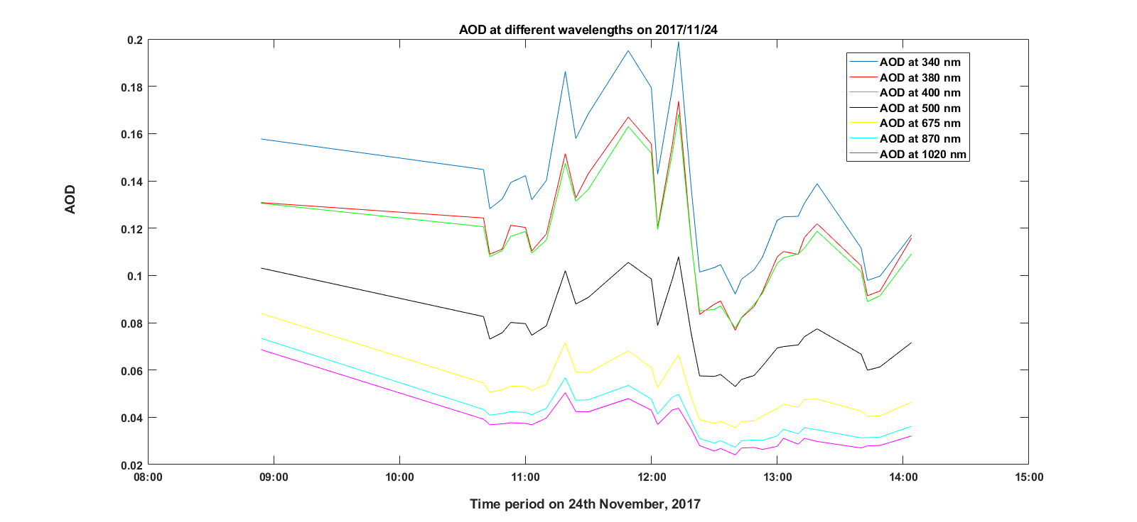
AOD at different wavelengths using Skynet on 24th November, 2017

Slide 8
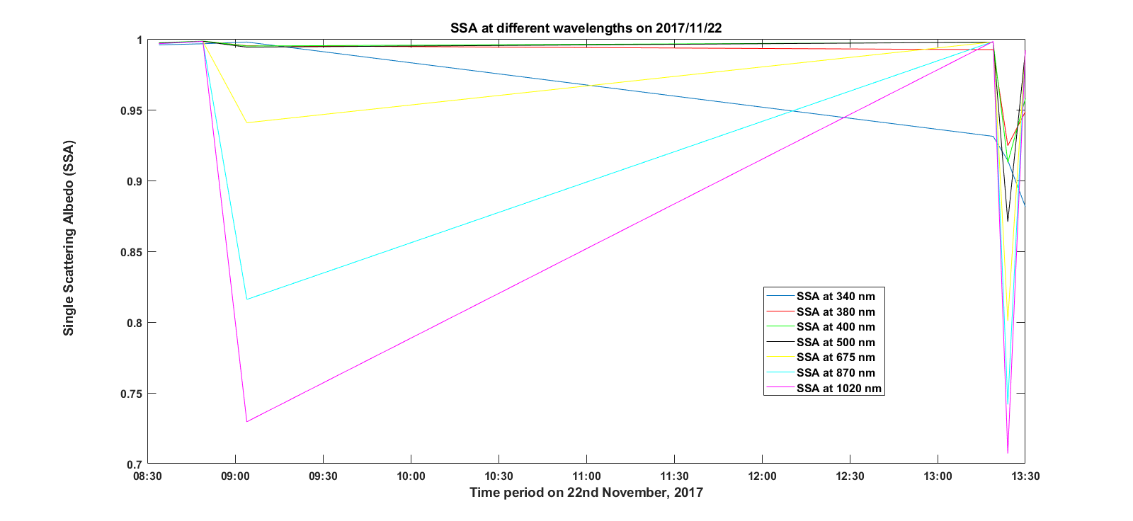
SSA at different wavelengths using Skynet on 22nd November, 2017

Slide 9
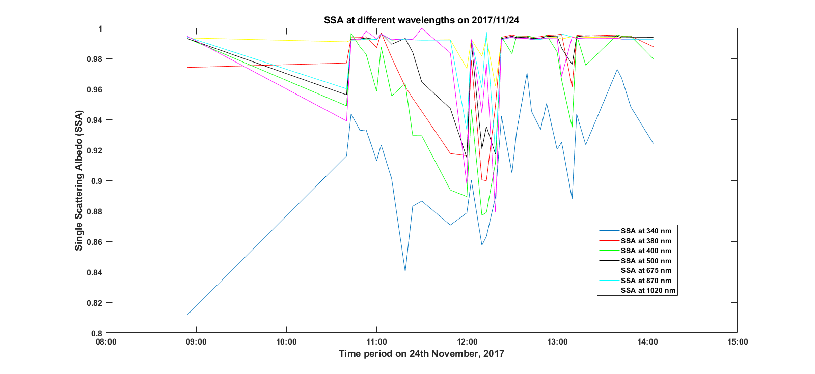
SSA at different wavelengths using Skynet on 24th November, 2017

Slide 10
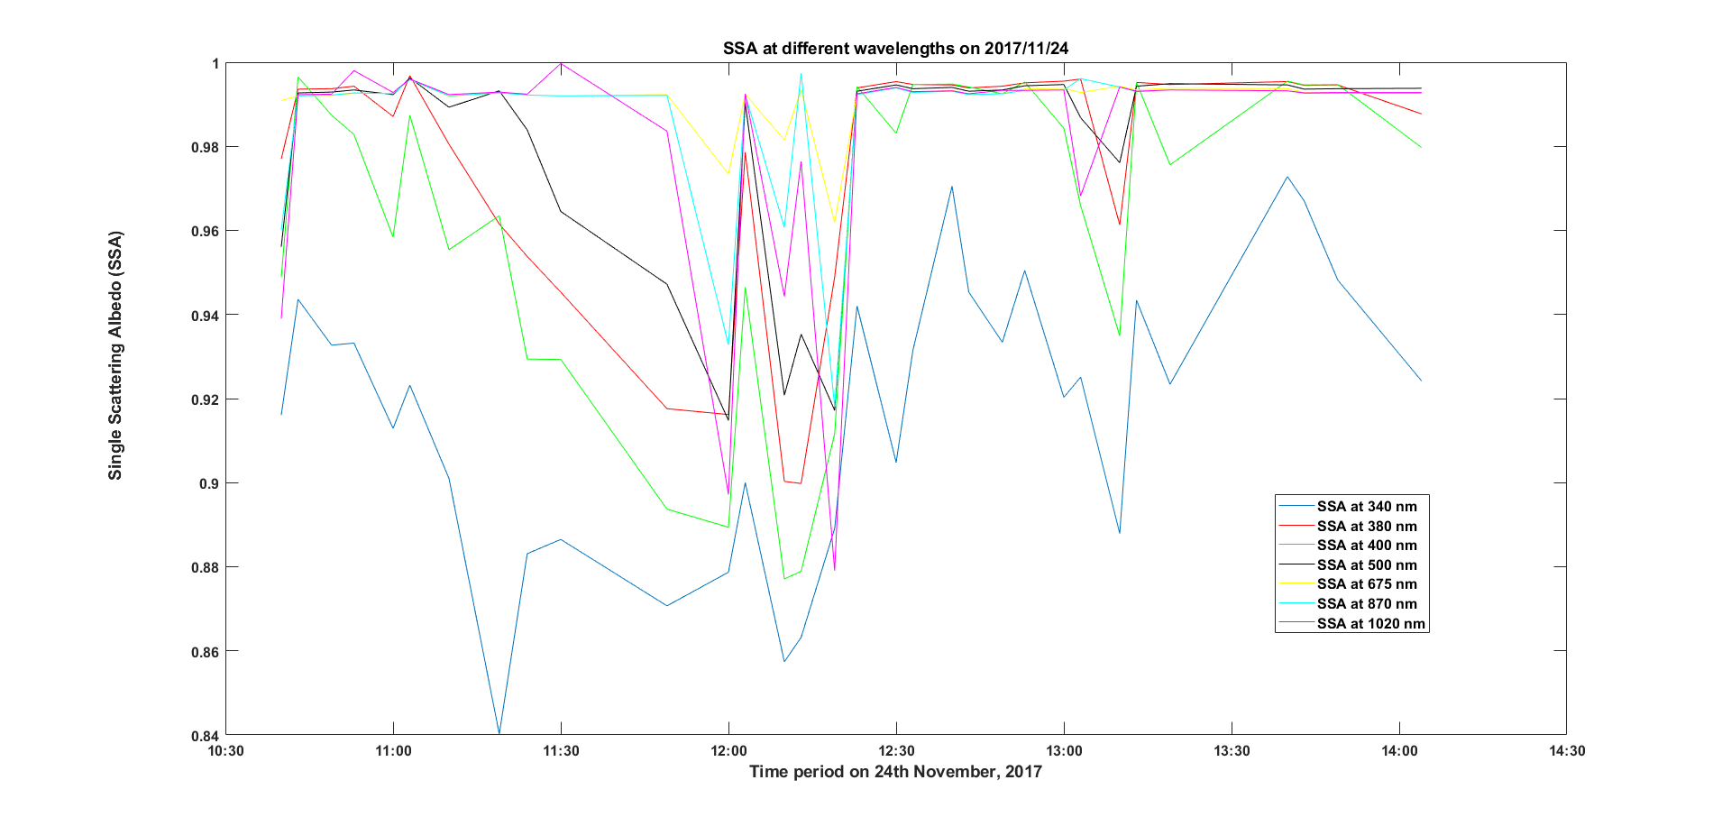
SSA at different wavelengths using Skynet on 24th November, 2017 (from 10 a.m. to 15:00 p.m.)

Slide 11
Observations (考察)
Only 6 sets of data were available on 22nd November
Observation for 23rd was not found on Skynet
Wavelength dependency can be inferred for Aerosol Optical Depth (AOD); however, for Single Scattering Albedo (SSA), wavelength dependency cannot hypothesized

