Slide 1
Chiba Campaign (POM & CIMEL data)
2017/11/21
Al Mashroor Fatmi

Slide 2
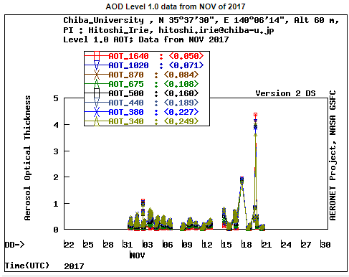
CIMEL data until 21st November, 2017

Slide 3
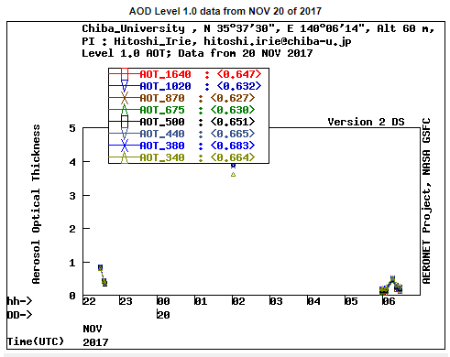
CIMEL data on 21st November, 2017

Slide 4
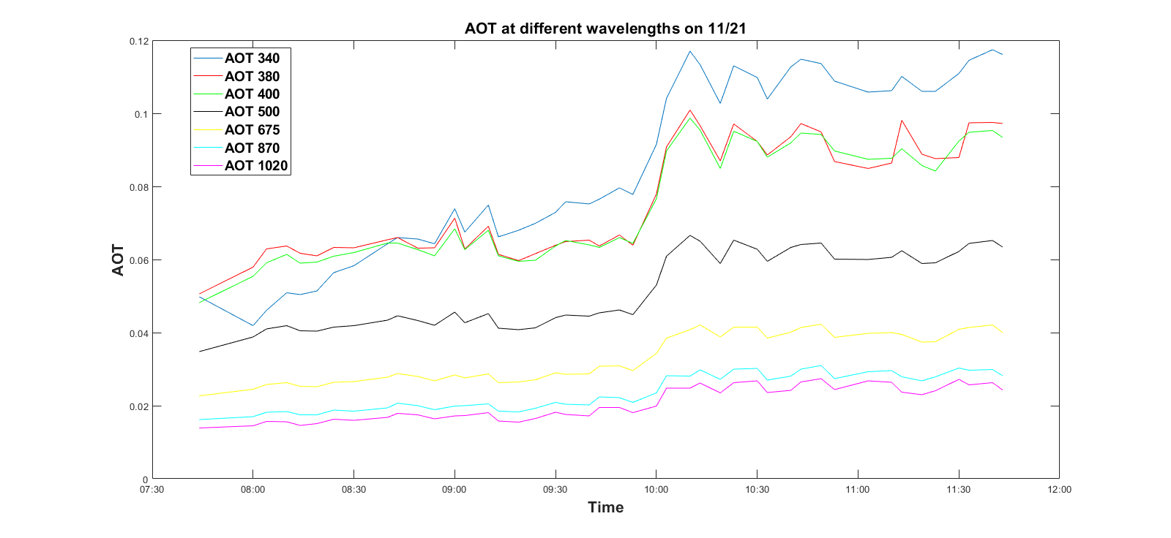
AOD at different wavelengths using Skynet on 21st November, 2017

