Slide 1
Daily Report for Chiba Campaign (7/24)
Al Mashroor Fatmi

Slide 2
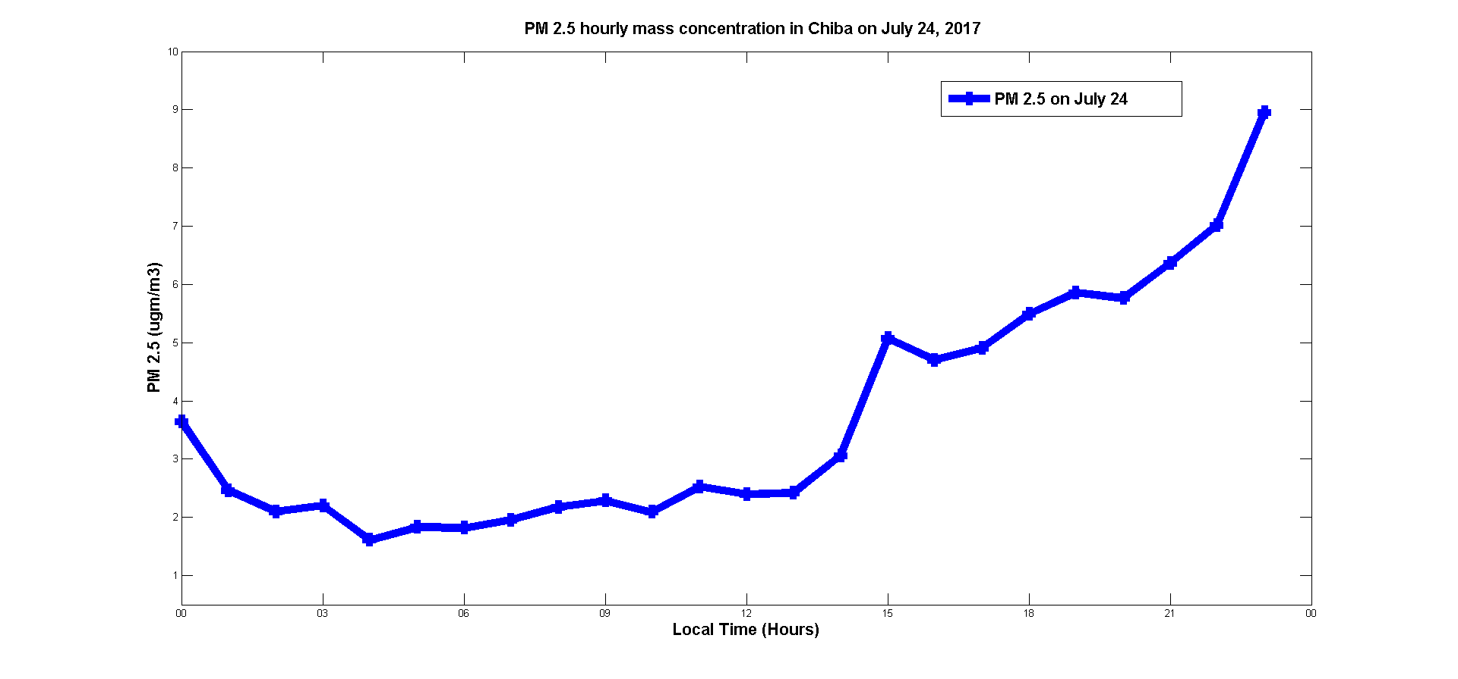
Hourly mean value of PM 2.5 measured on 7/12

Slide 3
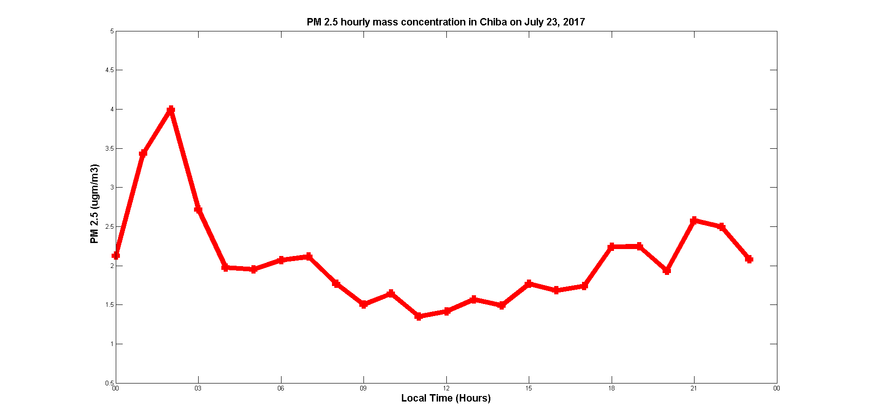
Hourly mean value of PM 2.5 measured on previous day (23rd July)

