Slide 1
Daily Report for Chiba Campaign (7/13)
Al Mashroor Fatmi

Slide 2
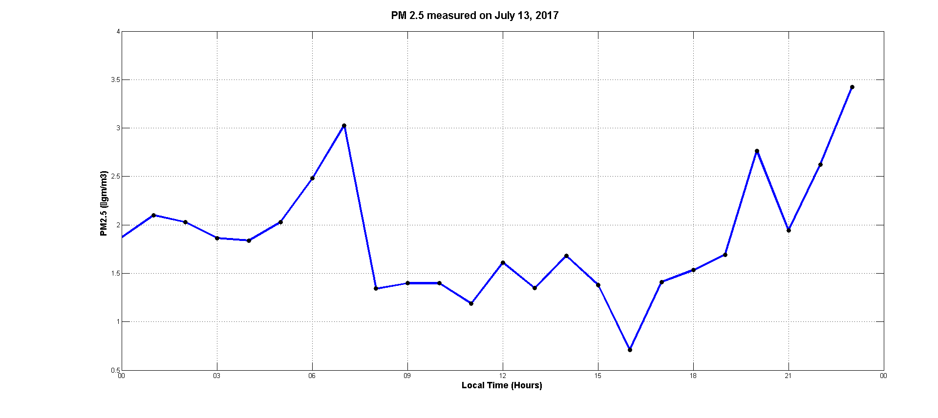
Hourly mean value of PM 2.5 measured on 13th July, 2017

Slide 3
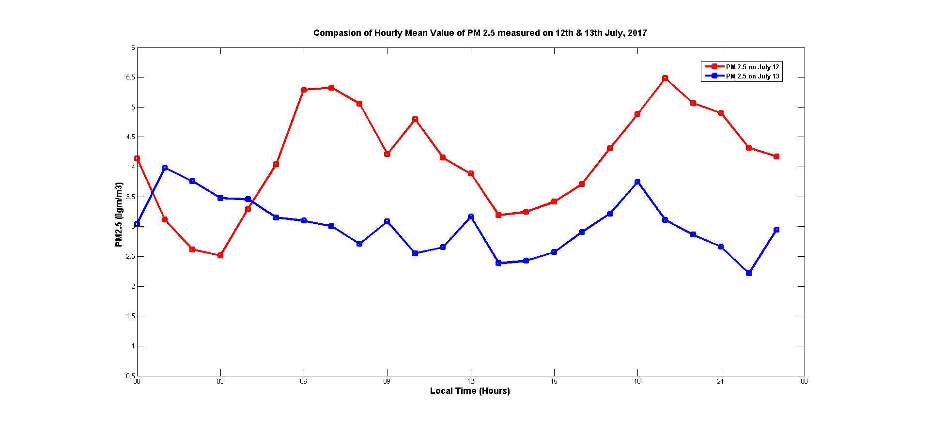
Scattering of PM 2.5 value measured on 12th & 13th July, 2017

